Slide 1
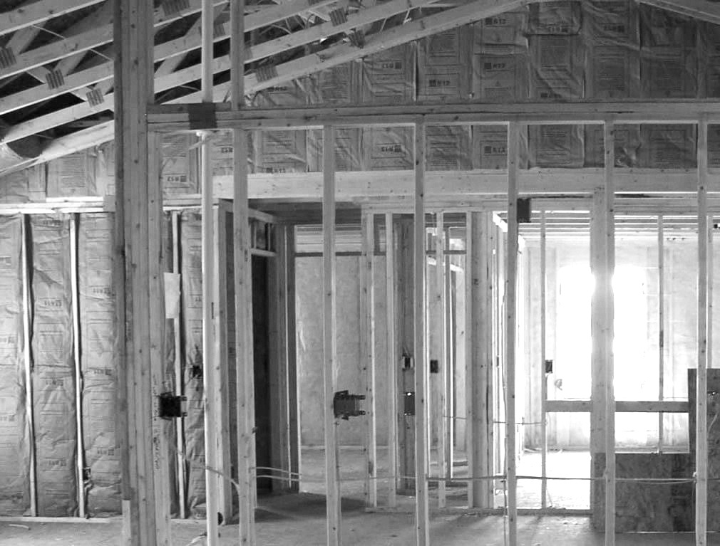
COMPLETING THE BUILDING ENCLOSURE

Slide 2
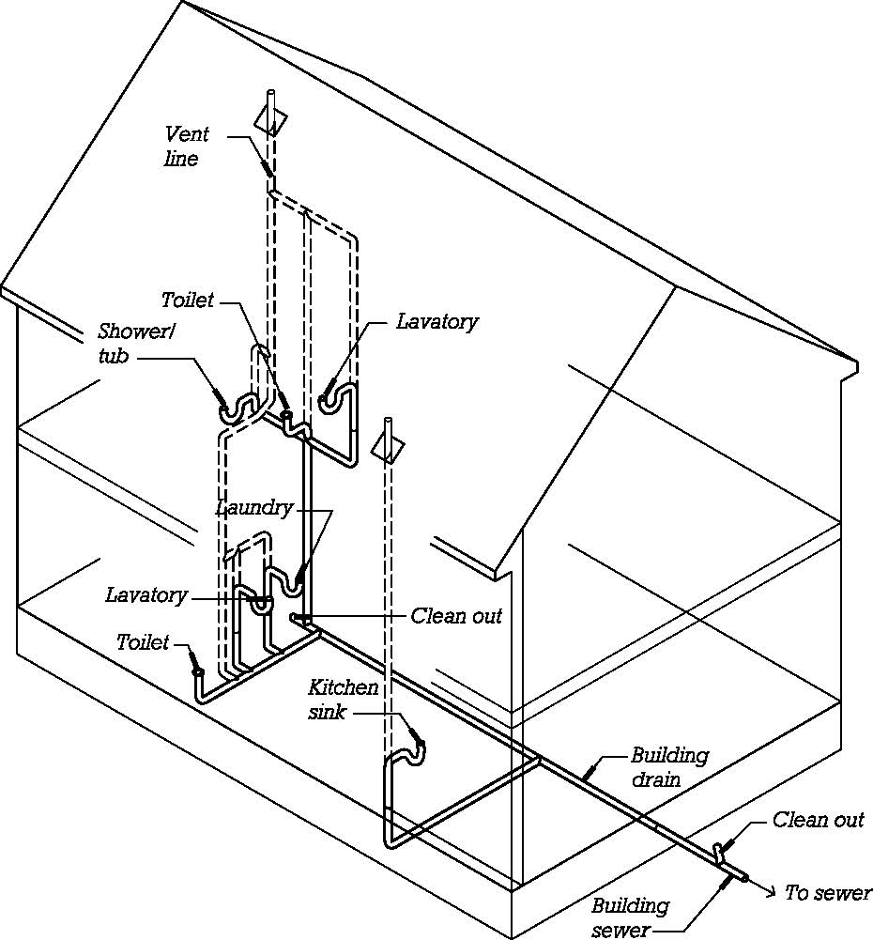
Drain-waste-vent (DWV) piping
Carries sanitary waste to the sewer or septic system.

Slide 3
The vent portions of the system prevent differential air pressures from obstructing flow and allow sewer gasses to escape above the roof.

Slide 4
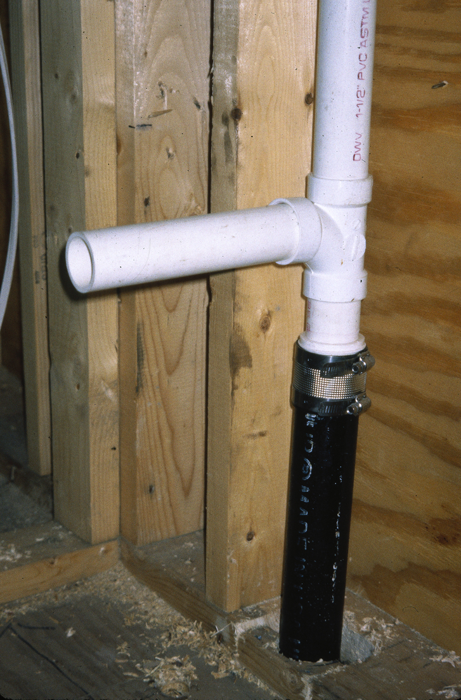
DWV Piping
Cast iron below and PVC above
The horizontal stub will connect to a sink or other fixture.

Slide 5
PVC pipe joints are solvent welded.
The pvc to cast iron connection relies on a neoprene sleeve and stainless steel compression shield.

Slide 6
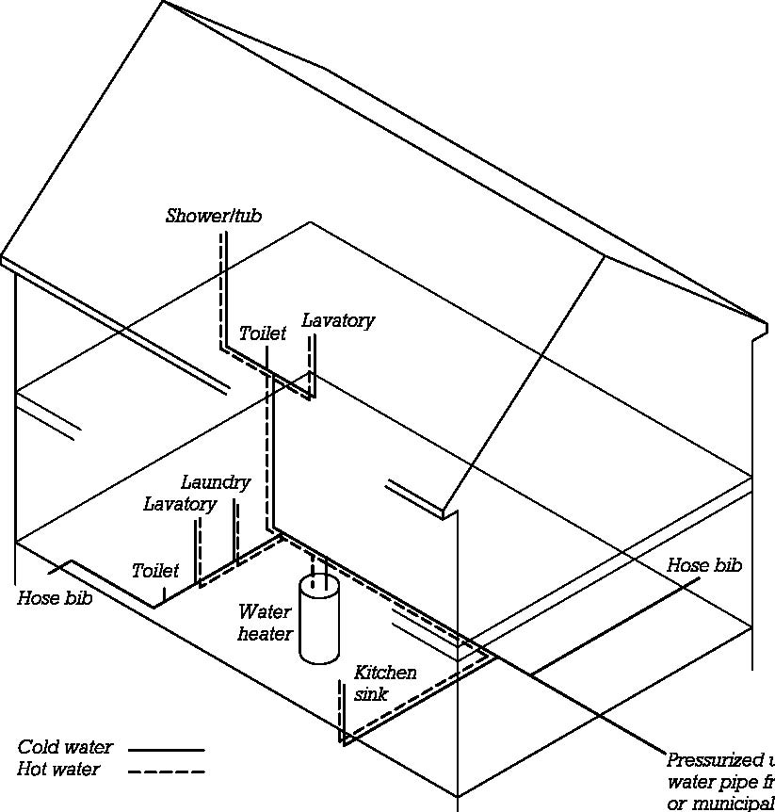
Water Supply Piping
Carries hot and cold domestic (potable) water to fixtures throughout the house.

Slide 7
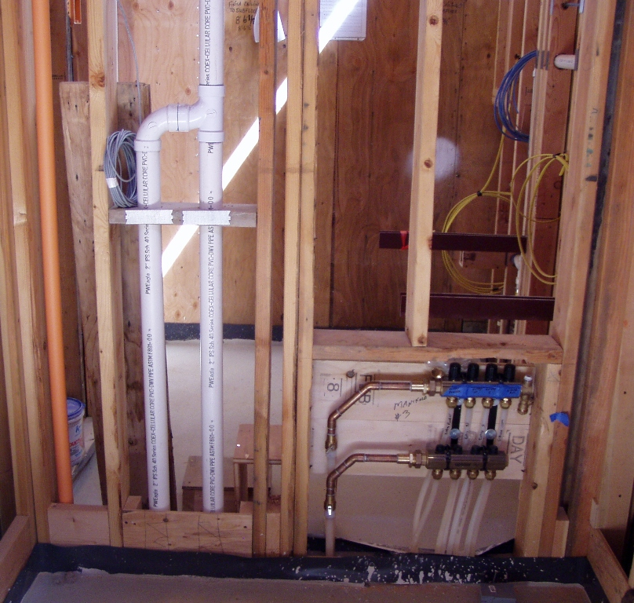
Bathroom Plumbing Rough-In
Orange sprinkler piping, left
White DWV piping, middle
Water supply distribution manifolds for a hot tub, right

Slide 8
Metal nail guards protect DWV piping from future nail or screw damage after wallboard or other finishes are installed and piping is concealed.

Slide 9
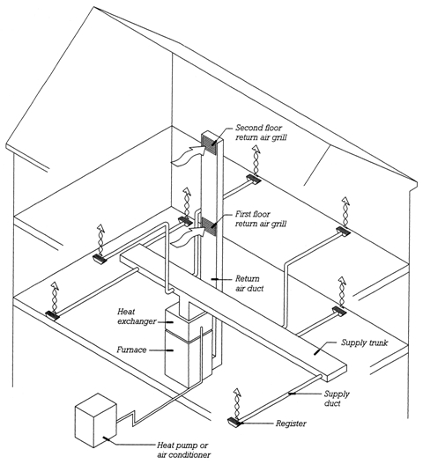
Forced Air Heating
Fan pushes heated air through supply ducts to spaces throughout the building.
Return air ducts carry return air back to the furnace.

Slide 10
With the addition of an exterior compressor and an evaporator (heat exchanger) within the furnace, cooled air can also be provided.

Slide 11
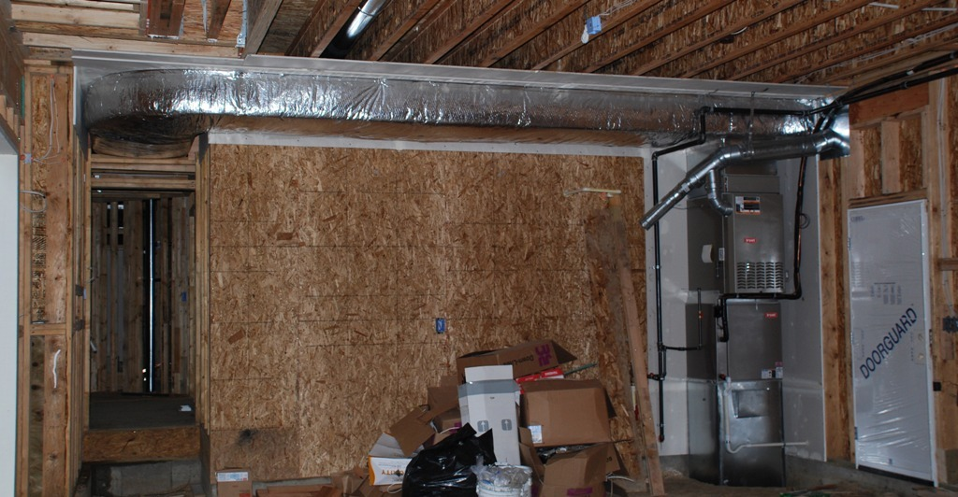
Forced-air heating and air conditioning with insulated supply duct

Slide 12
Wallboard has been preinstalled behind the furnace and ductwork.

Slide 13
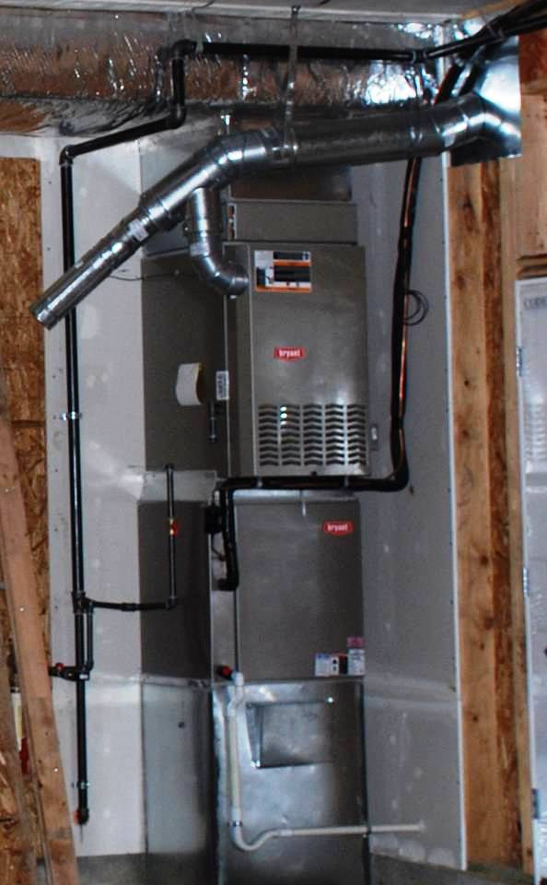
Furnace hookups
Natural gas supply piping
Exhaust vent for furnace and future water heater
Refrigerant piping between evaporator and compressor

Slide 14
Evaporator drain pan piping
Furnace supply air is ducted out of the top. Return air is ducted in from below (via a crawlspace).

Slide 15
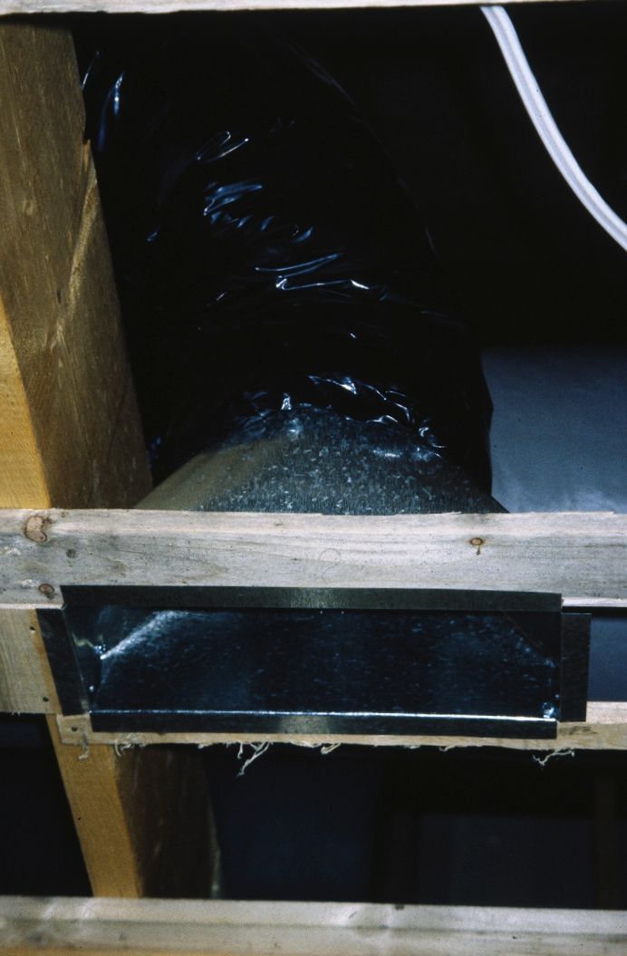
Termination of supply duct at ceiling framing, ready to receive finish ceiling and register

Slide 16
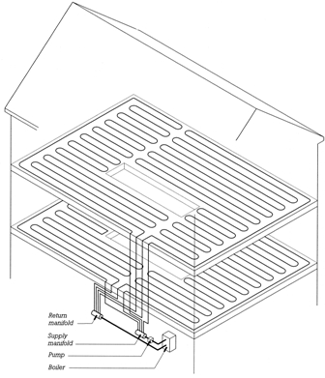
Hydronic Radiant Heating
Heated water moves through plastic pipes within in floors. These heated surfaces then radiate heat into the building spaces.
Ventilation air must be provided by some other system.

Slide 17
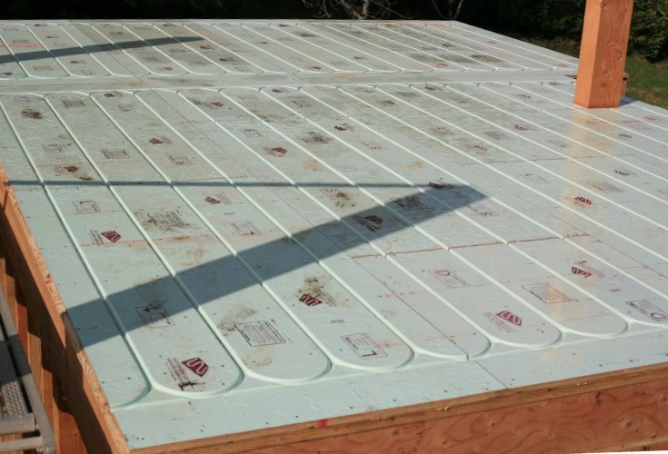
Proprietary underlayment panels for installing hydronic heating tubes under finish floor

Slide 18
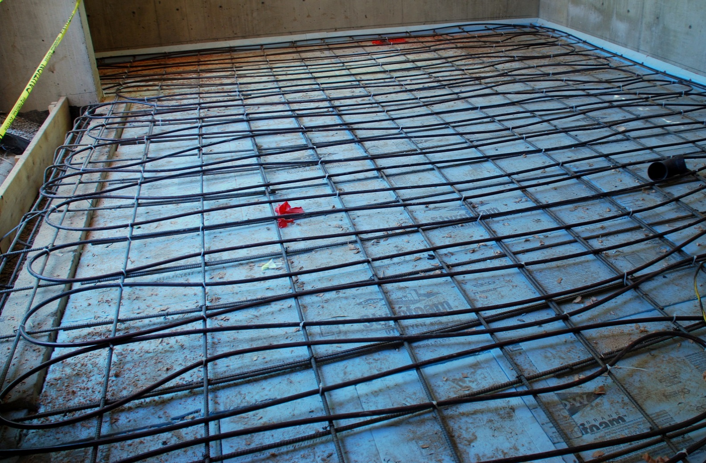
Hydronic piping tied to reinforcing, to be cast into a concrete slab on grade.
Rigid foam insulation below and around the edges of the slab.

Slide 19
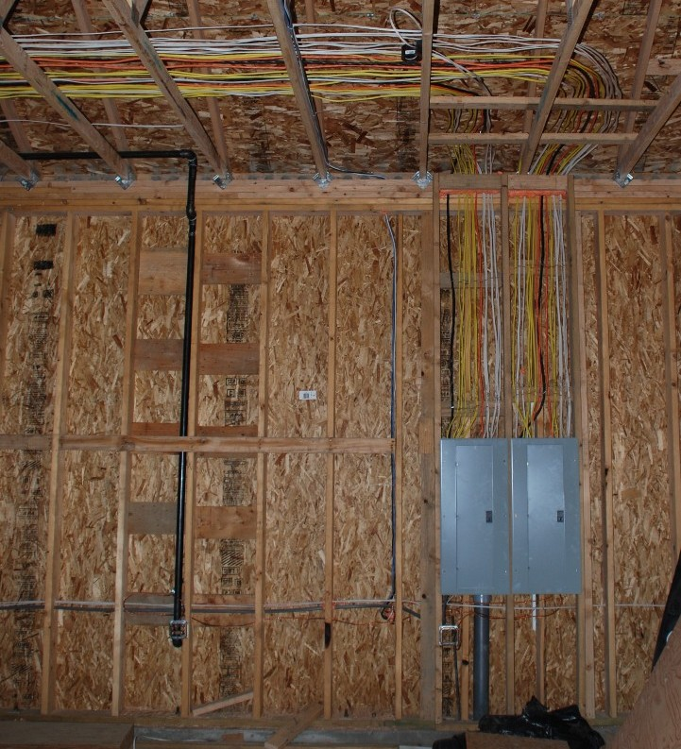
Power and Communications Wiring
Electrical panels are fed by the main service from below and, in turn, feed branch circuits above.

Slide 20
Black piping to left is natural gas for a backyard grill connection on opposite side of wall.

Slide 21
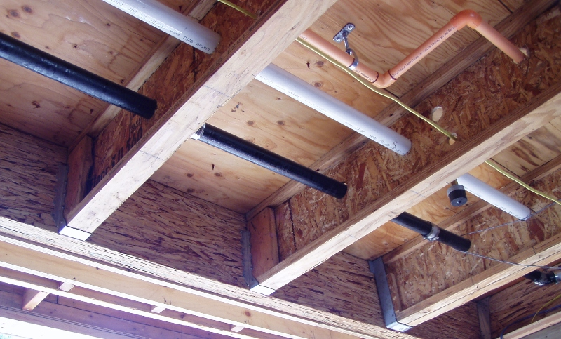
Cavities in light framing provide space for routing services.

Slide 22
Allowable spacing and sizing of holes in I-joist webs are established by the joist manufacturer.

Slide 23
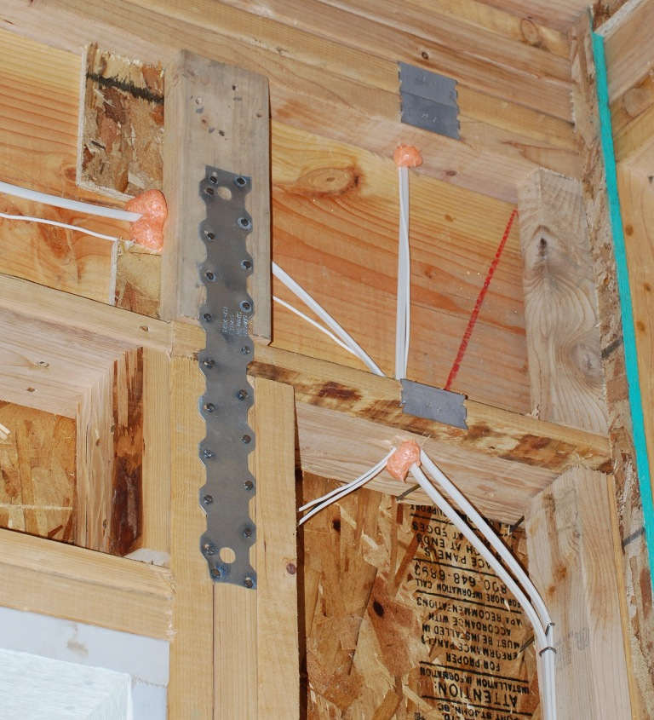
Fireblocking
Expansive foam sealant prevents the passage of smoke and flame through holes in framing.
Also used to reduce air leakage through exterior assemblies.

Slide 24
Large metal plate is seismic reinforcing.
Smaller metal plates are nail guards to protect wiring.

Slide 25
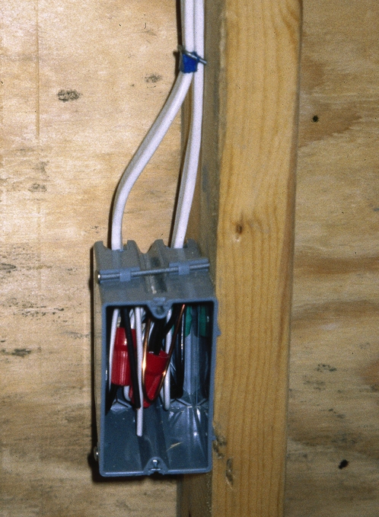
Fixture Box
For power outlets, switches, etc.
Cable is secured to the stud with an insulated staple.
Inside: Insulated wires, bare ground wire, and red wire nuts.

Slide 26
The box is nailed to stud, proud of the stud face, so that box will be flush with the finish surface of the wall once the wallboard or other finish materials are applied.

Slide 27
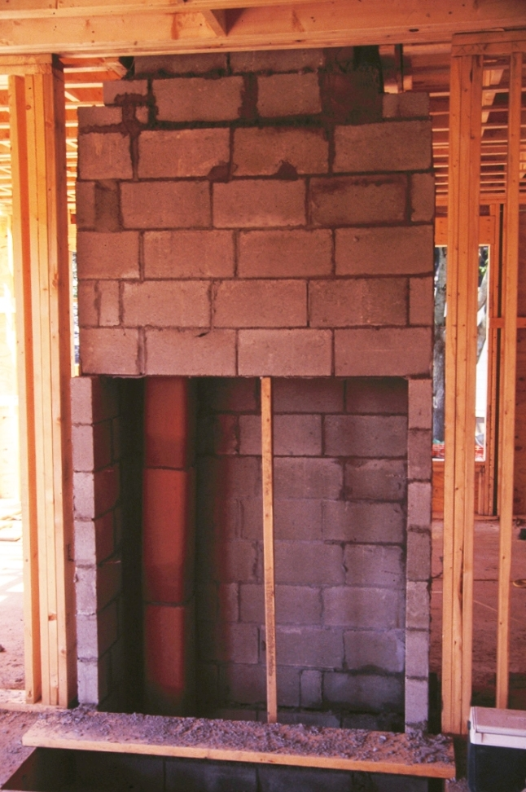
Masonry Fireplace
Combustible wood framing is kept separated from masonry for fire safety.
Hollow clay flue to the left serves a separate fireplace at floor below.

Slide 28
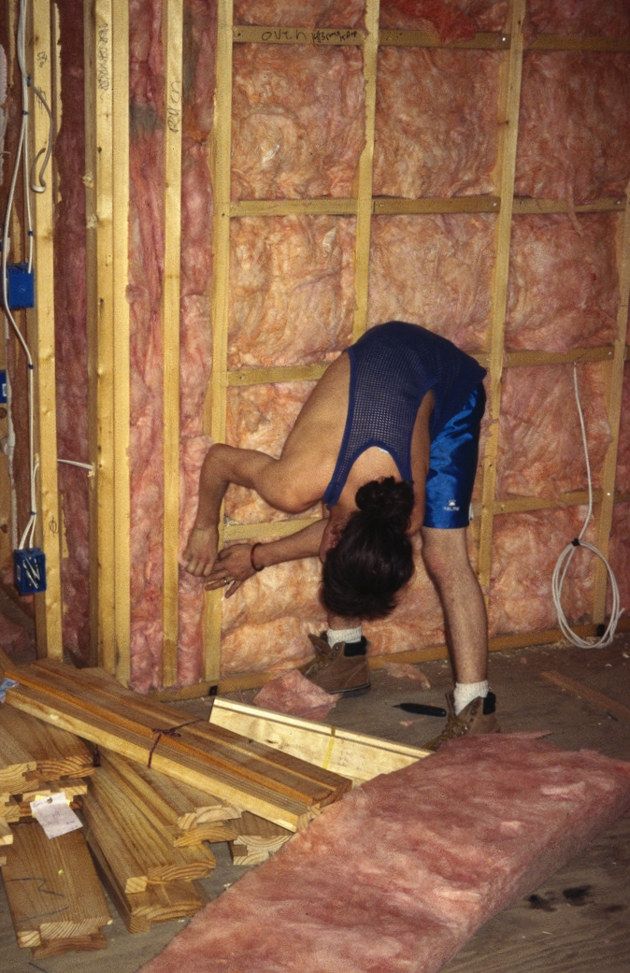
Glass Fiber Batts
Unfaced batts, shown here, are held in place by friction.
Batts with paper or foil facing are stapled to face of stud.
(Installer should be wearing protective gear.)

Slide 29
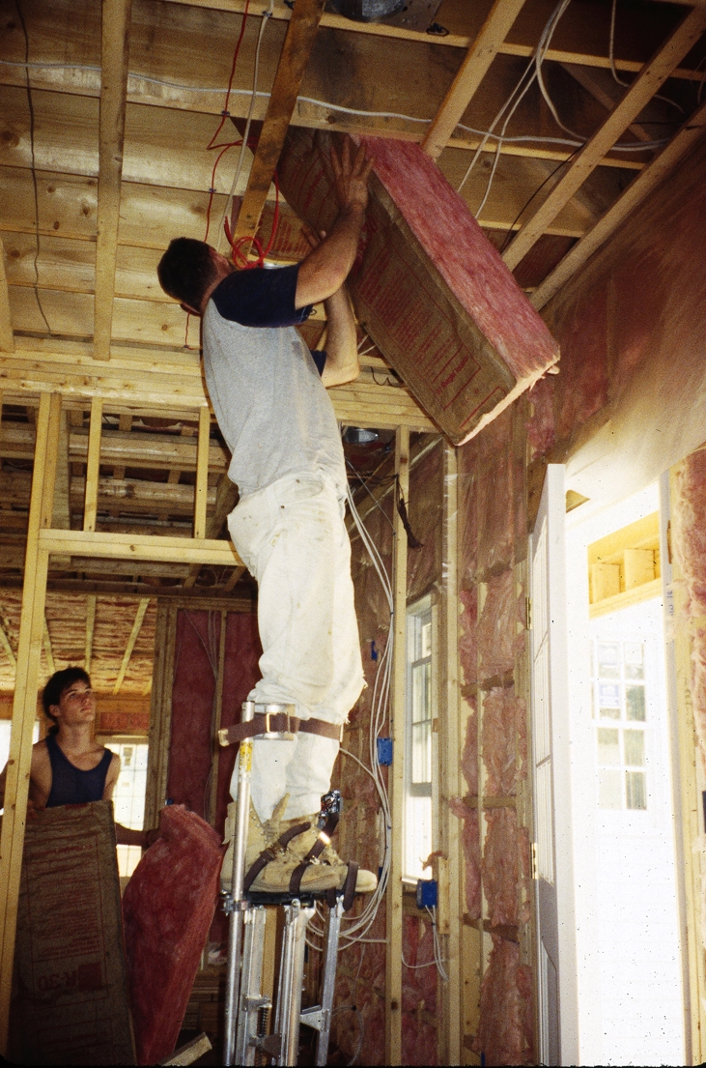
A worker on stilts installs paper-faced glass fiber batt insulation into the ceiling/roof framing.

Slide 30
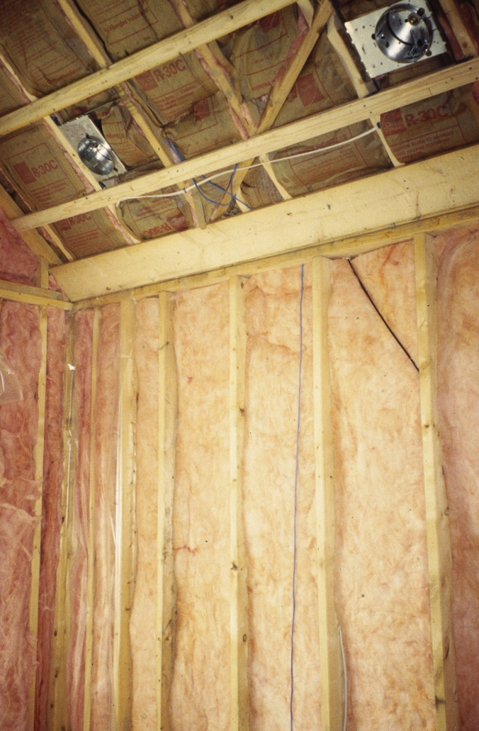
In cold climates, a vapor retarder is installed over the unfaced wall batts (visible at left).
Paper facing on ceiling batts acts as vapor retarder.

Slide 31
Ceiling light fixtures must be rated for direct contact with insulation or insulation must be kept back from fixture.
If not carefully sealed, recessed fixtures are a potential source of air leakage.

Slide 32
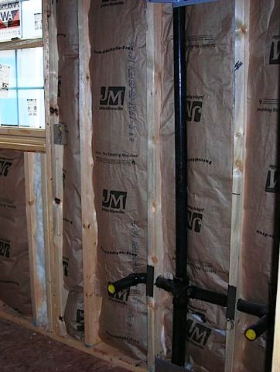
Plumbing pipes must remain on the warm side of the insulation, to prevent freezing in cold weather.

Slide 33
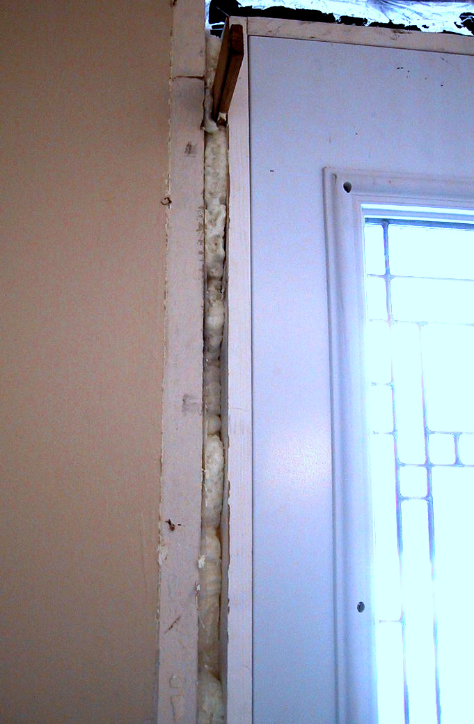
Spray Foam
Spray foam insulates gap between finish door frame and rough opening.
This foam is non-expansive so that it doesn’t distort door frame as it is installed.

Slide 34
A tapered shim protrudes near top of jamb rough opening.
photo.

Slide 35
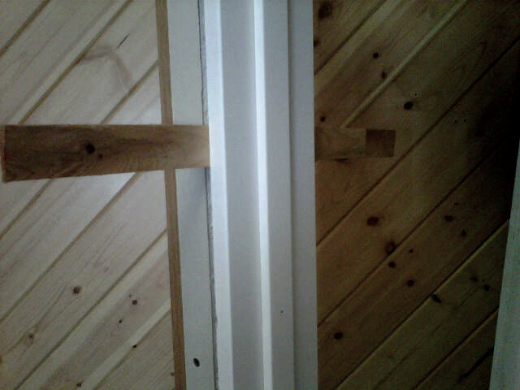
Tapered shims are inserted in pairs, one from each side of the frame.
Sliding the shims together or apart adjusts the total thickness.

Slide 36
Later, the protruding portions of the shims are snapped or cut off, to be concealed behind finish materials.

Slide 37
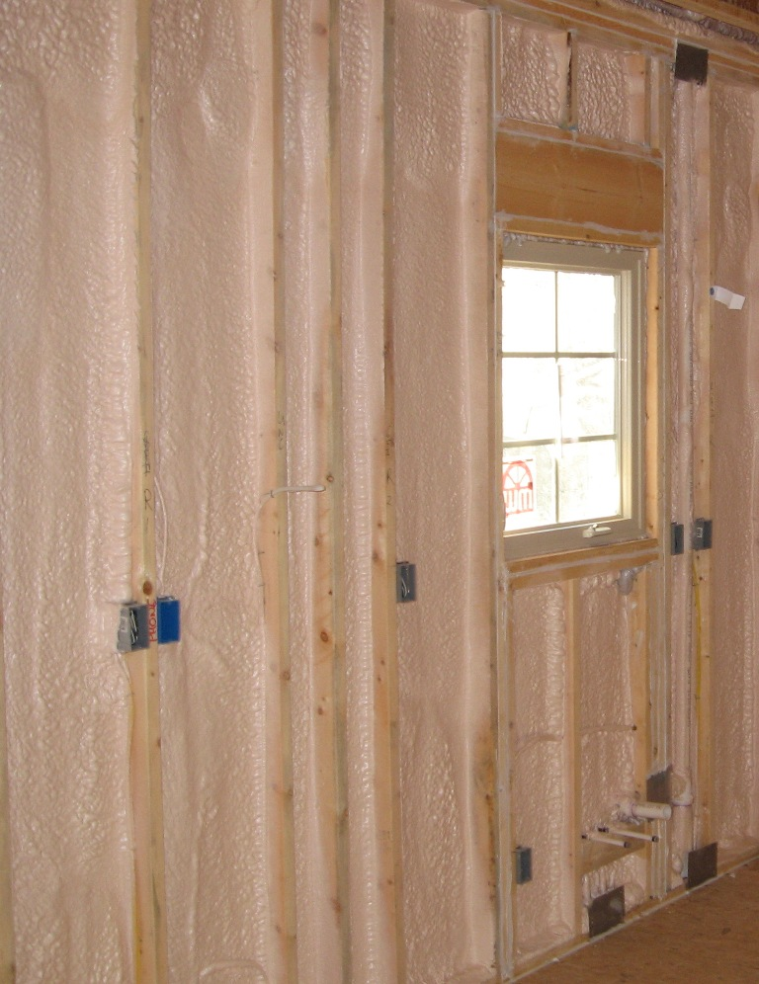
Spray foam creates a more air-tight, energy efficient enclosure.
Many foams have relatively high insulation values in comparison to other types.

Slide 38
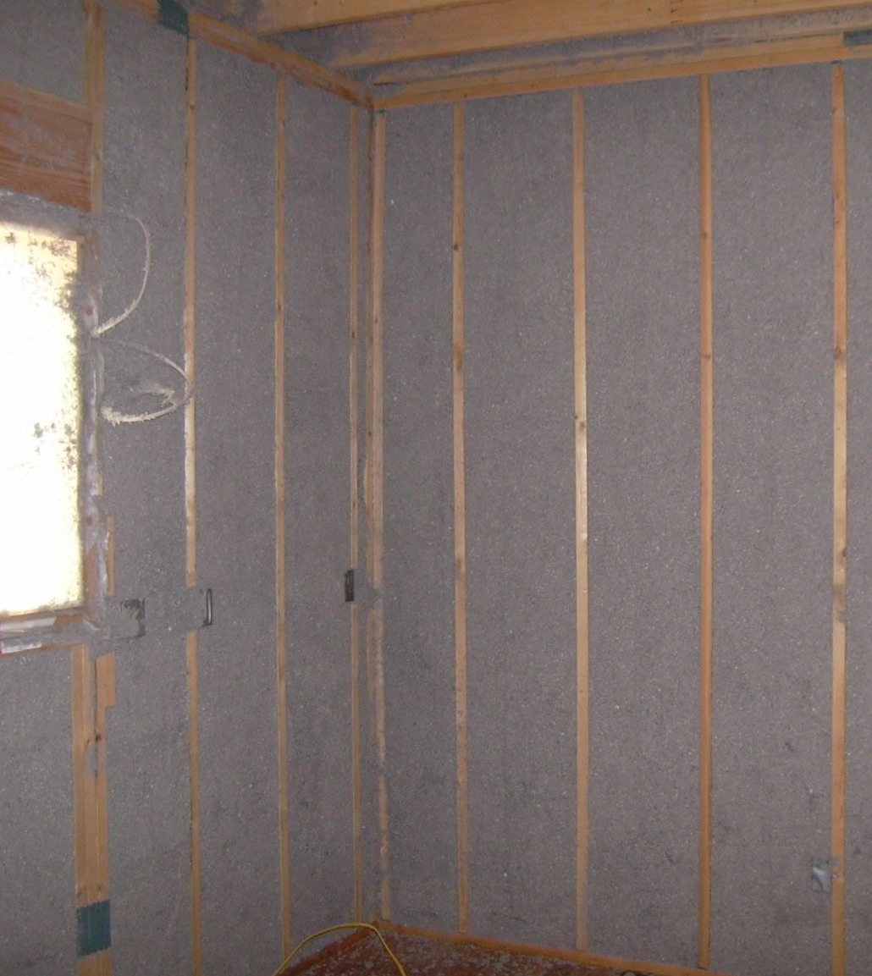
Blown-In Insulation
Blown-in insulation may be cotton, glass fibers, or cellulose (right).
The dense packing reduces convective air movements in wall cavities.

Slide 39
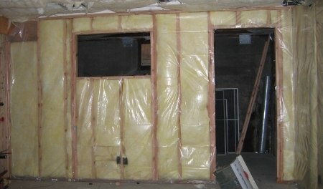
Vapor Retarder
Required in colder climates:
Plastic sheet (photo)
Low-perm primer on wallboard
Faced batts
Some spray foams

Slide 40
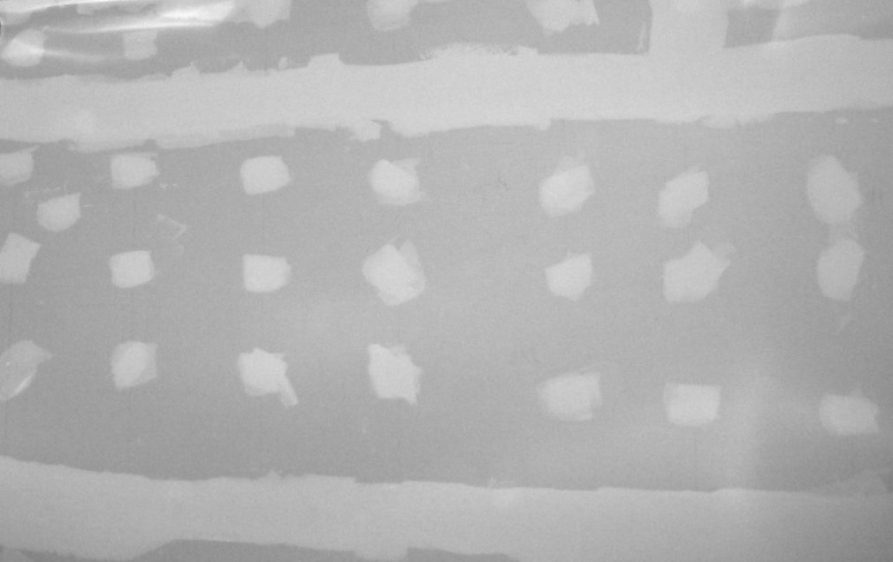
WALL AND CEILING FINISH

Slide 41
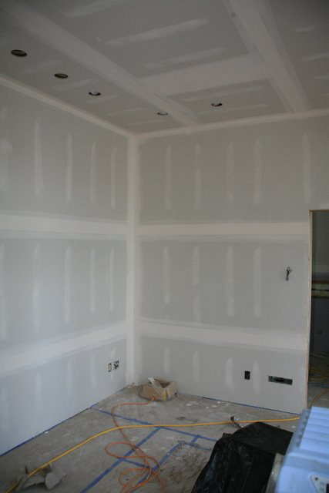
Gypsum Wallboard
Joints are finished level and smooth with reinforcing tape and, usually, three coats of joint compound.
Depressions at fasteners are also leveled.

Slide 42
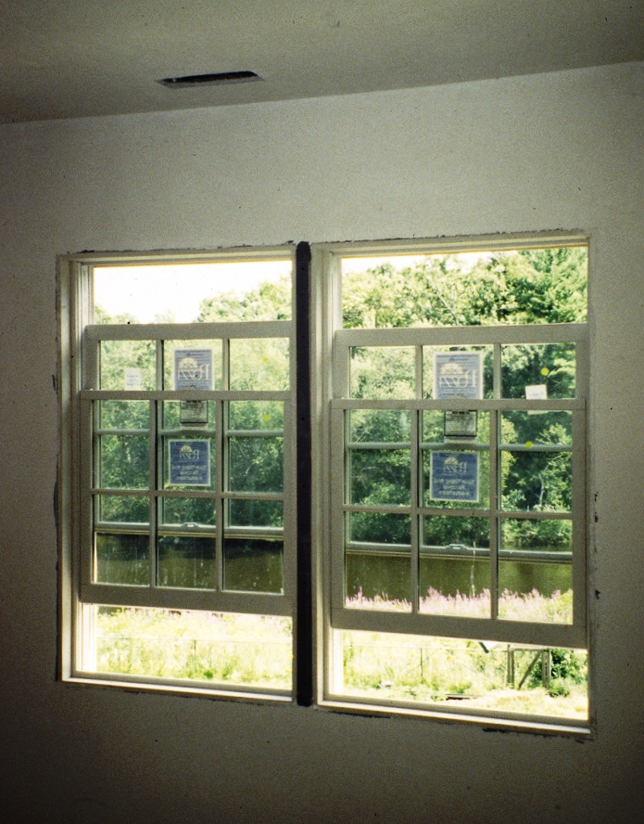
Cut, rough edges are typically covered with finish trim.

Slide 43
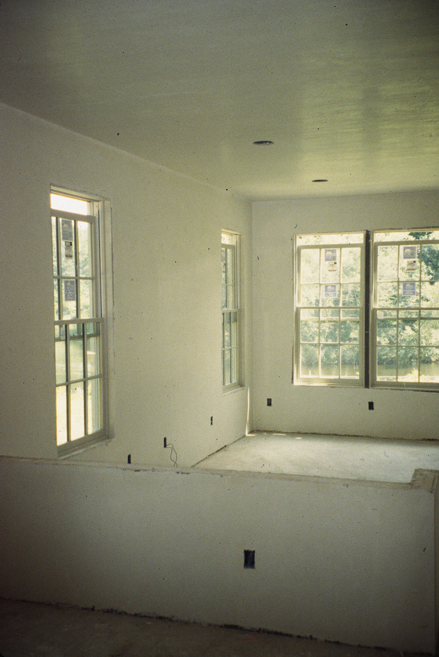
Veneer Plaster
Thin gypsum plaster coating over special gypsum board base.
It creates a smoother, more durable surface than conventionally finished gypsum wallboard.

Slide 44
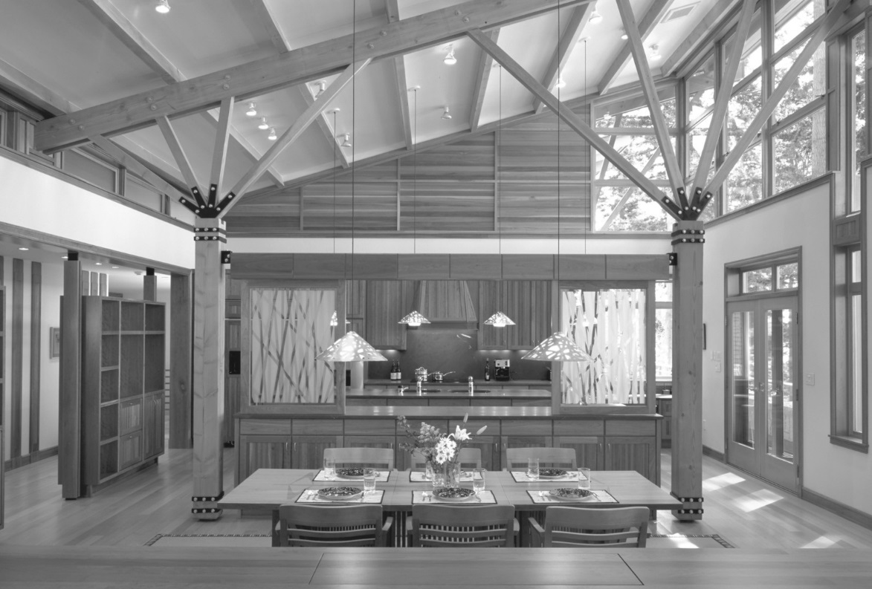
MILLWORK AND FINISH CARPENTRY

Slide 45
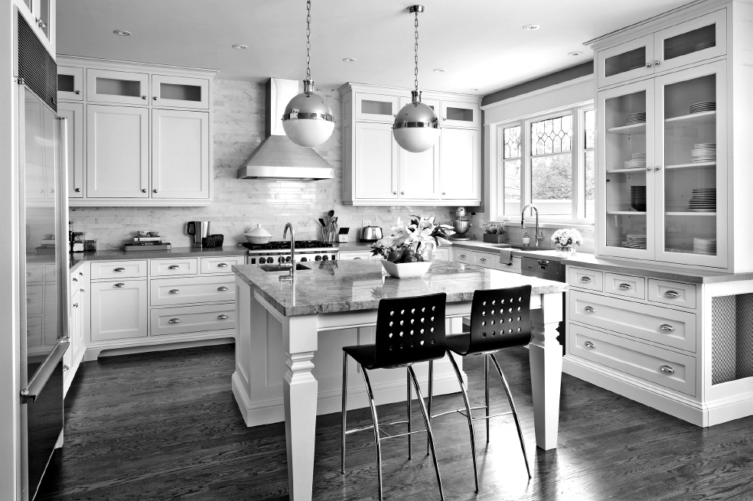
Millwork
Carpentry components—moldings, cabinets, stairs, etc.—manufactured off-site.

Slide 46
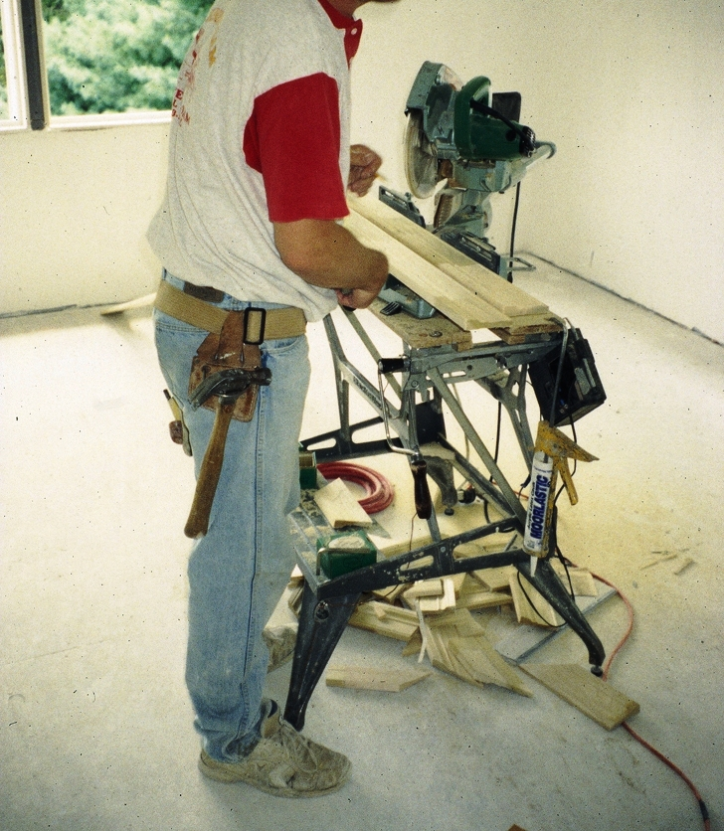
Finish Carpentry
Carpentry completed on site.
Right: Using a powered miter saw to cut wood moldings for trimming out a door frame.

Slide 47
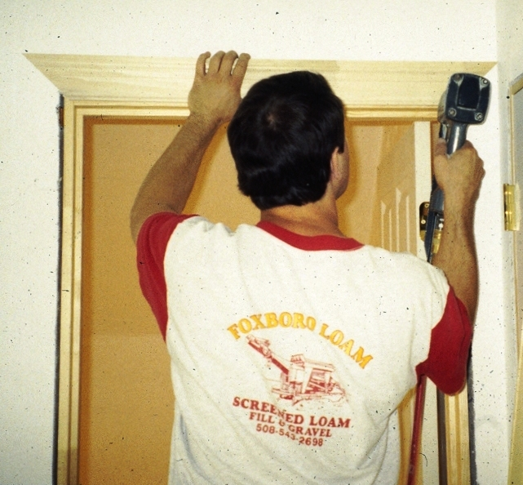
Head casing being installed using a pneumatically-powered finish nail gun.
Ends are mitered.

Slide 48
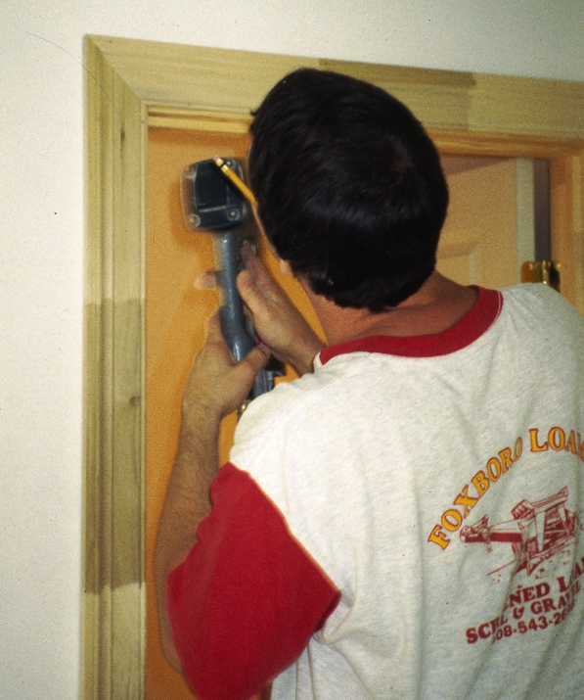
Moldings here are manufactured from shorter lengths, finger-jointed and glued end-to-end.
After painting, they will appear continuous.

Slide 49
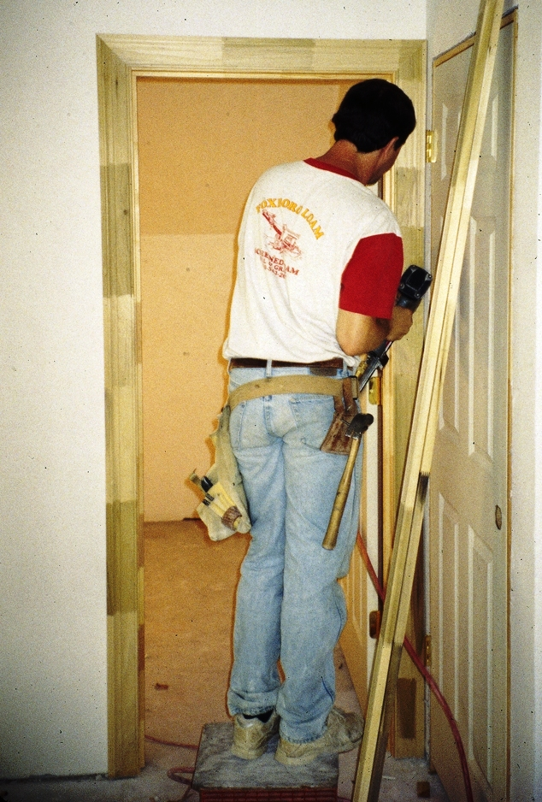
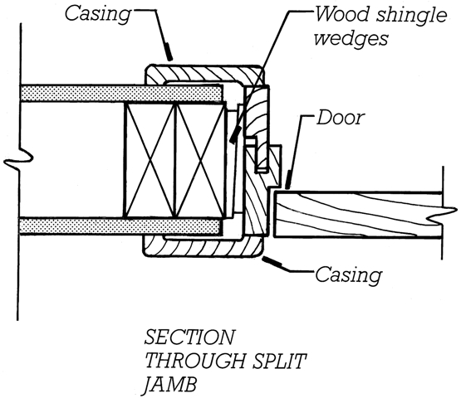
The split-jamb frame below can arrive on site with casings pre-applied.

Slide 50
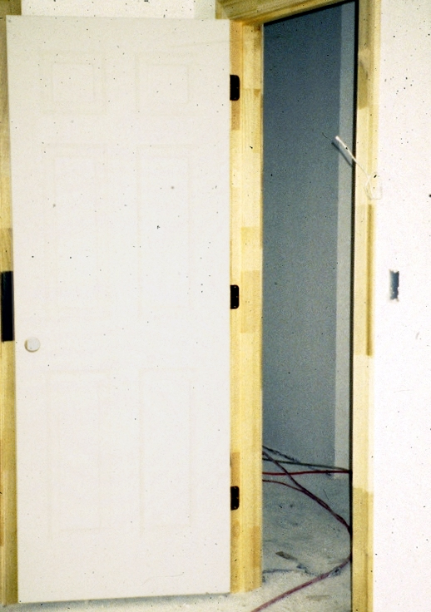
A six panel door (panels are difficult to see in this photograph), hung with three hinges.
Door has been drilled for the lockset at left edge.
Doors may be prehung in the factory or fitted and installed on site.

Slide 51
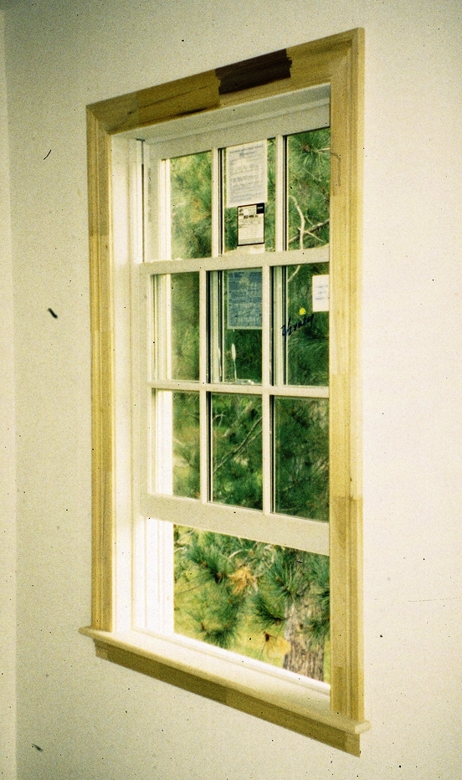
Sides and top of a window are trimmed in a manner similar to that for a door.
The bottom of the window opening is trimmed with a sill and apron.

Slide 52
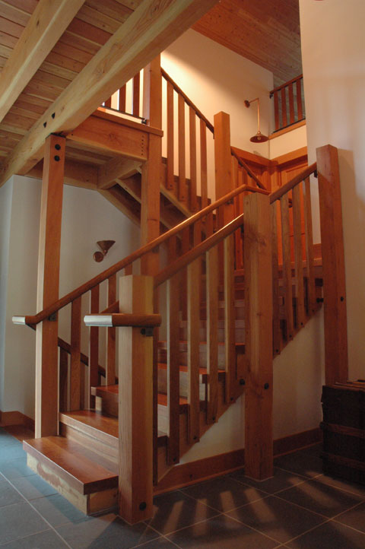
Site-built stair.

Slide 53
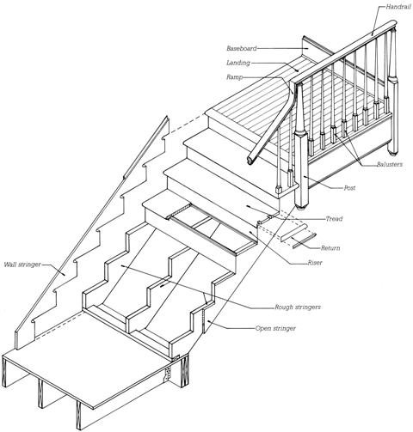
Factory-built stair.

Slide 54
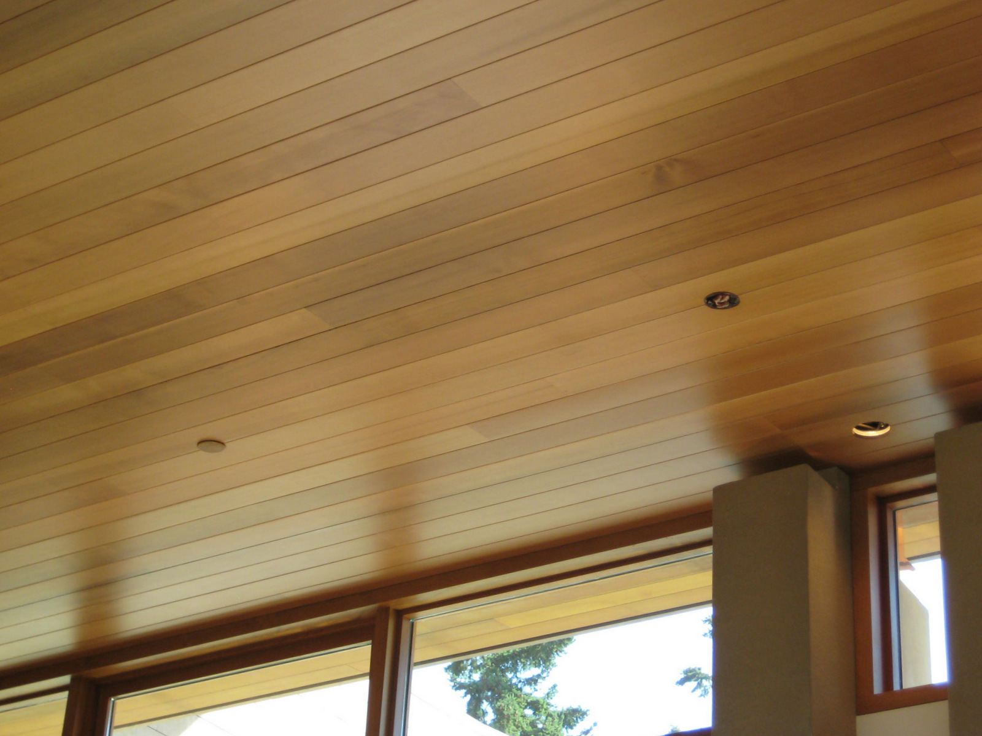
Finish wood ceiling.

Slide 55
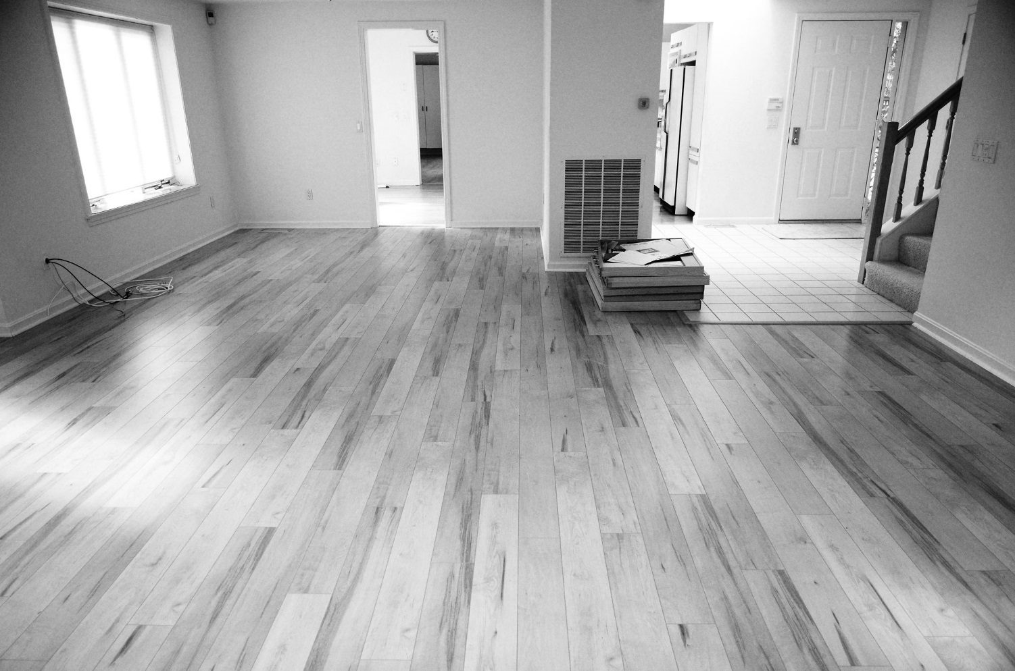
FLOORING AND CERAMIC TILE WORK

Slide 56
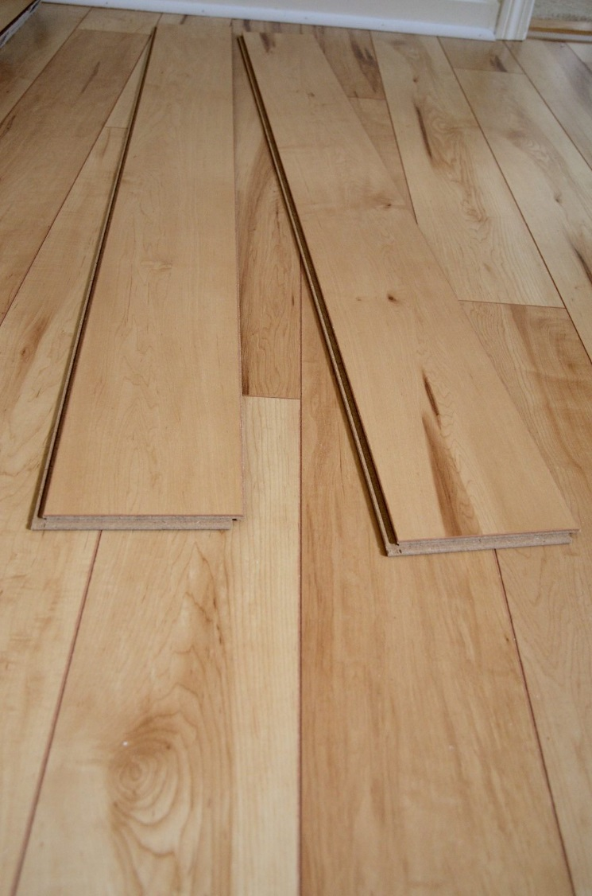
Engineered wood flooring.

Slide 57
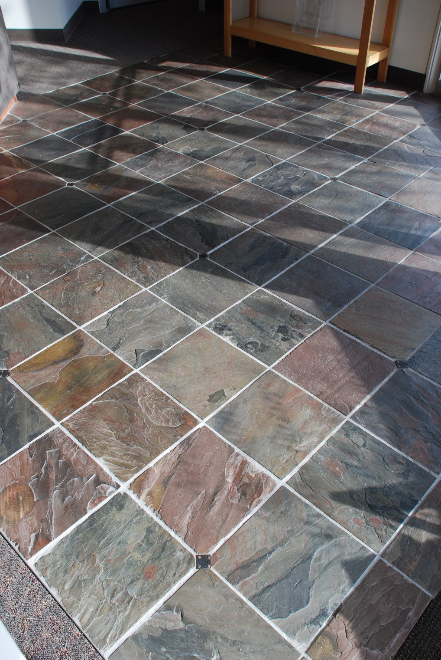
Stone tile.

Slide 58
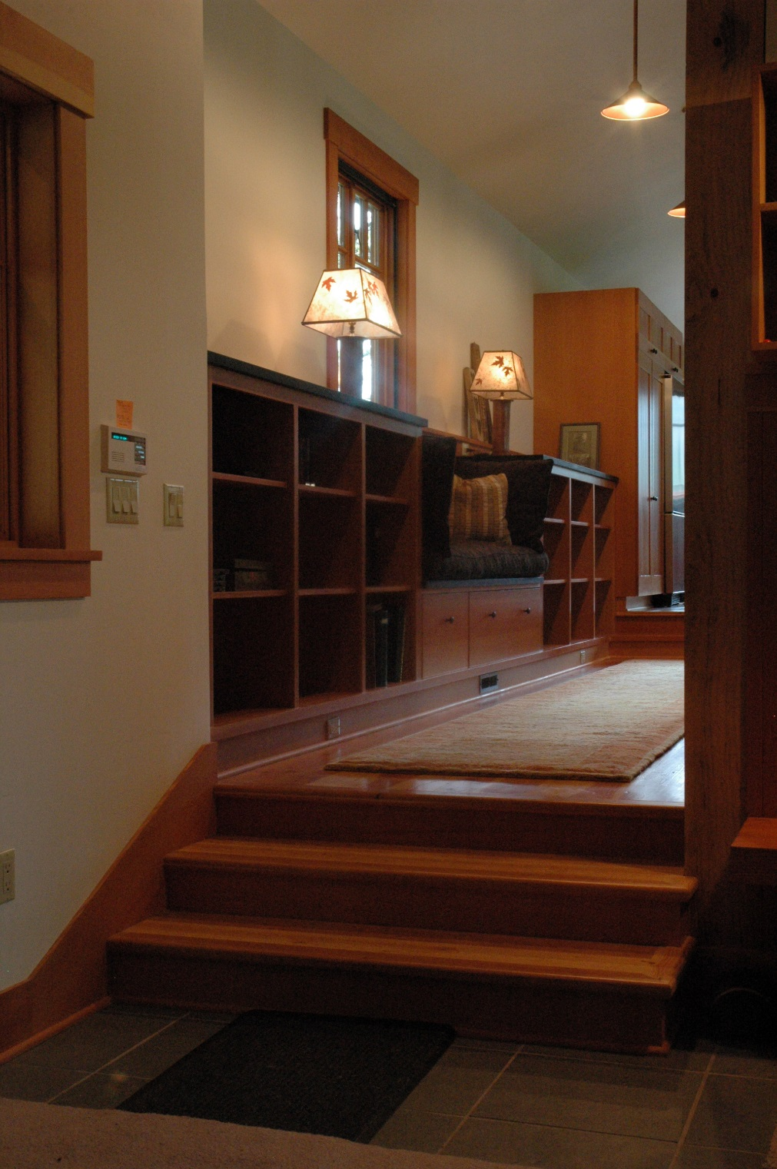
Painted gypsum wallboard walls and ceilings
Stone flooring (foreground)
Wood baseboards and trim
Wood stairs
Wood flooring (beyond)
Custom wood casework

Slide 59
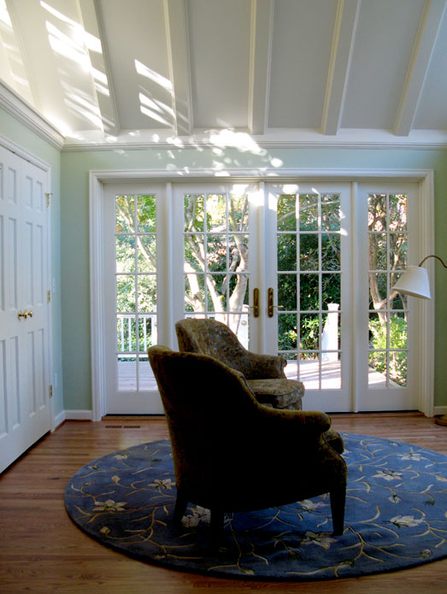
Painted wood baseboards, door casings, wall cornice, and cased ceiling beams
Six paneled doors
Glazed French doors
Solid wood strip flooring

Slide 60
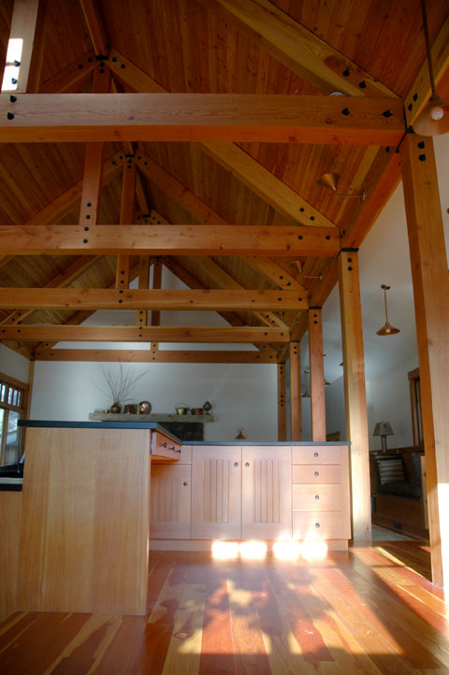
Custom wood casework
Wide plank wood flooring
Wood deck ceiling
Exposed heavy timber framing
Gypsum wallboard walls

