Slide 1
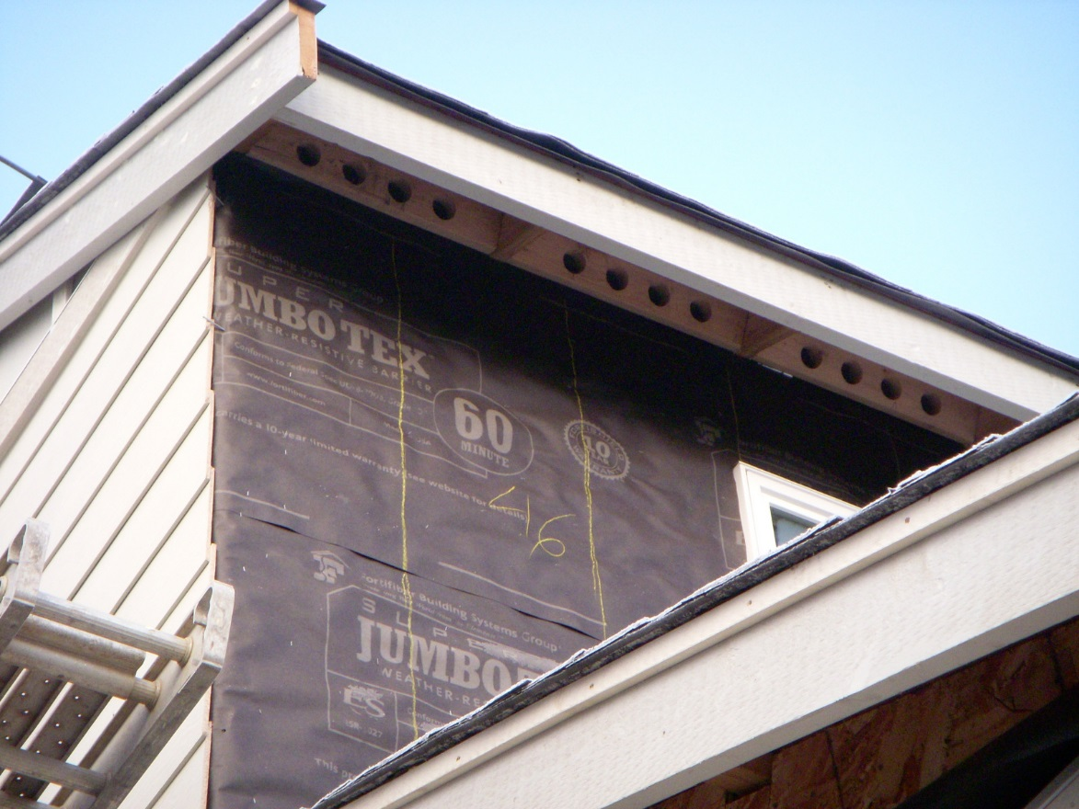
PROTECTION FROM THE WEATHER

Slide 2
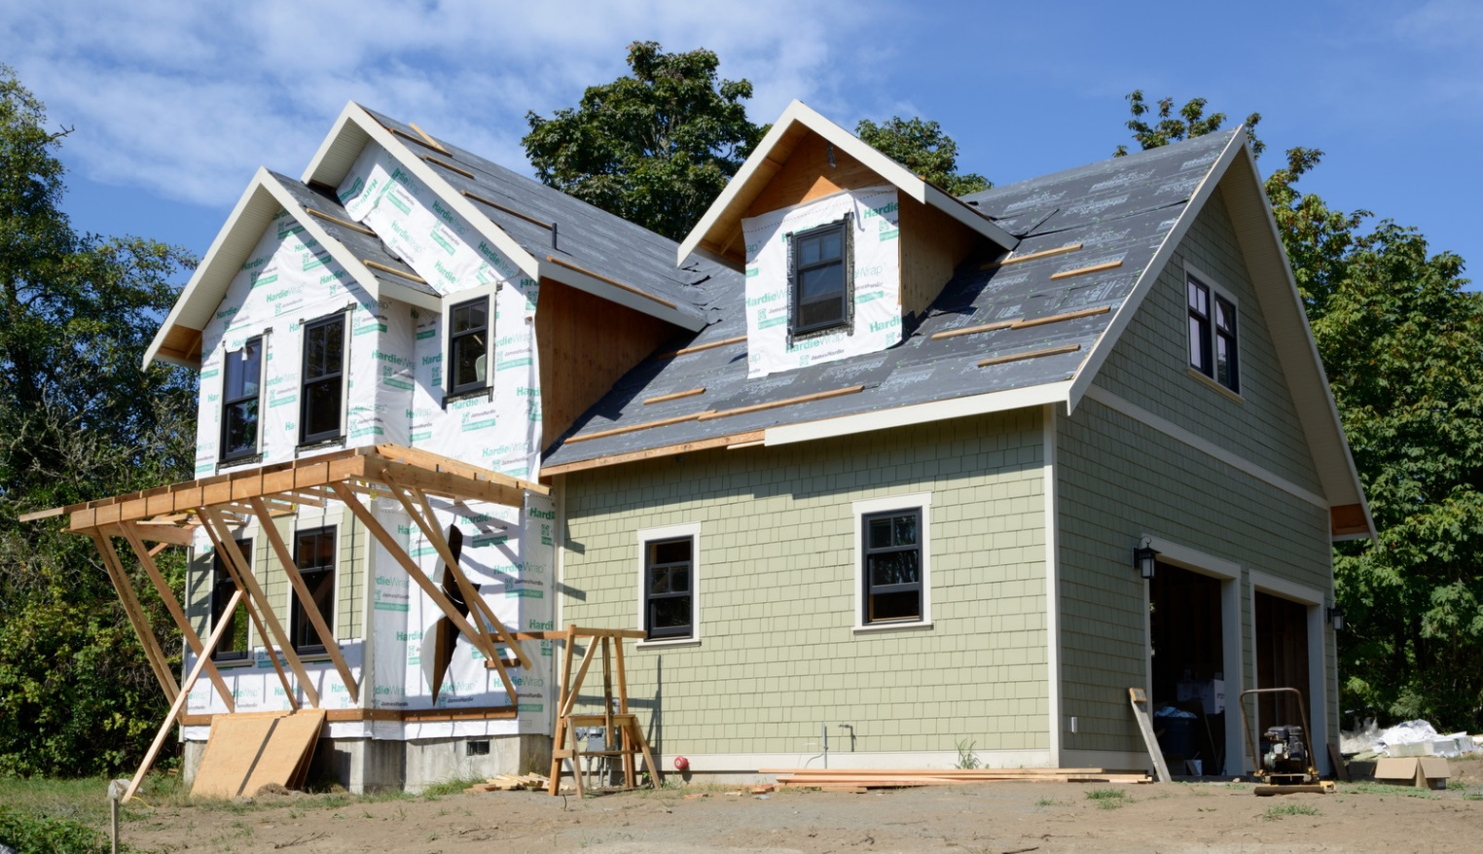
“Tight to the weather”
The structure is closed in as quickly as possible, so that it may begin to dry in preparation for interior finish work.

Slide 3
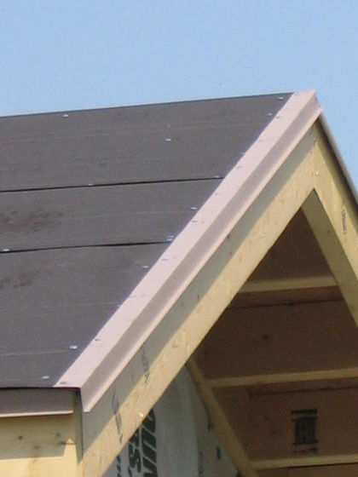
Roofing Underlayment
Roofing underlayment is installed first, to provide temporary protection from rain until the finish roof covering is installed.
The rake metal drip edge has also been installed.

Slide 4
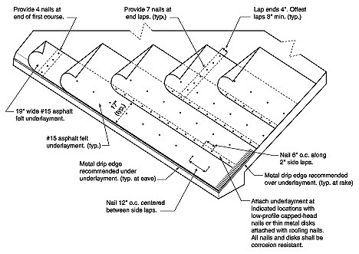
Underlayment is applied starting from the low point of the roof, working upward.
Overlapping in shingle fashion prevents water from running underneath.

Slide 5
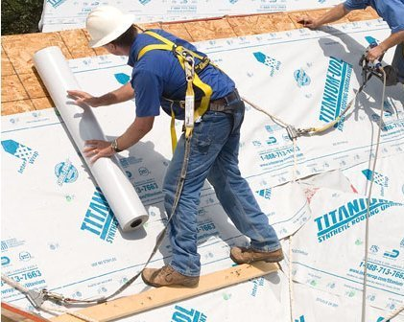
Underlayment may be traditional building felts or newer synthetic sheet materials.

Slide 6
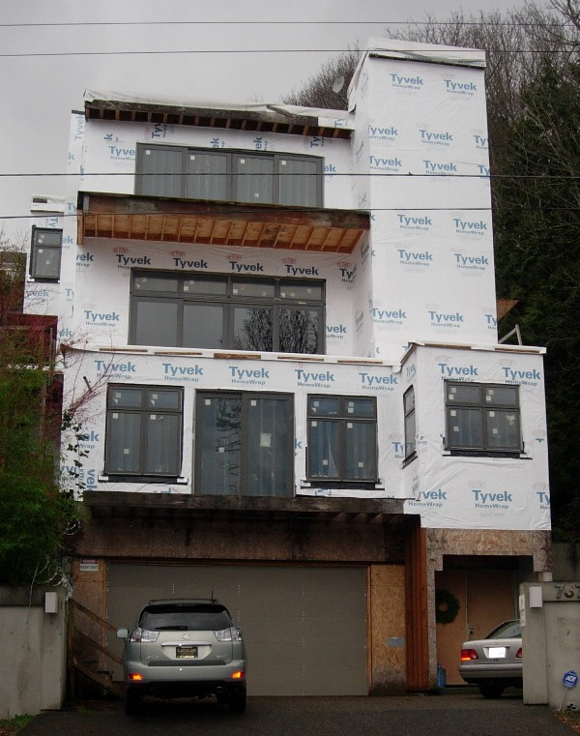
Wall Moisture Barrier
Installed after the framing and sheathing are completed, or delayed until after windows and doors are installed.

Slide 7
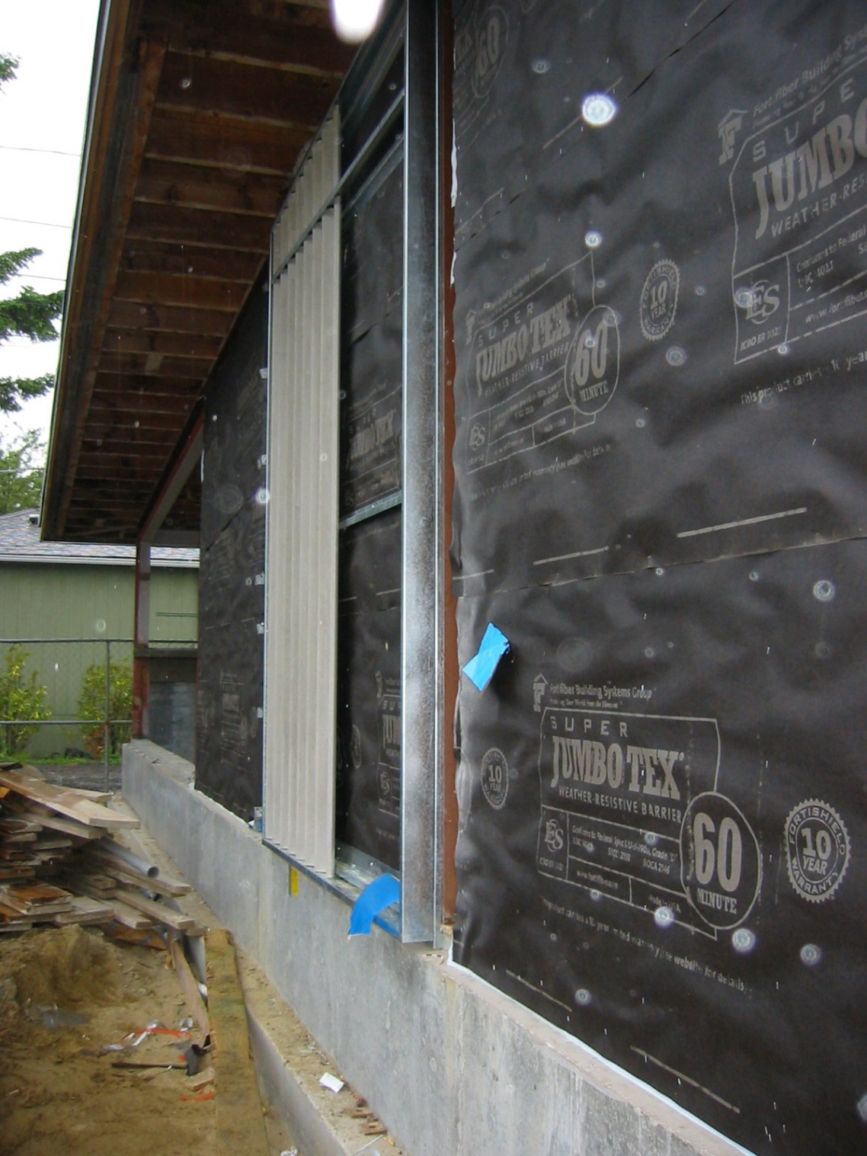
asphalt-saturated paper (right)
building felt
synthetic wraps
Installed from the bottom up, shingle-fashion, like roof underlayment.

Slide 8
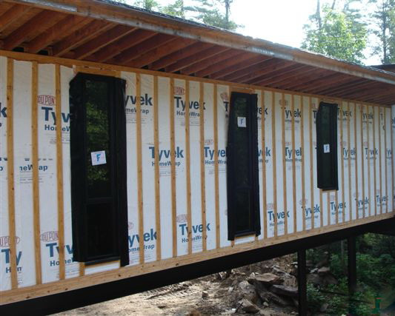
Synthetic wraps offer better air-tightness.
(Rainscreen cladding shown)

Slide 9
Wall moisture barriers are usually moisture-resistant, but also breathable to moisture vapor (humidity), so that moisture within the wall can diffuse outward rather than become trapped and accumulate within the wall.

Slide 10
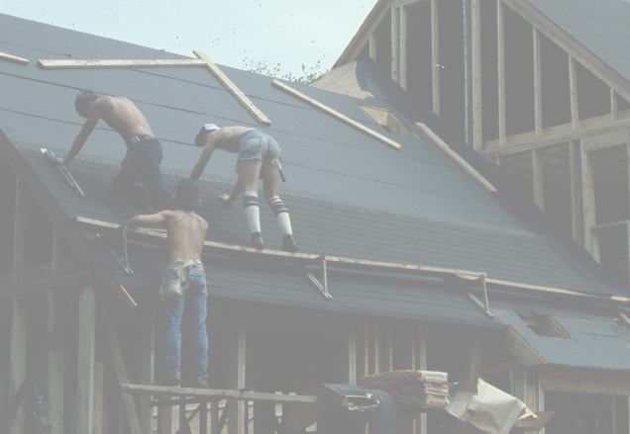
ROOFING

Slide 11
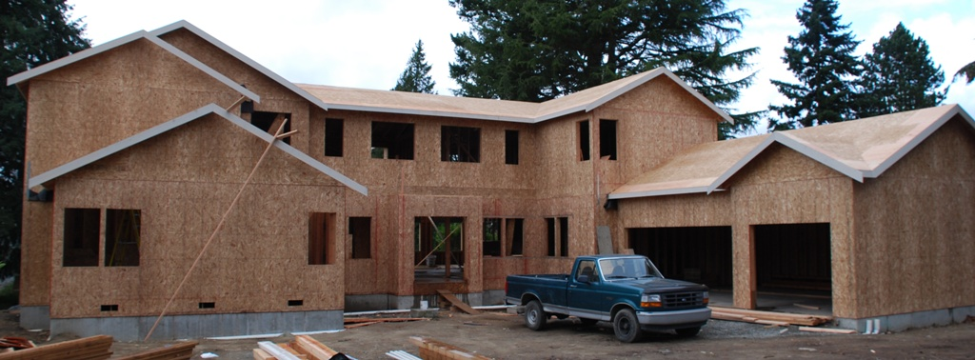
Eaves and Rakes
Eaves and rakes are finished before roofing is installed, here before roofing underlayment as well.

Slide 12
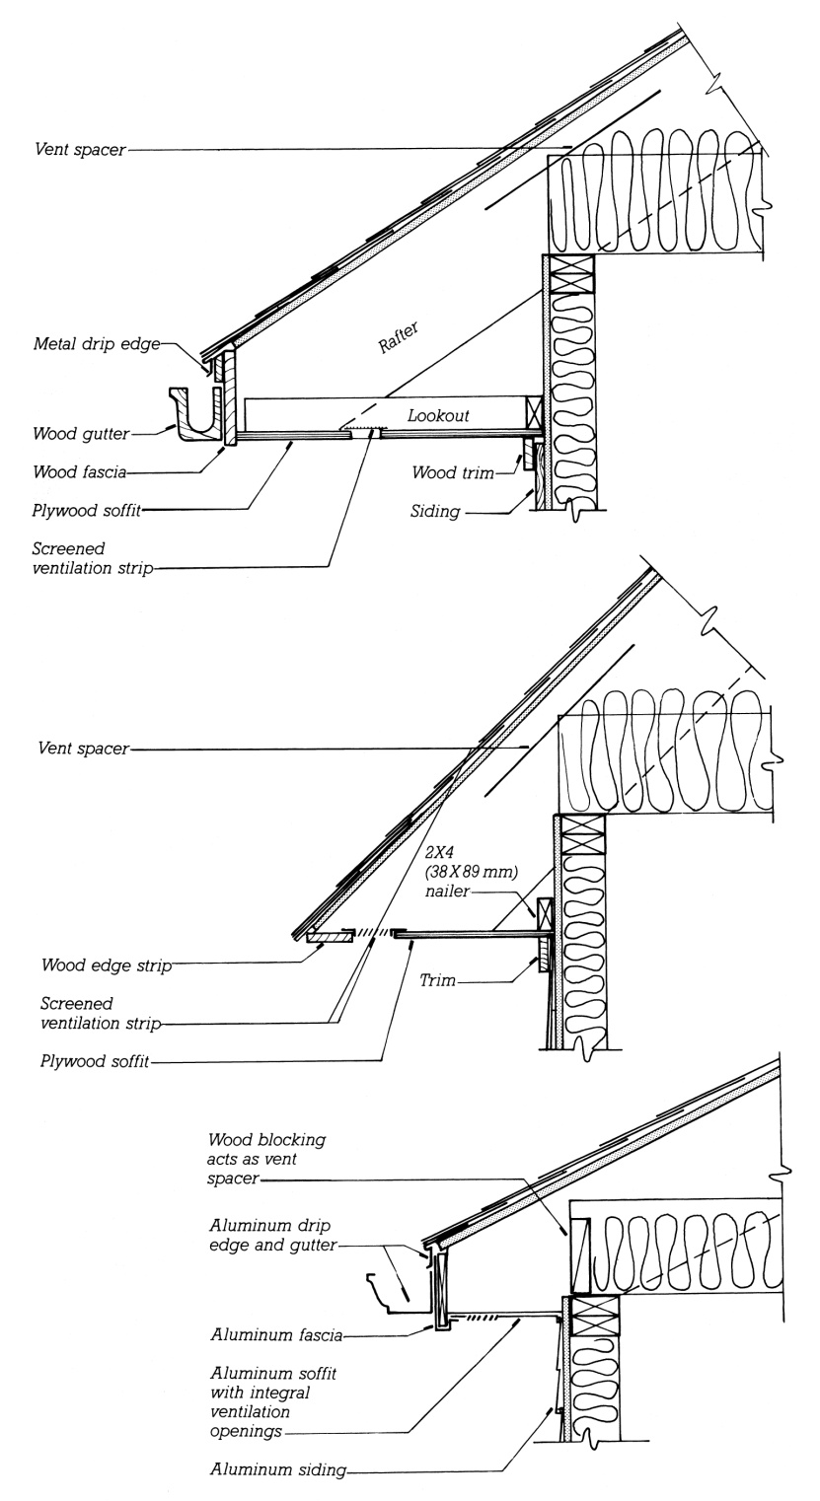
Eaves
Drip edge
Fascia
Soffit
Ventilation strip
Gutter

Slide 13
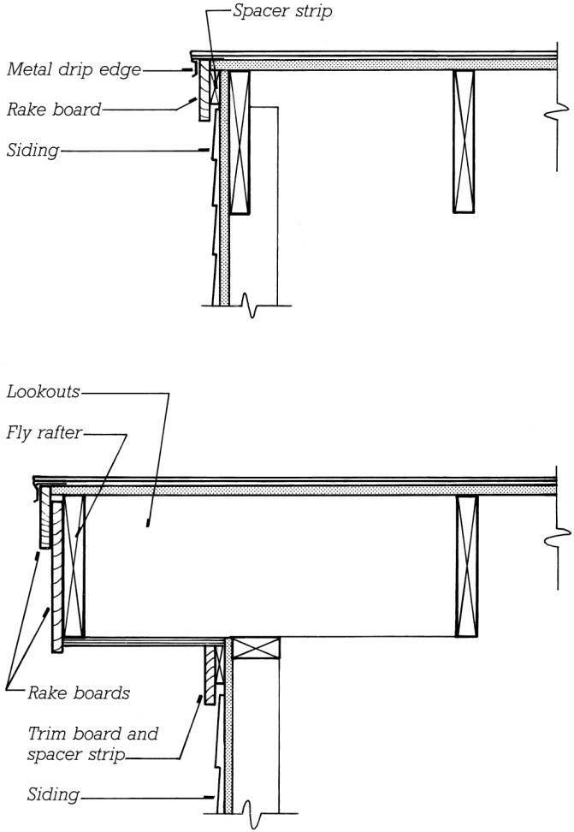
Rakes
Rake board
Fly rafter

Slide 14
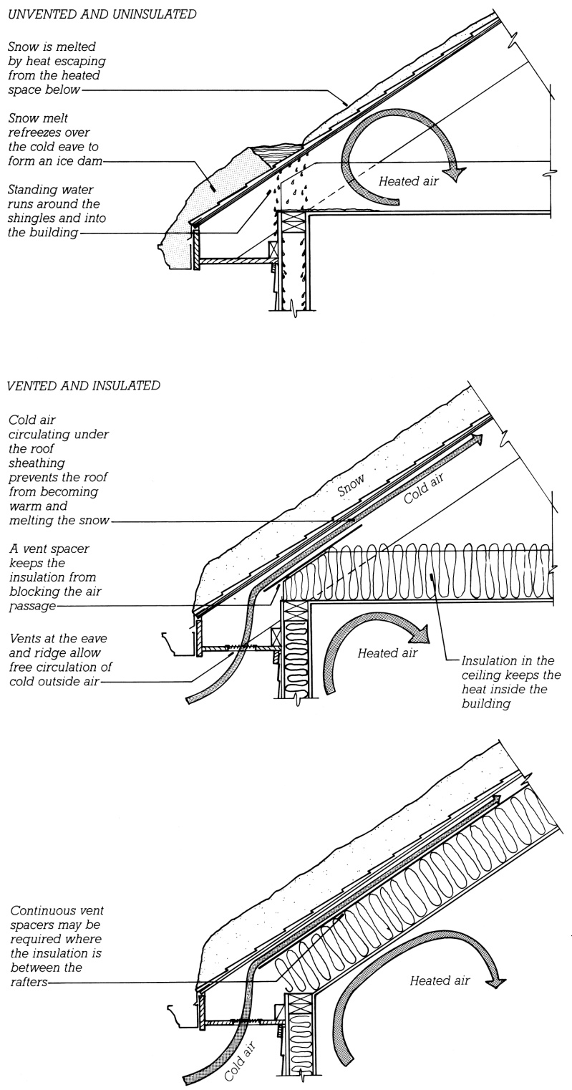
Roof Ventilation
Roof ventilation under the sheathing and above the insulation helps to remove moisture that enters from above or condensation from below and reduces the risk of ice damming in cold climates.

Slide 15
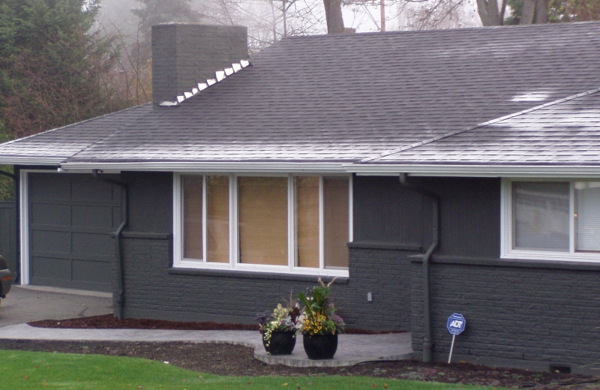
Nighttime frost lingers on the colder overhanging portions of the roof while it has already melted over the heated spaces.

Slide 16
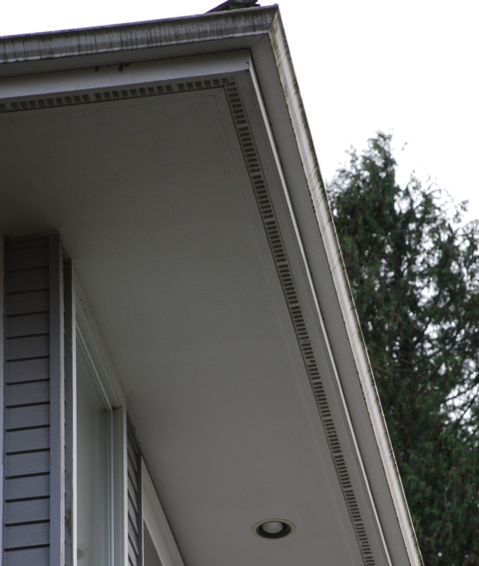
Soffit vent

Slide 17
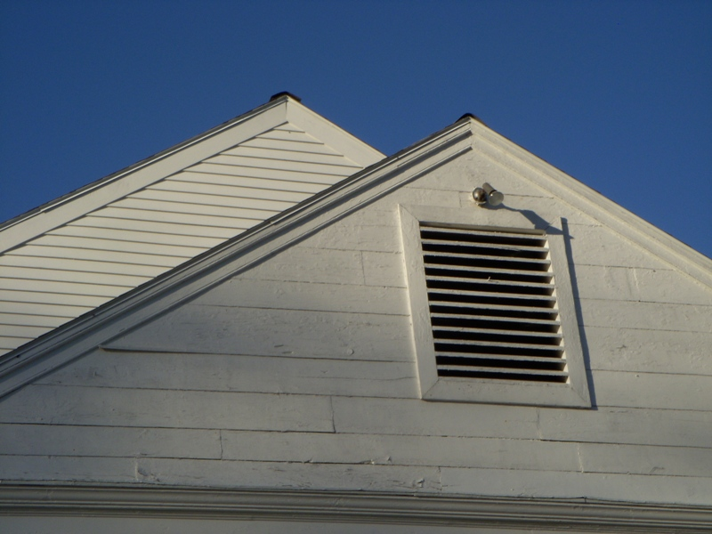
Gable vent

Slide 18
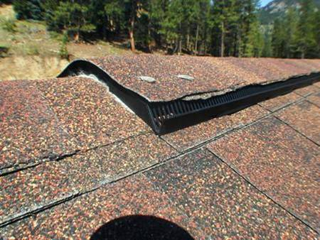
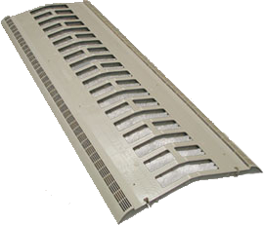
Ridge vent

Slide 19
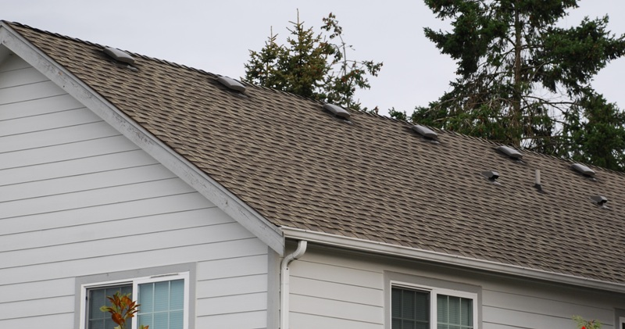
Roof “mushroom” vents

Slide 20
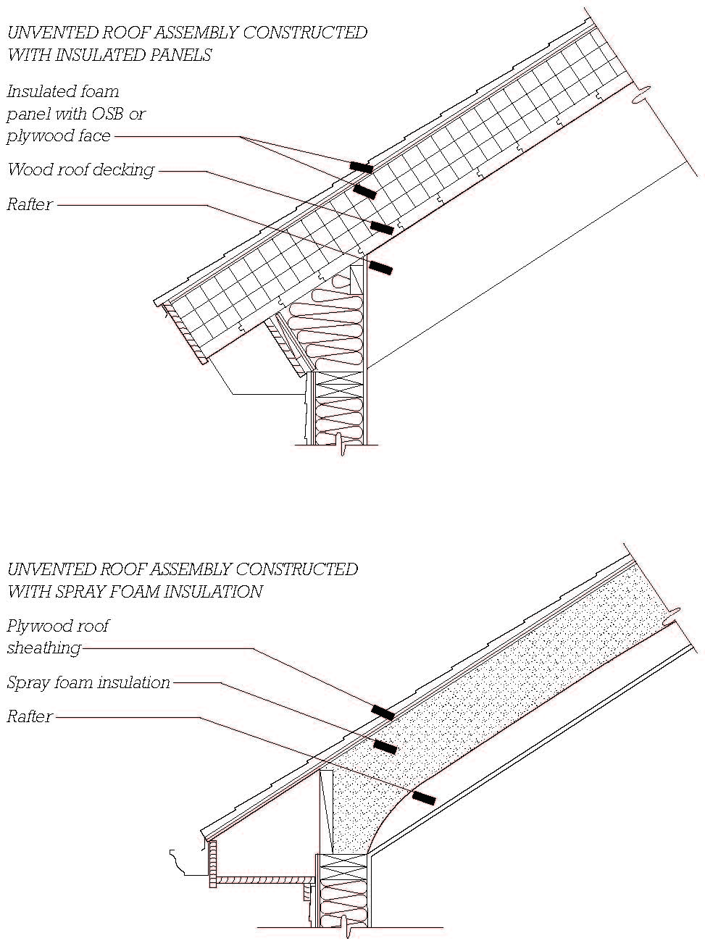
Unvented Roofs
When insulation is positioned above the roof sheathing, ventilation is not required (top).

Slide 21
When sufficient air-impermeable insulation, such as spray foam, is installed directly below the sheathing, ventilation is not required (bottom).

Slide 22
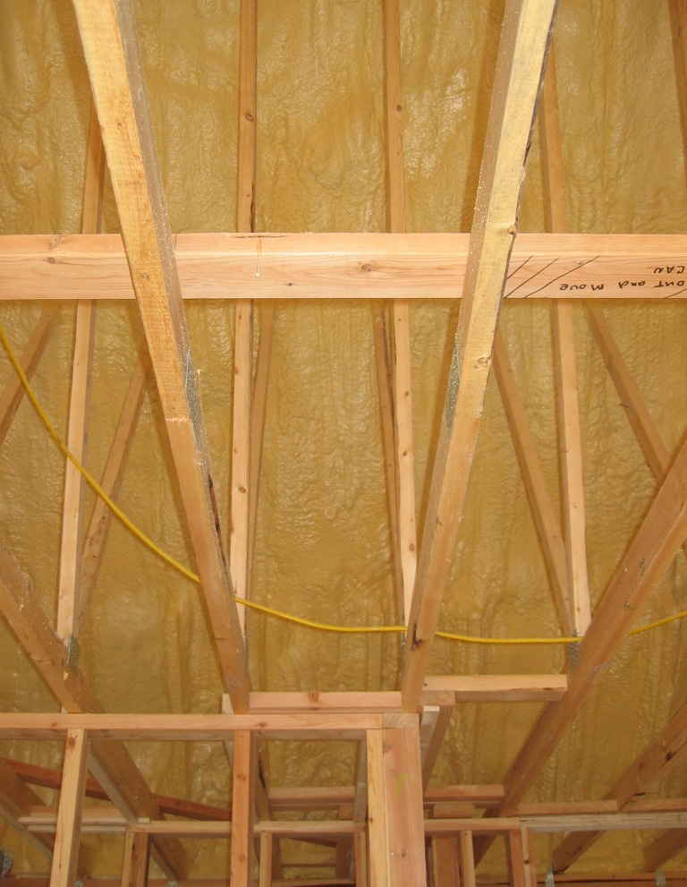
Spray foam insulation applied to underside of sheathing.
Spray foam also improves air-tightness, reducing energy losses.

Slide 23
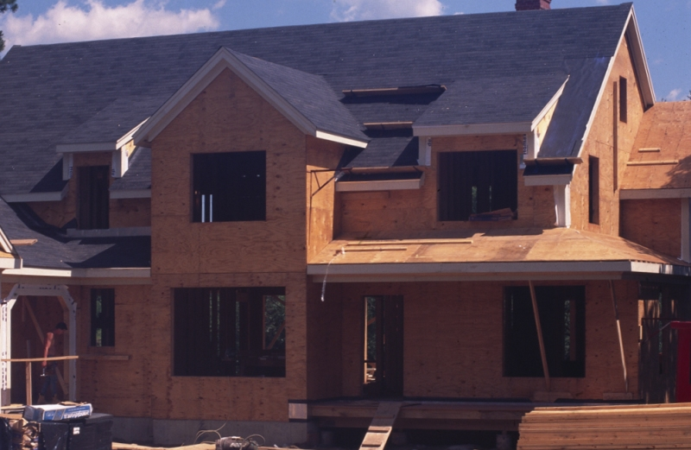
Asphalt composition shingles

Slide 24
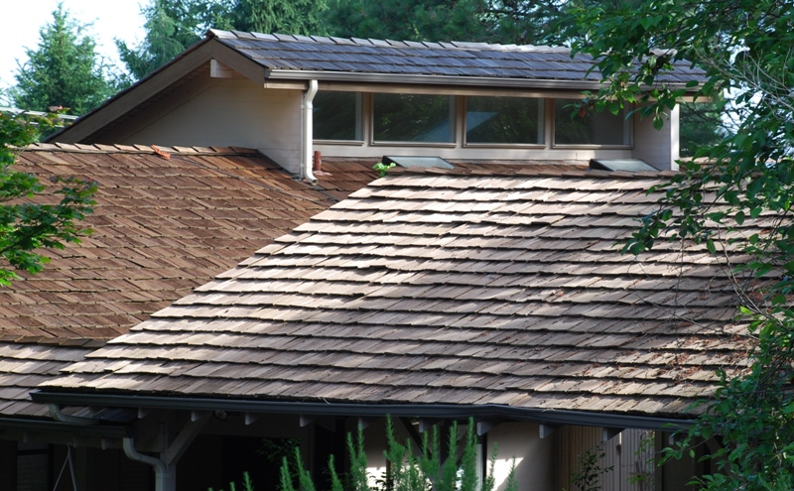
Split wood shakes

Slide 25
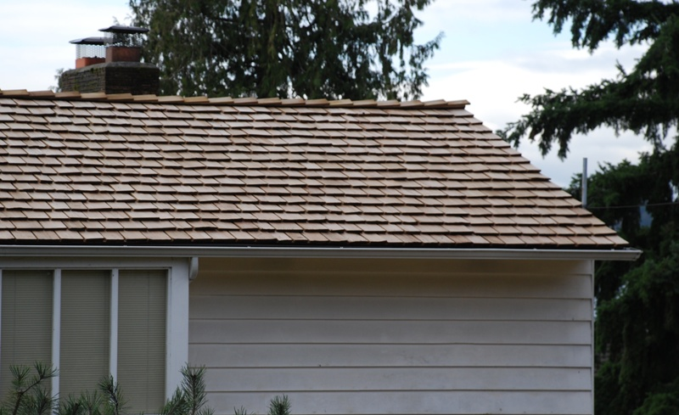
Sawn wood shingles

Slide 26
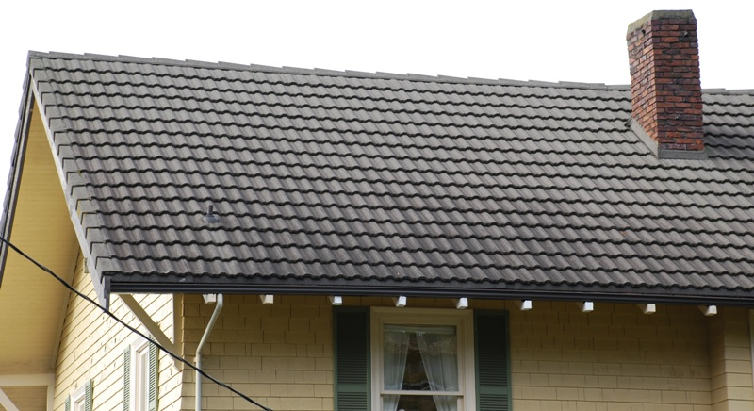
Concrete tile

Slide 27
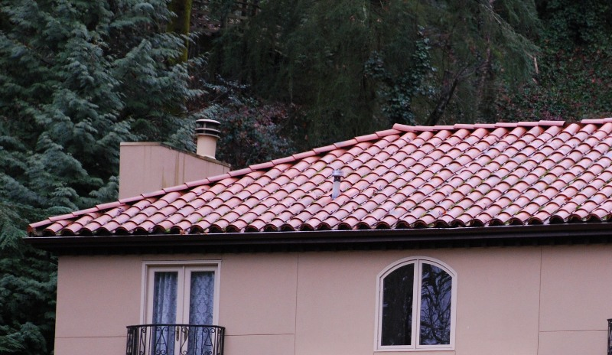
Clay tile

Slide 28
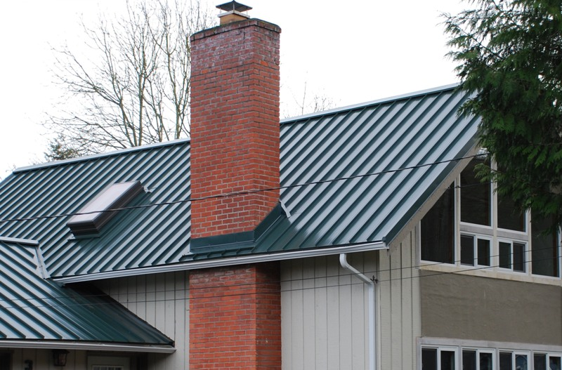
Sheet metal

Slide 29
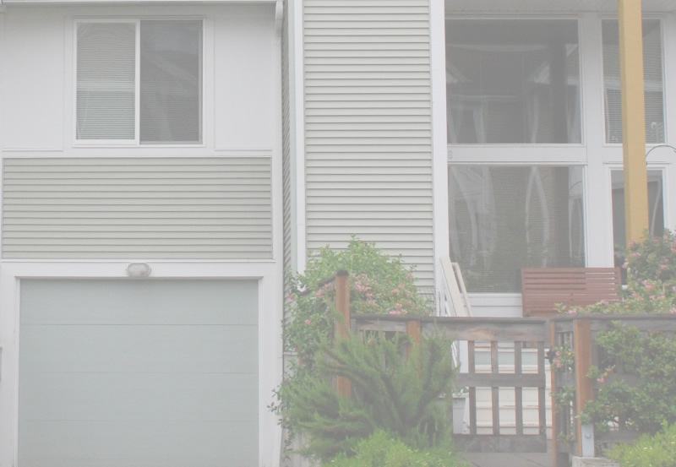
WINDOWS AND DOORS

Slide 30
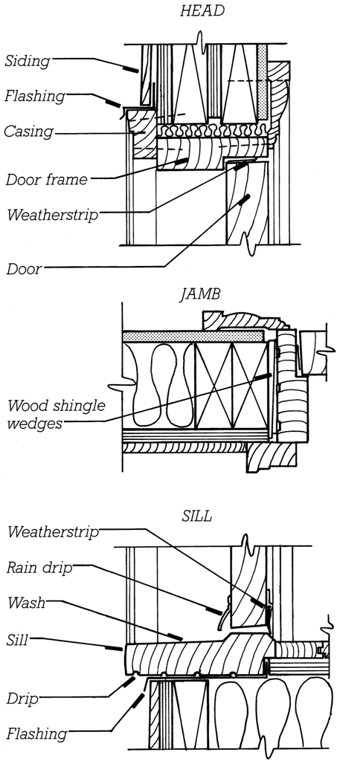
Installing Doors and Windows
Head flashing and sill flashing (sill pan)
Door frame
Tapered shims or shingle wedges
Sill
Exterior and interior casing

Slide 31
Shim space allows for plumbing and squaring of the frame.
Later it is insulated or sealed to reduce heat loss and air leakage.

Slide 32
Flashings
Waterproof membrane or layers that captures water within the assembly and directs it back to the exterior (red at right).

Slide 33
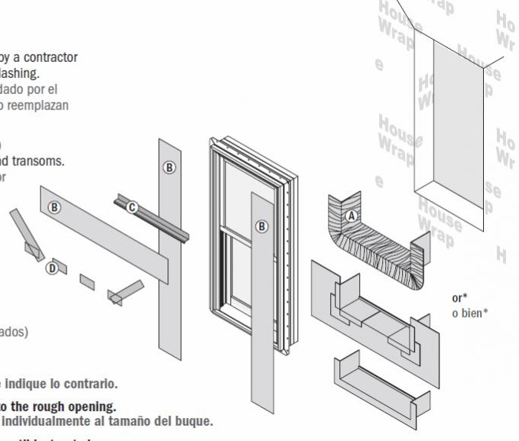
Example manufacturer flashing diagram; Order of installation:
Sill flashings
Window
Jamb flashings
Head flashings

Slide 34
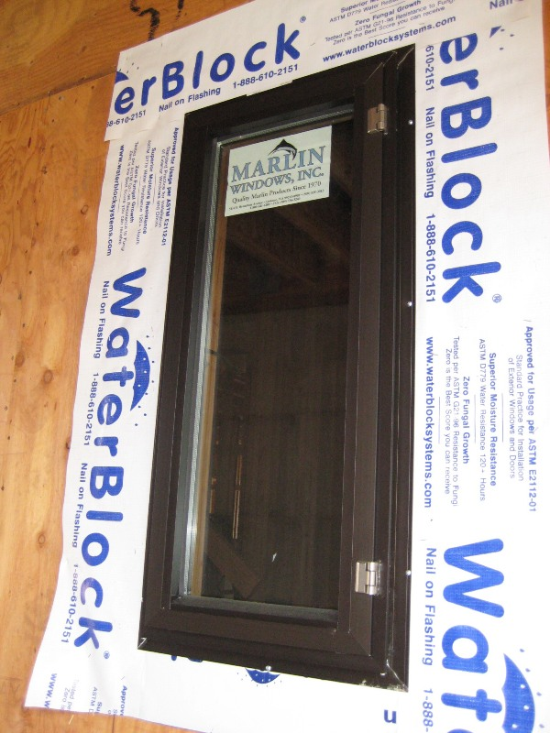
Flashing
Nail flange window installed with synthetic fabric flashing.
Flashing at head laps over the nailing flange, while the side and bottom strips lap under.

Slide 35
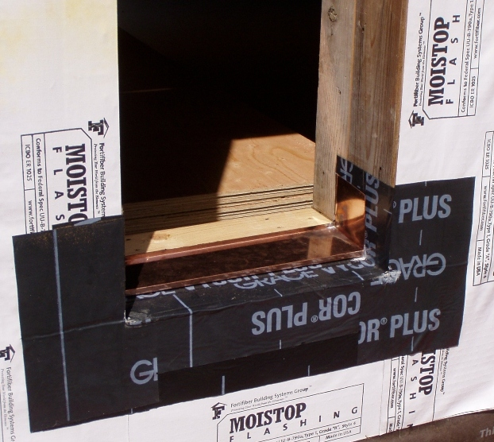
Sill flashing work in progress: Copper pan over self-adhered bituminous flashing, over fabric.

Slide 36
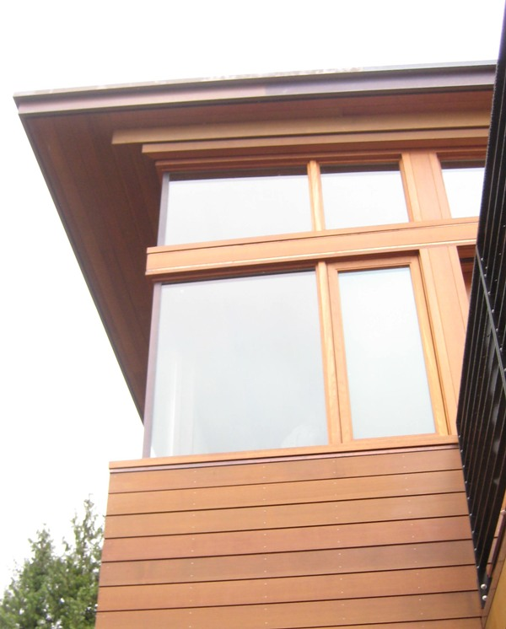
A finished installation of wood windows and horizontal board siding.
Note the head and sill flashings.

Slide 37
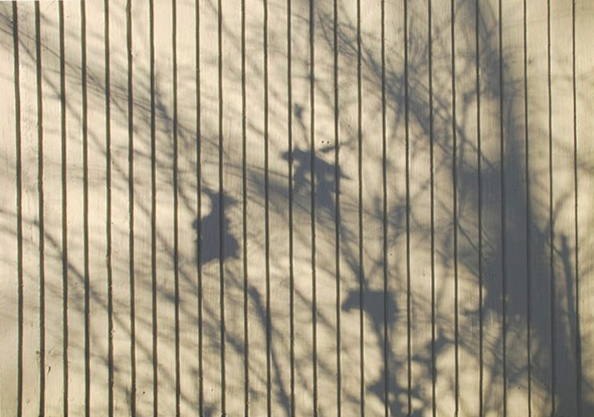
SIDING

Slide 38
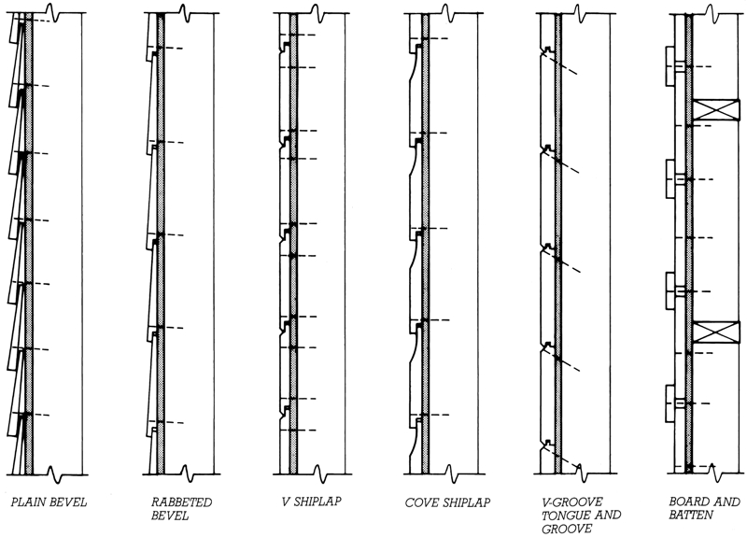
Board Siding
Attachment and overlap allow expansion and contraction of boards.

Slide 39
Board Siding
First four are normally applied horizontally, the last, vertically, and the fifth, either way.

Slide 40
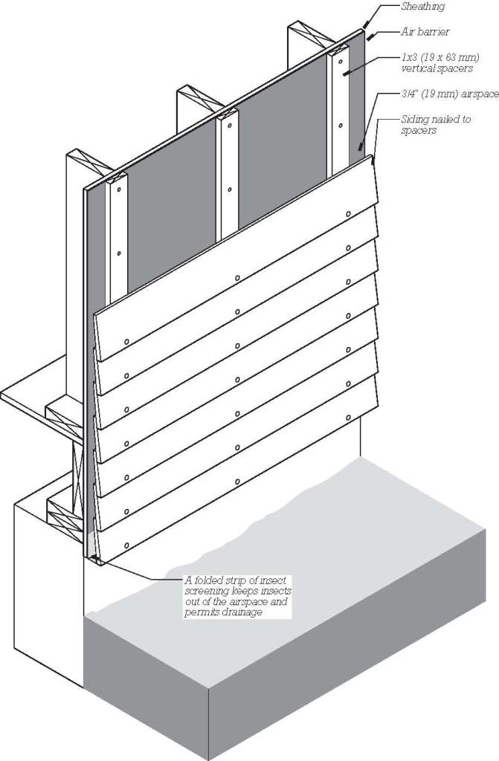
Rainscreen Siding
Vertical furring strips of preservative treated wood or plastic create a continuous airspace behind the siding facilitating water drainage and air flow.

Slide 41
Rainscreen Siding
Screening at the top and bottom of the airspace prevent insect entry.

Slide 42
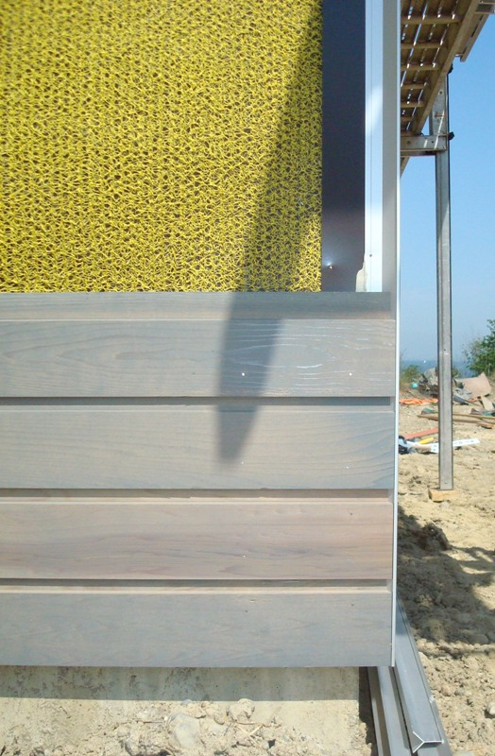
A matting of tangled plastic filament (yellow in this photograph) creates a narrow air space that improves drainage and drying behind the siding without furring.

Slide 43
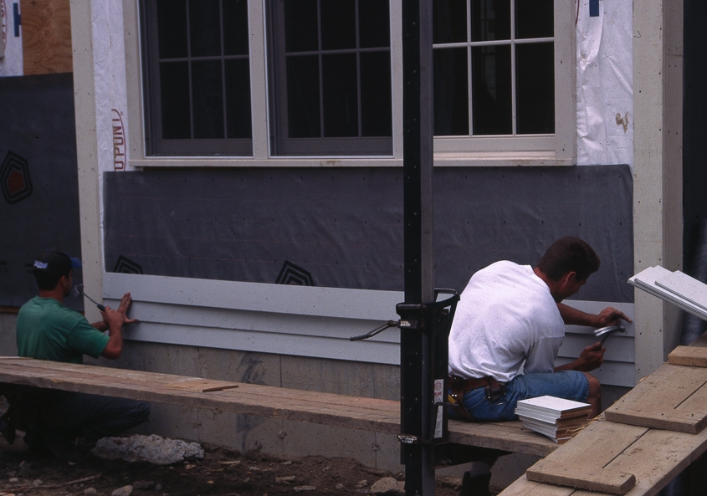
Painted wood clapboards

Slide 44
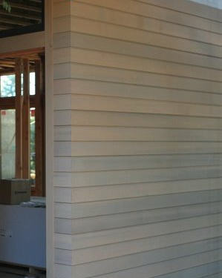
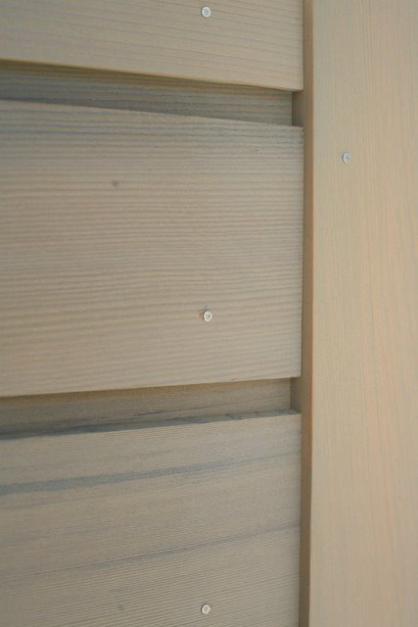
Horizontal board siding with mitered corners (left) and corner board (right)

Slide 45
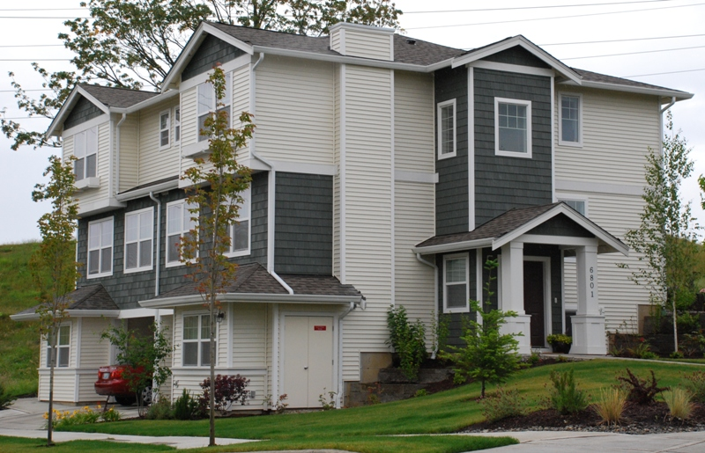
Vinyl and cedar shingle siding

Slide 46
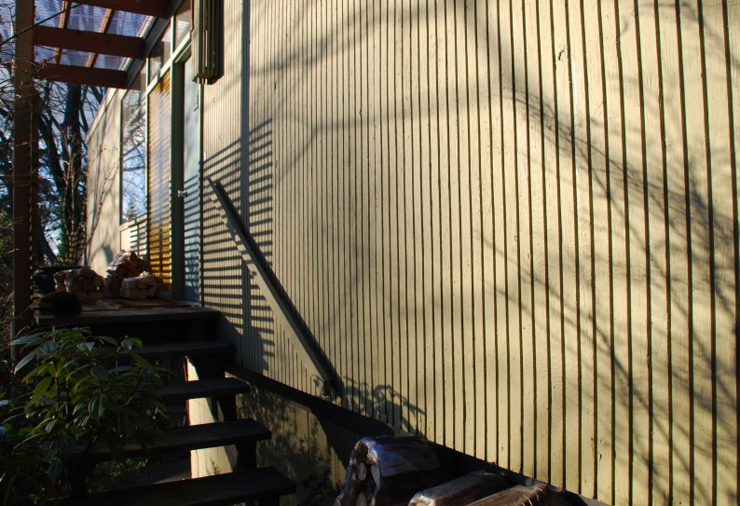
Exterior plywood siding grooved to simulate vertical boards

Slide 47
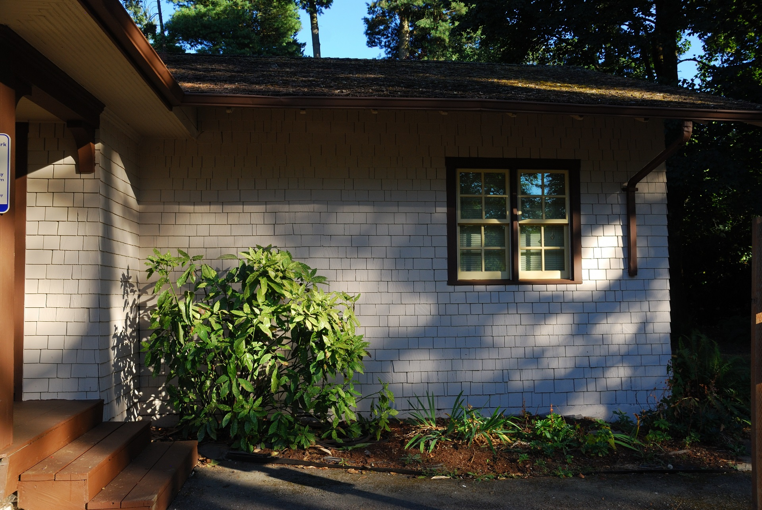
Painted cedar shingles

Slide 48
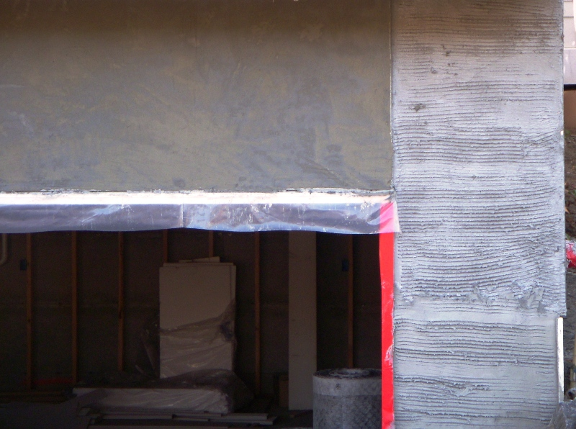
Close-up of stucco work in progress. Right: scratch coat. Left: brown coat.

Slide 49
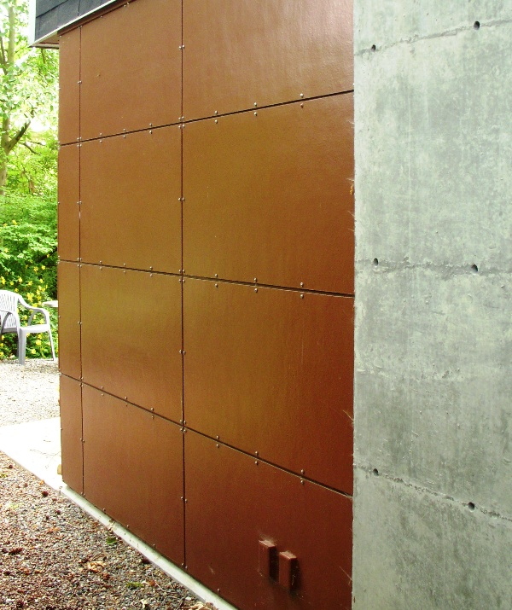
Fiber-cement panel siding adjacent to cast-in-place concrete

Slide 50
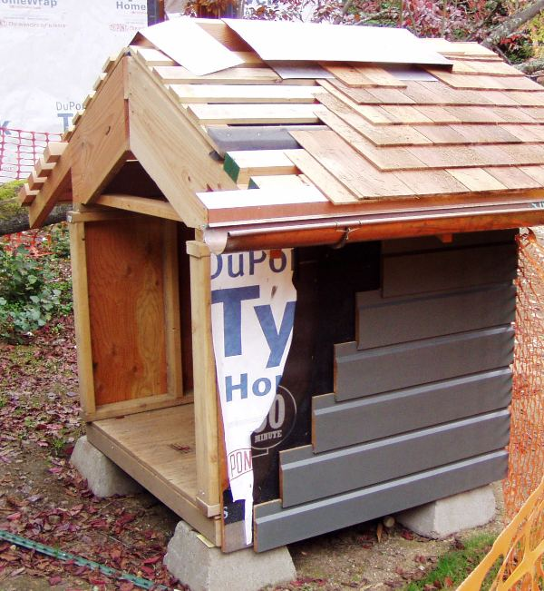
Construction mockup of proposed roofing, siding, and related exterior finish materials and their detailing.

Slide 51
EXTERIOR CONSTRUCTION

Slide 52
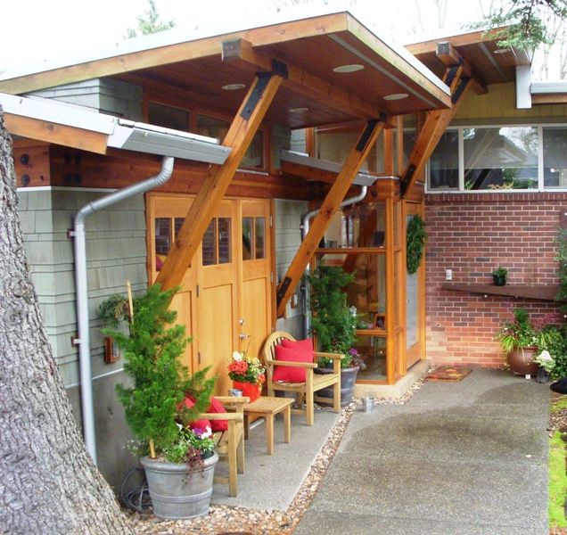
sheet metal trim, gutters, downspouts
soffit vents
steel connection hardware
soffit lighting
shingle siding
wood doors, windows, and trim
concrete paving

Slide 53
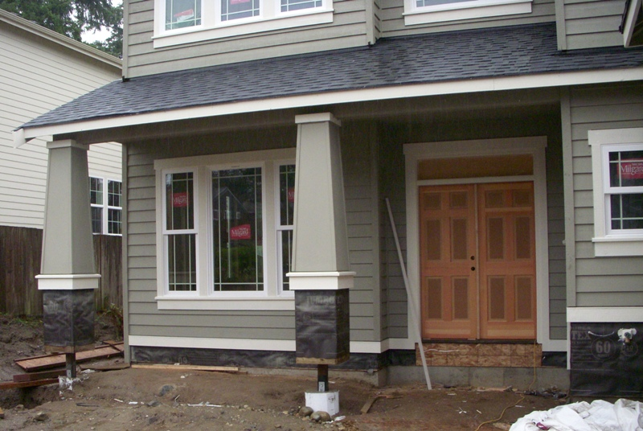
A wood porch with stone veneer column bases in progress

Slide 54
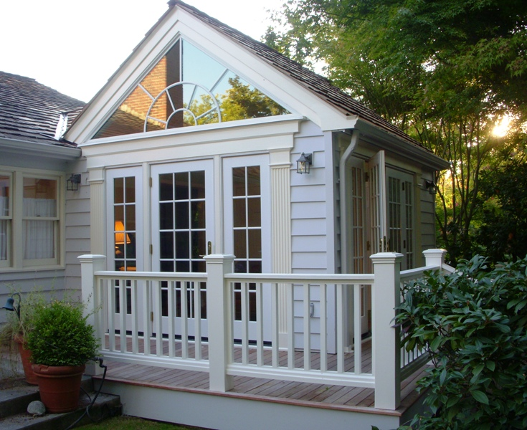
wood doors and windows
wood clapboards and trim
ipe decking
wood deck railings

Slide 55
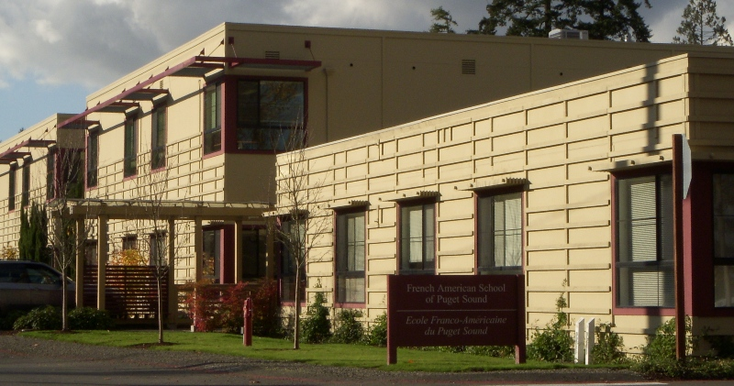
Exterior wood trim and trellises

Slide 56
Ipe wood decking wood frames supported on adjustable plastic pedestals over a protection sheet and low-slope membrane roof.

Slide 57
Exterior ramp of preservative-treated lumber, galvanized steel fasteners, and concrete post bases

Slide 58
Stainless steel flashing protects the top surface of an exterior glulam beam from direct exposure to rain.

