Slide 1
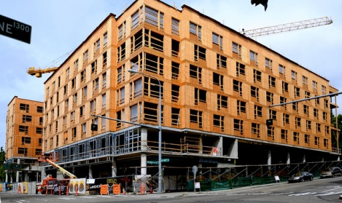
PLATFORM FRAME

Slide 2
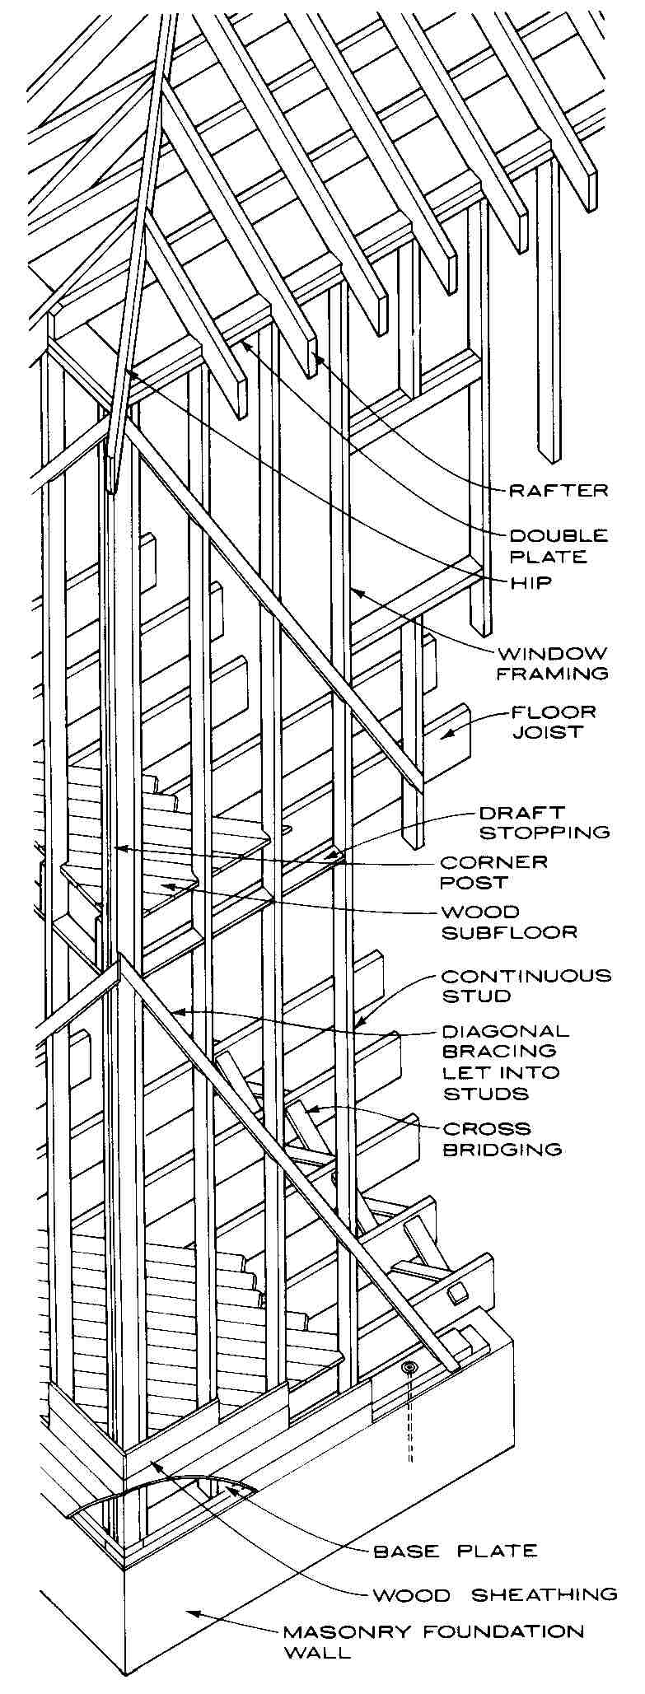
Balloon Frame
Small-dimension members span from ground floor to roof.
North-American invention
Light wood frame uses lighter wood members, simpler nailed connections
Requires less skilled builders

Slide 3
Precursor technologies:
Water- or steam-powered saw mills
Machine-made nails
Railroad transportation

Slide 4
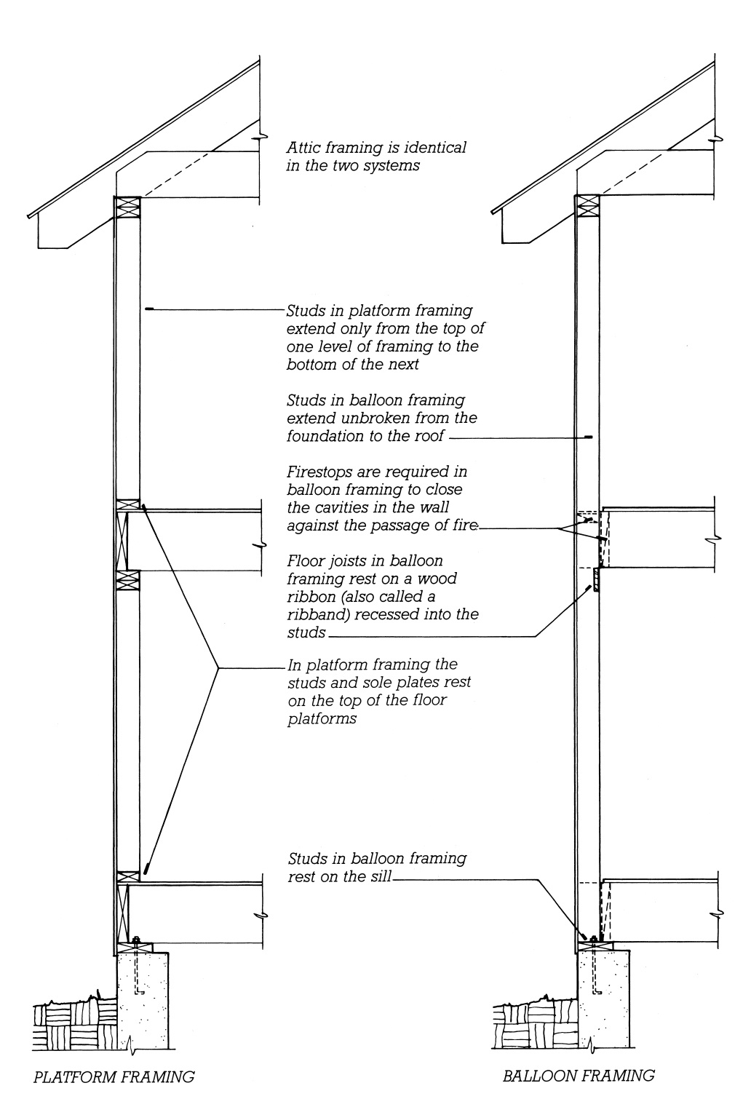
Platform Frame
Relies on shorter length, single-story height members that are easier to produce, handle, and erect.

Slide 5
Platform Framing
Platform…walls…platform…walls…

Slide 6
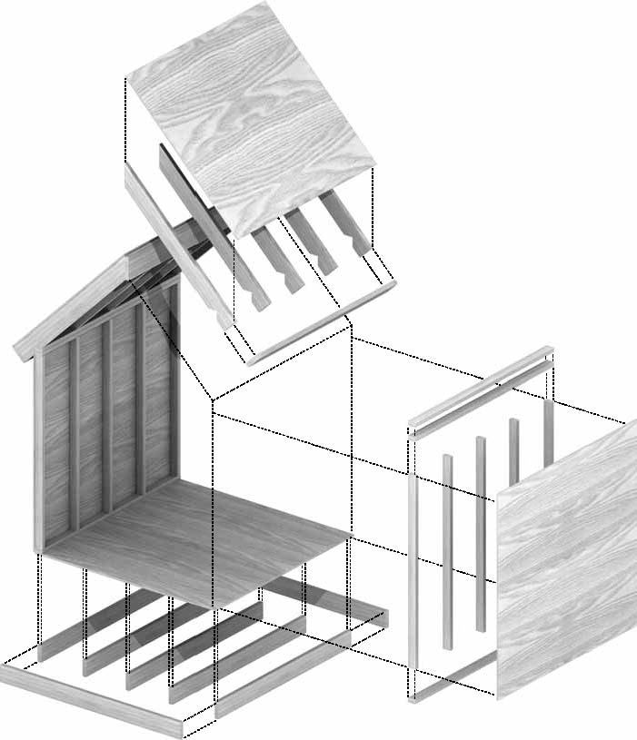
Nominal 2-inch members
Spaced at 16" or 24"
Floor, ceiling joists
Wall studs
Roof rafters

Slide 7
Panels applied over framing:
Floor subflooring
Wall and roof sheathing
OSB, plywood, or other material

Slide 8
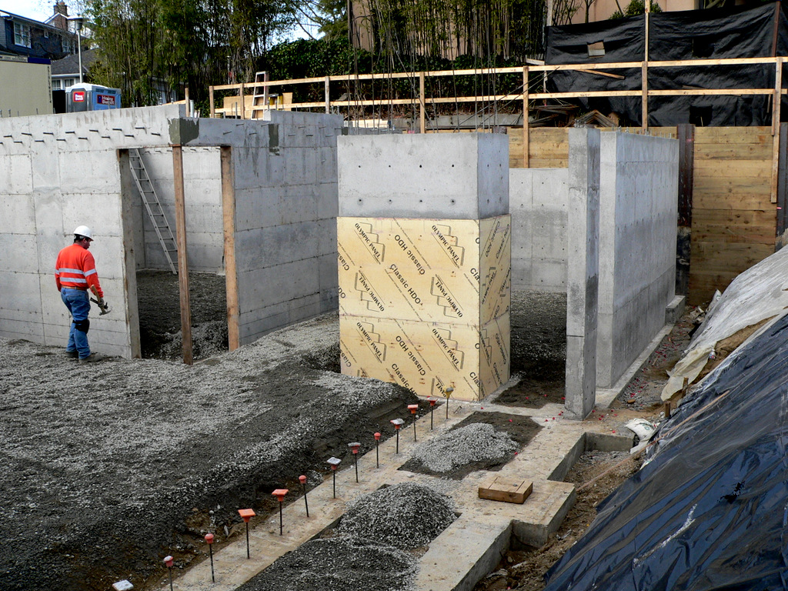
FOUNDATIONS FOR LIGHT FRAME STRUCTURES

Slide 9
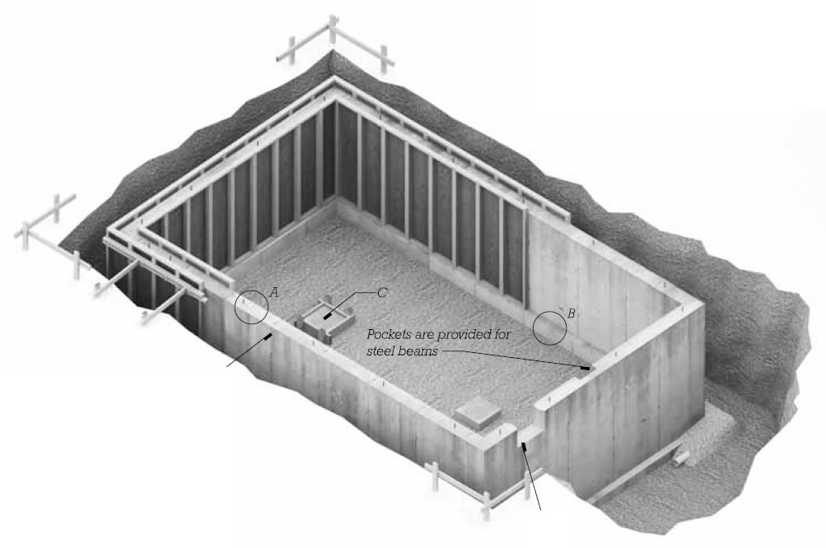
Residential Basement Foundation
Excavation to necessary depth of basement (and at least below the frost line)

Slide 10
Cast-in-place concrete strip footing
Cast-in-place concrete foundation wall, 8" to 12" thick, 8' to 10' tall

Slide 11
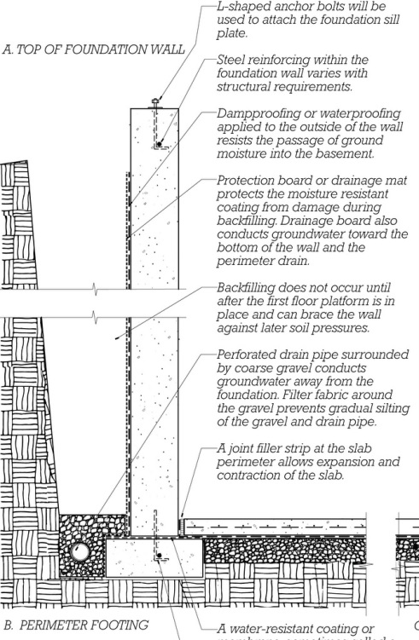
Section
Anchor bolts cast into top of wall
Steel reinforcing top and bottom of wall

Slide 12
Dampproofing or waterproofing on outside of wall
Crushed stone and perforated perimeter drain

Slide 13
Backfill, after floor platform is erected and can brace walls.
Slab on grade may be delayed until structure is closed in.

Slide 14
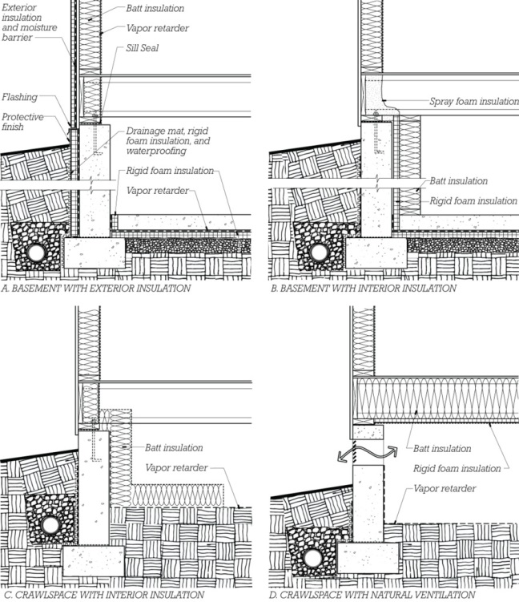
Foundation Insulation
Exterior: Usually board type, resistant to moisture and insects
Interior: Many types; some must be protected from fire.

Slide 15
Crawlspaces may be ventilated to the exterior or treated as interior conditioned space.

Slide 16
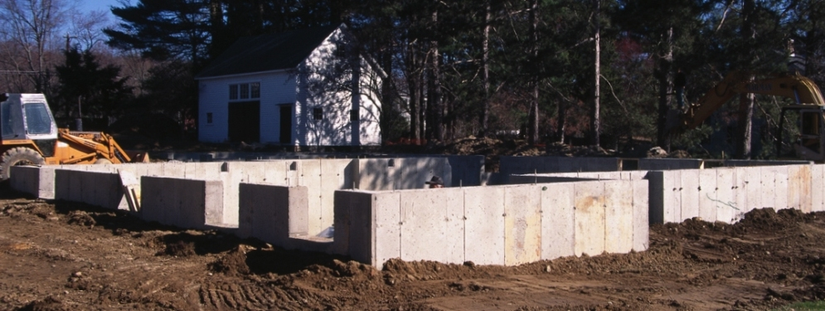
Cast-in-place concrete foundation wall with anchor bolts protruding
Note pockets in far side of concrete wall for setting of floor beams.

Slide 17
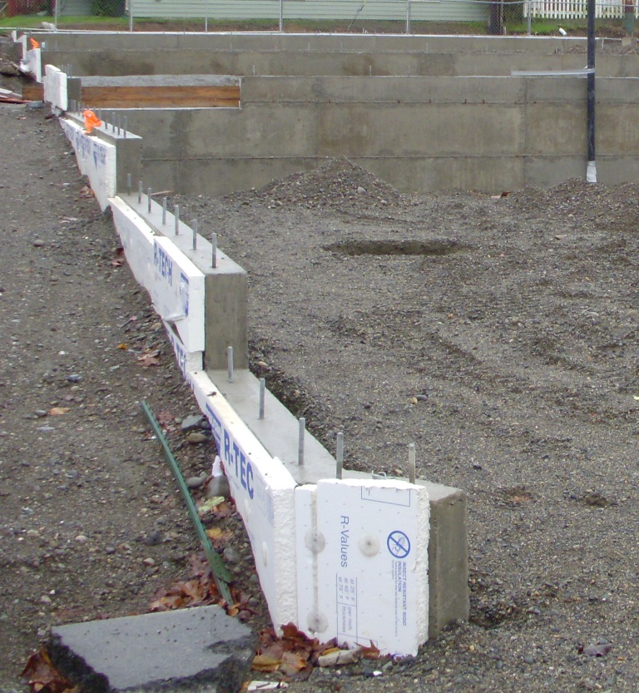
Exterior foundation insulation: Expanded polystyrene rigid foam

Slide 18
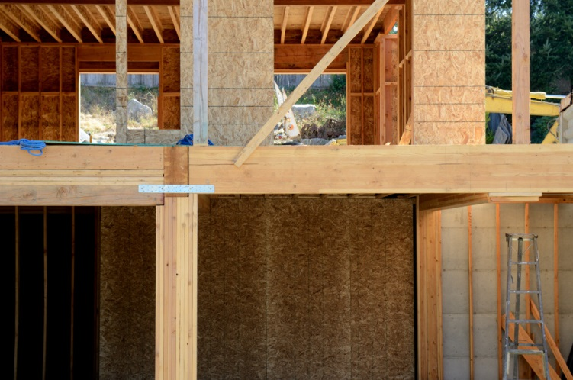
BUILDING THE FRAME

Slide 19
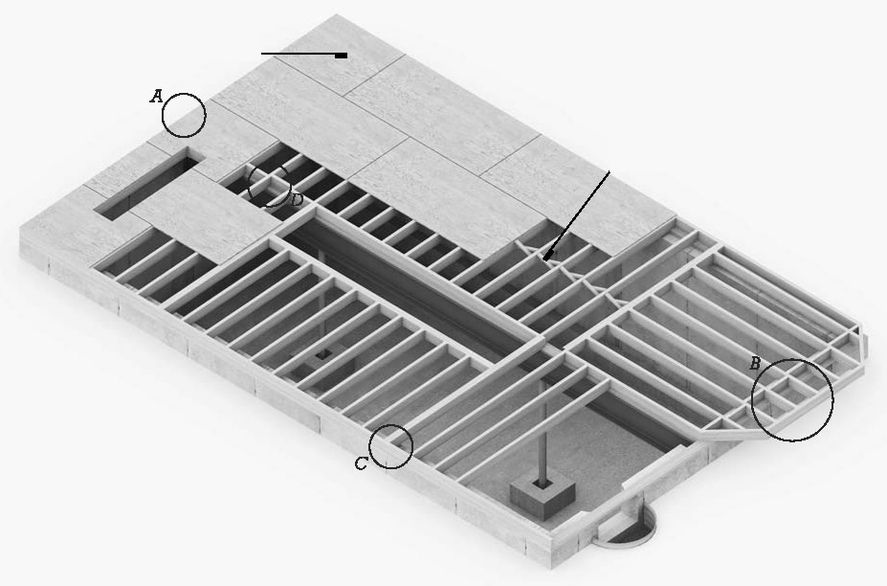
Ground Floor Platform
Sill plates anchored
Girders placed
Floor joists laid
Subflooring applied

Slide 20
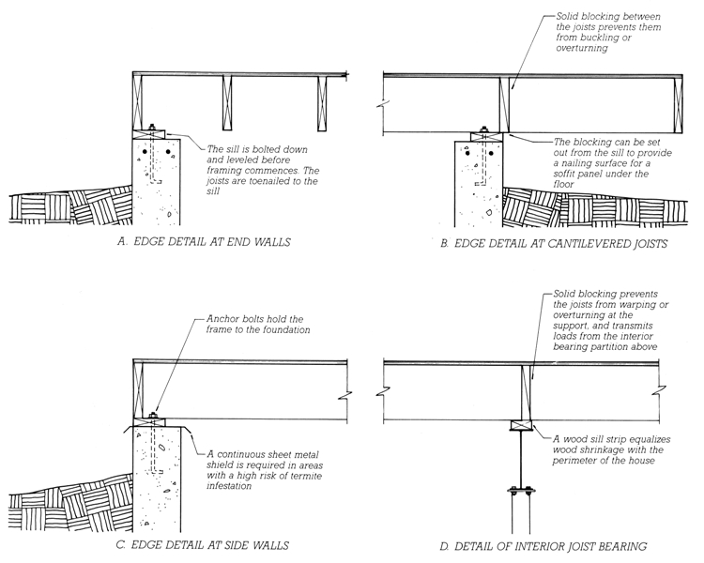
Section
Sill plates anchored
Girders placed
Floor joists laid
Subflooring applied

Slide 21
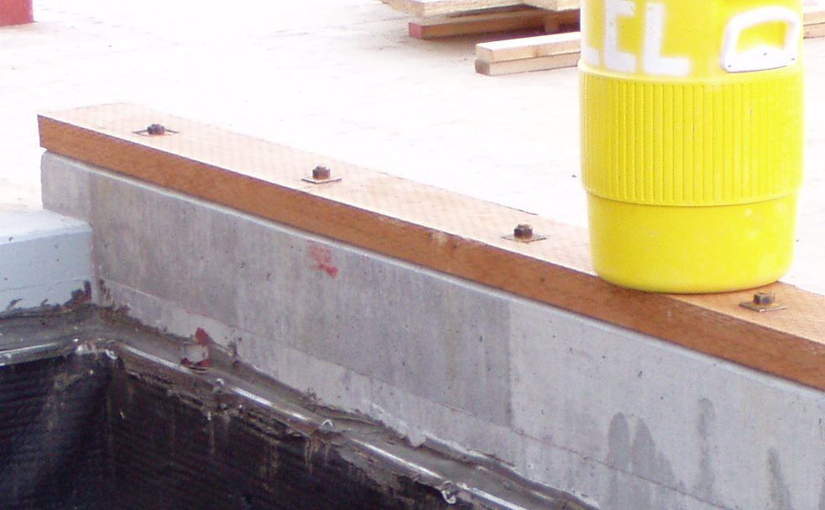
Preservative-treated 3x8 sill plate with closely spaced anchor bolts

Slide 22
Oversized square washers create a stronger sill-to-foundation connection, for resistance to seismic forces.

Slide 23
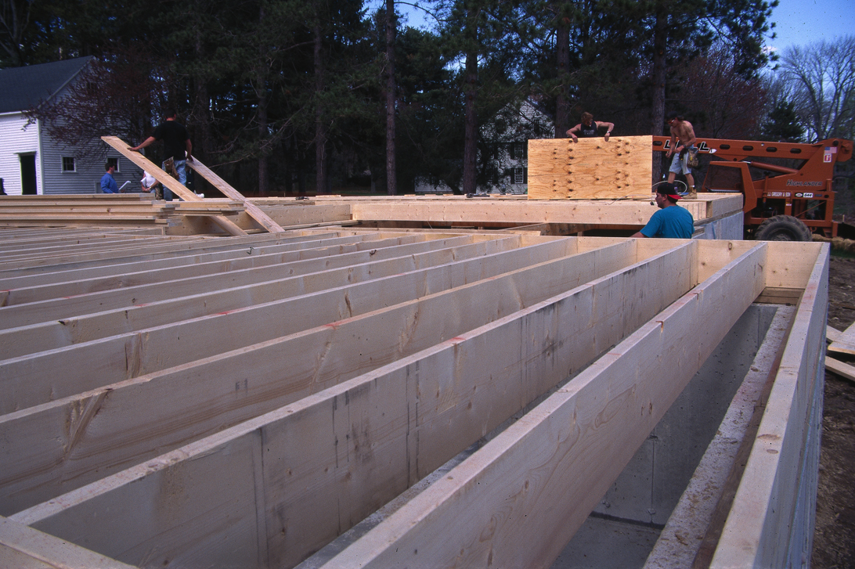
Floor framing with 2x12 solid member joists

Slide 24
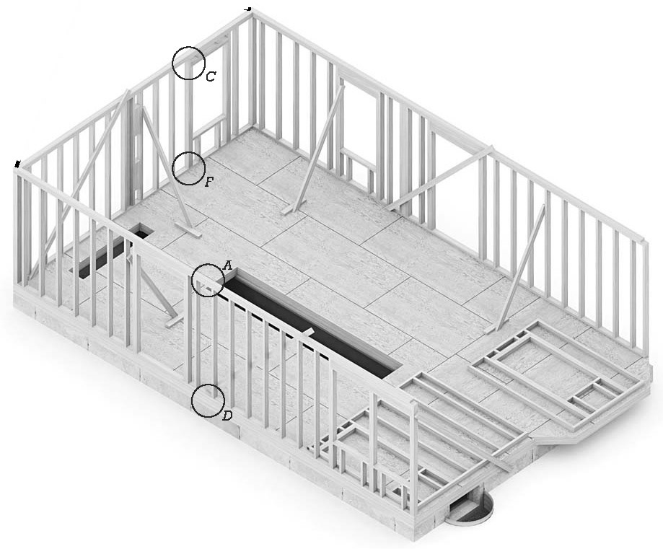
Wall sections are assembled lying down, then tilted into place.
Temporary bracing holds walls in alignment.

Slide 25
Wall sheathing may be applied before the walls are stood up, or later, after the frame is fully erected (as shown here).

Slide 26
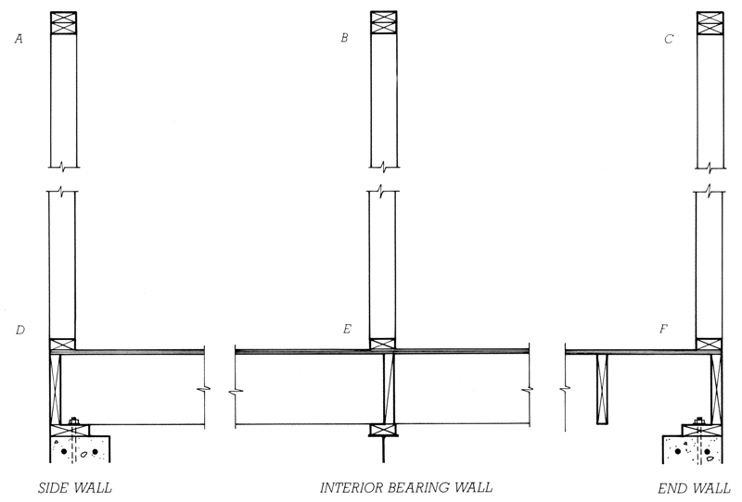
Section:
Bottom plates nailed to floor platform
Studs continuous between top and bottom plates

Slide 27
Top plates are doubled, to support joists or rafters above.
Plates ends are staggered to tie separate wall sections together.

Slide 28
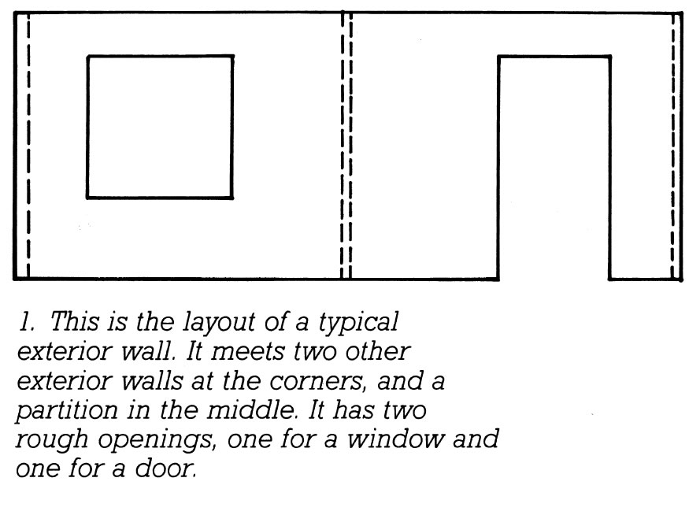
Steps in Framing a Wall
Layout

Slide 29
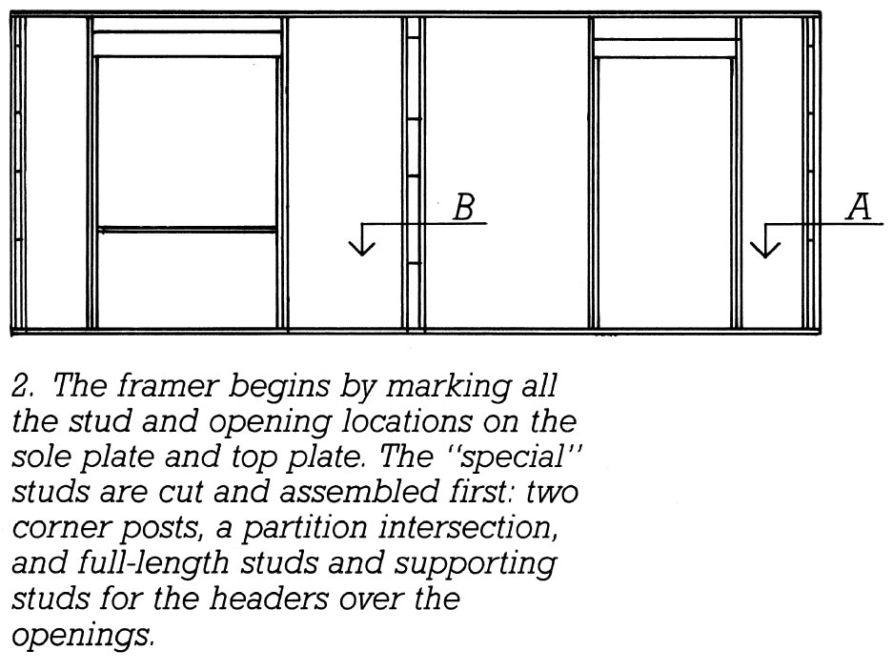
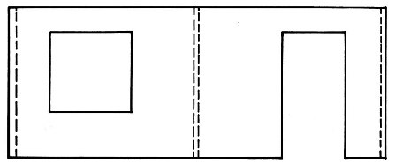
Studs at special locations for openings and corners are inserted first.

Slide 30
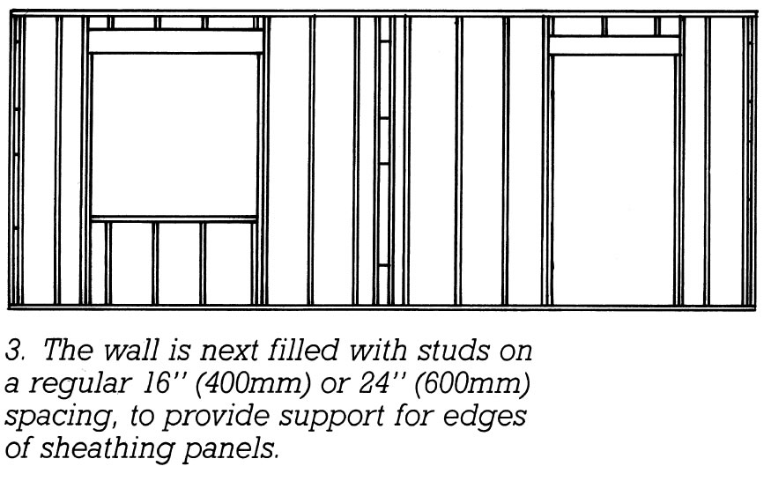
Regular studs spaced at 16” or 24” o.c. are filled in.

Slide 31
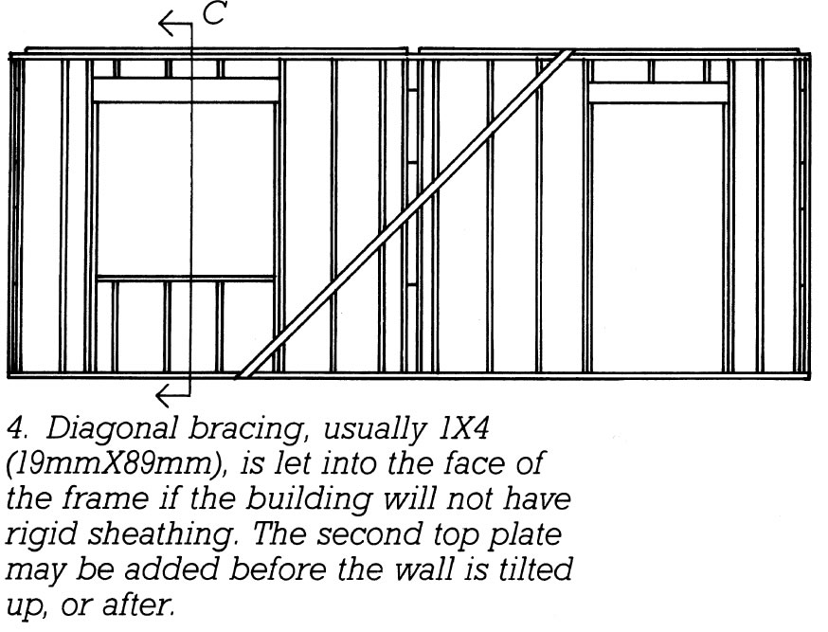
Diagonal bracing or rigid sheathing is applied.

Slide 32
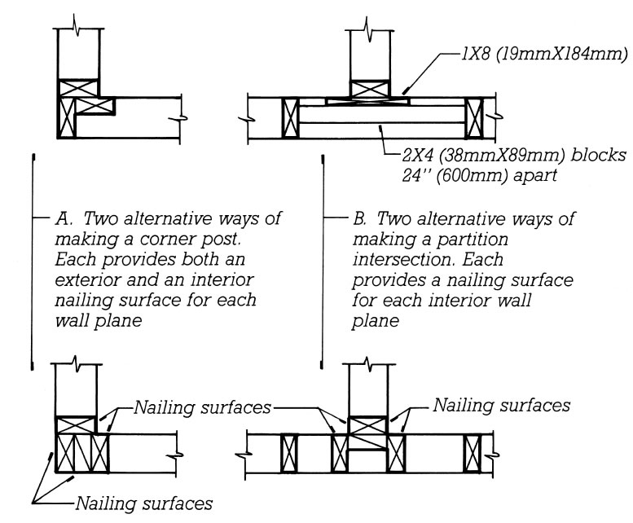
Framing at corners provides nailing surfaces for interior wallboard and exterior sheathing.

Slide 33
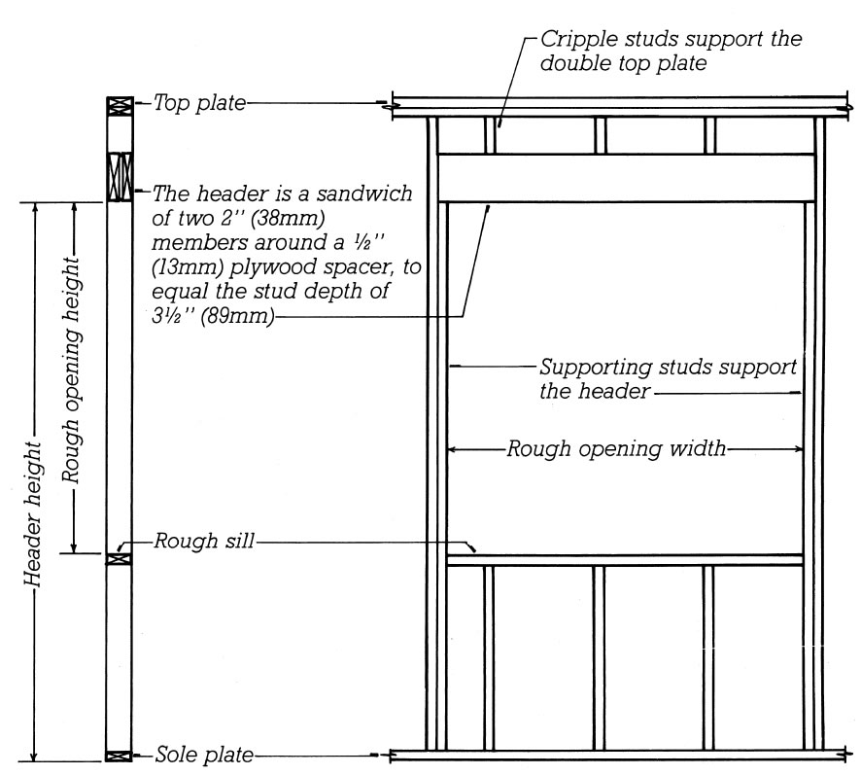
Rough Opening
Jack studs support the header.
The header supports the loads above the opening.

Slide 34
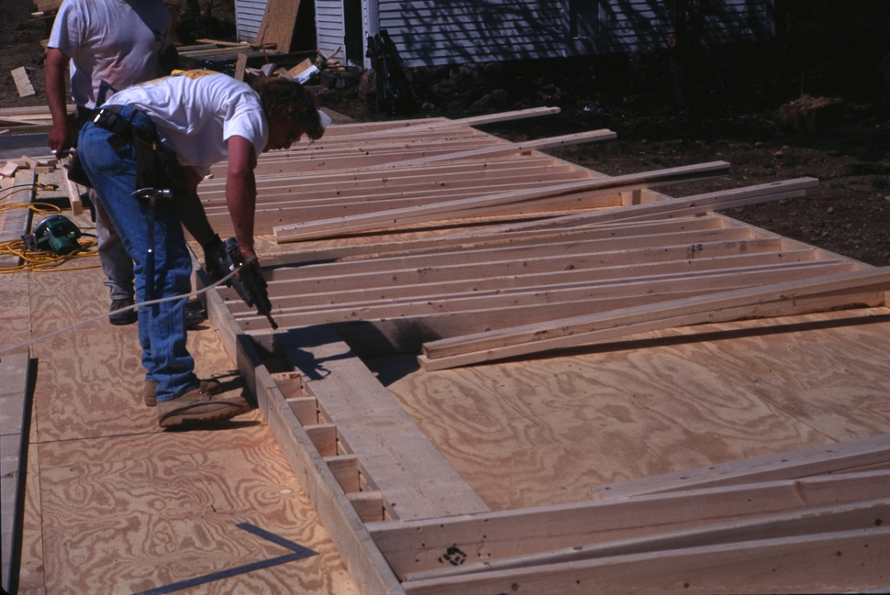
Walls are constructed in sections, lying down on the floor platform and then tilted up into position.

Slide 35
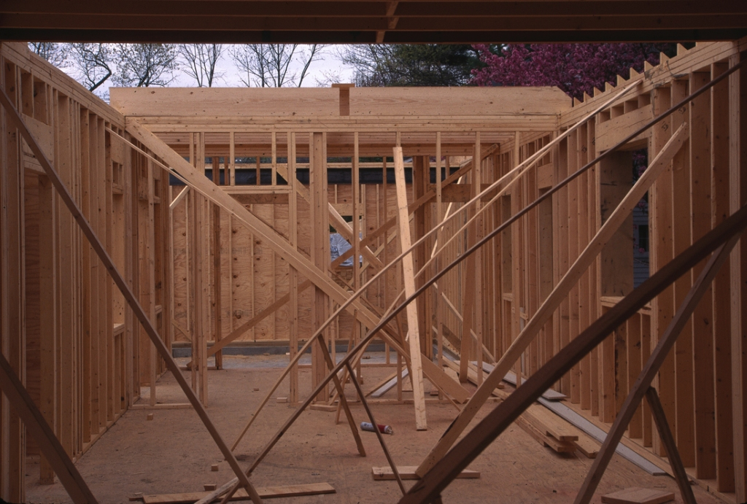
Adjustable, bowed springboards allow precise alignment of the walls.

Slide 36
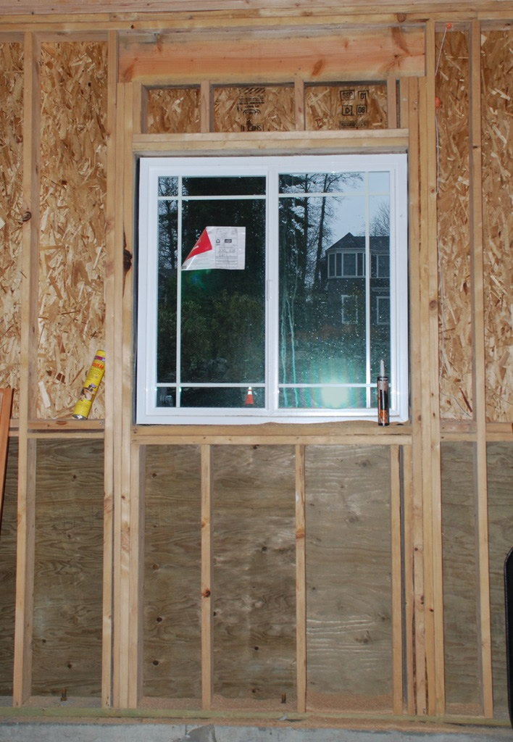
Window rough opening, viewed from the inside, with the window installed.

Slide 37
Bottom section of sheathing is preservative treated plywood, to protect from decay at raised grade on exterior side.
Upper portion is OSB.

Slide 38
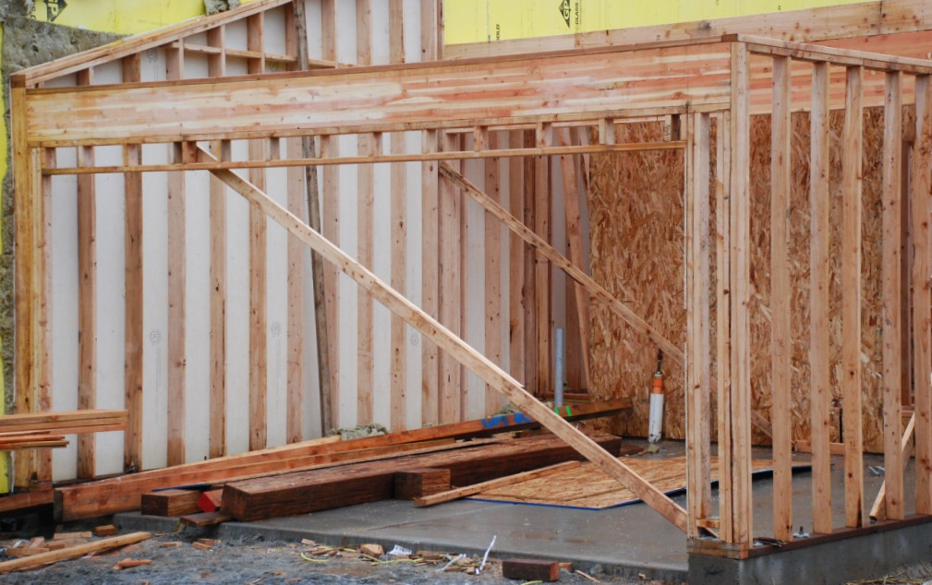
Glulam beam spans large garage door opening.

Slide 39
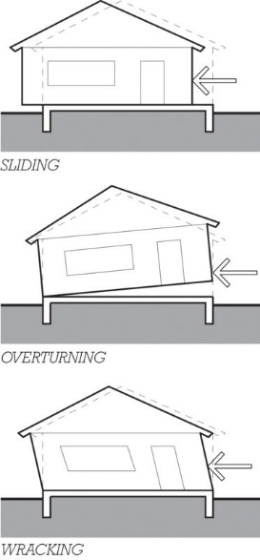
Lateral Force Resistance
Sliding
Overturning
Wracking
Failure among among parts

Slide 40
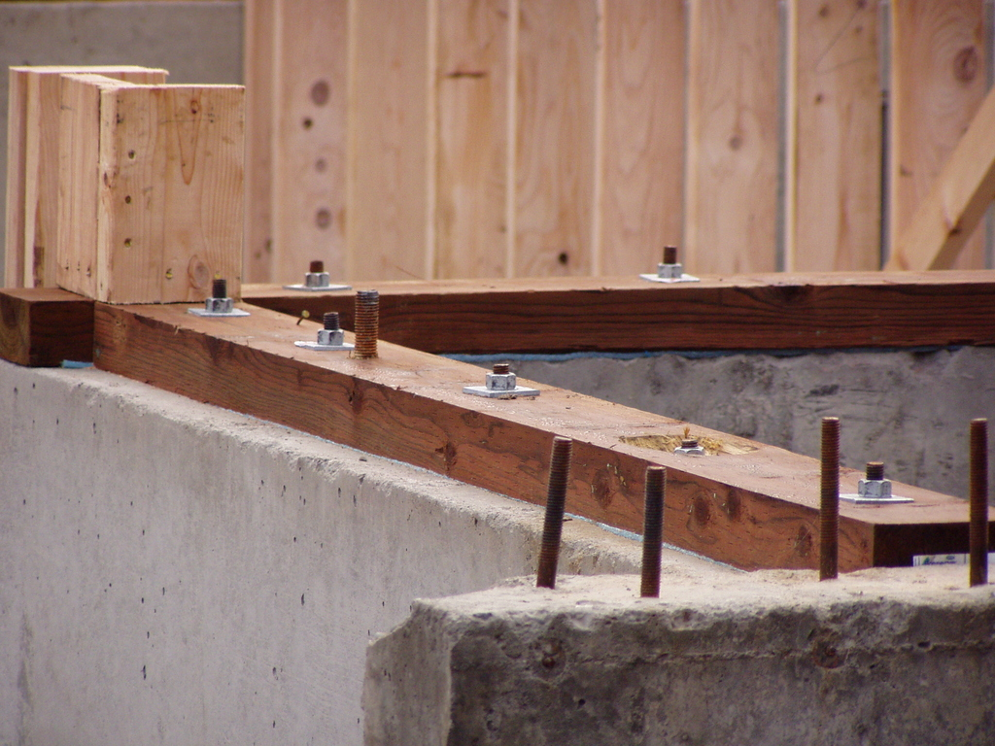
Anchor bolts resist sliding.

Slide 41
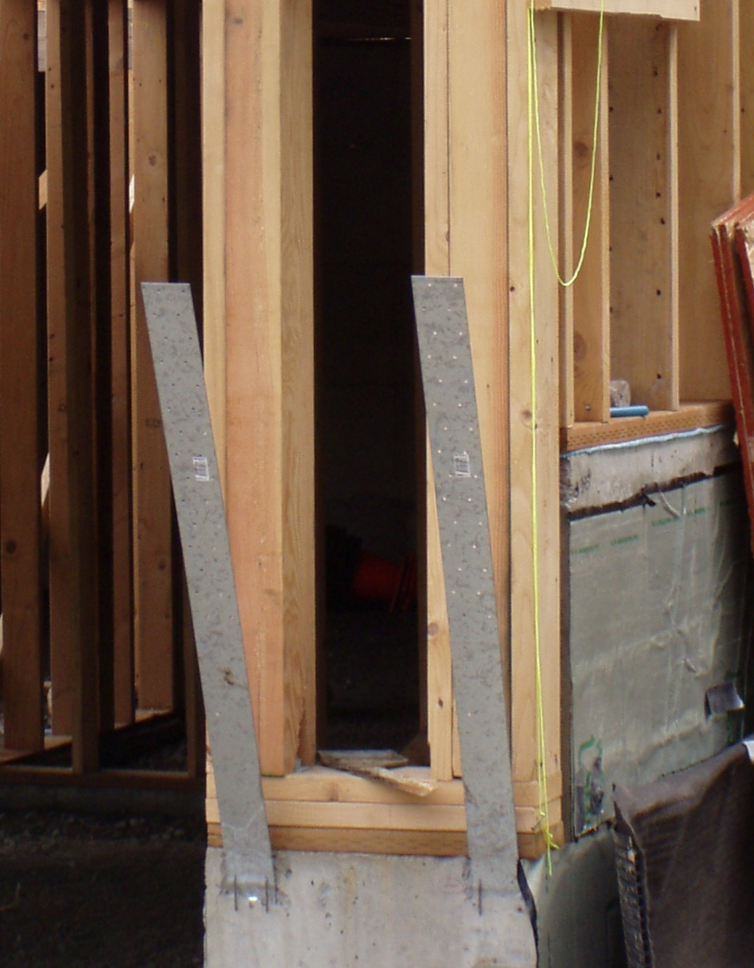
Hold-downs resist overturning.
(Will be nailed over sheathing after sheathing is applied).

Slide 42
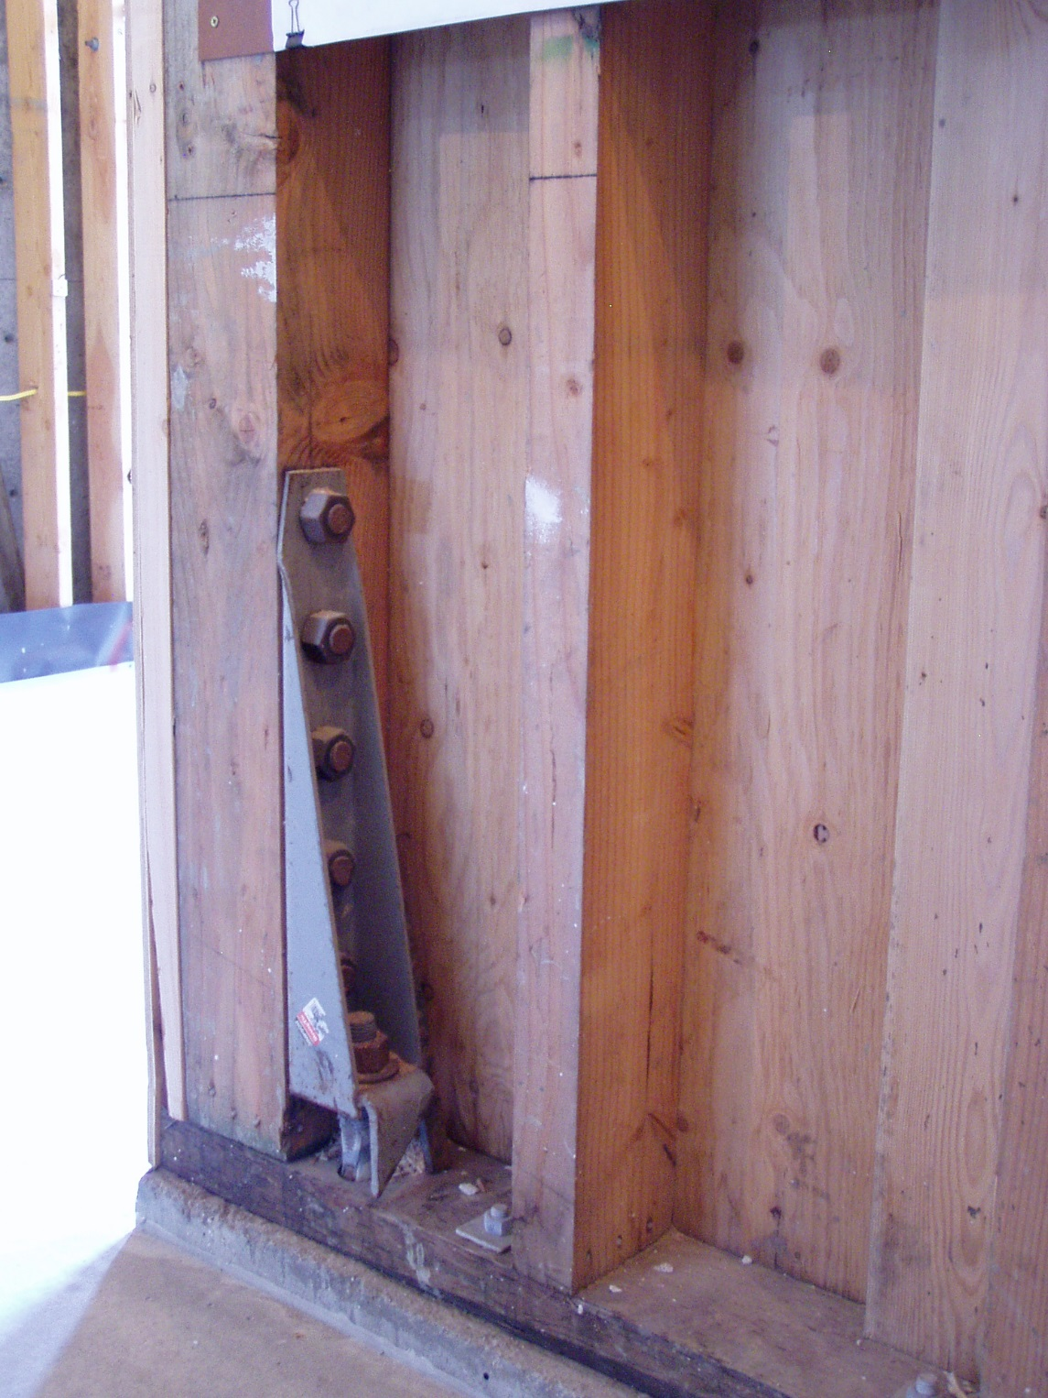

Slide 43
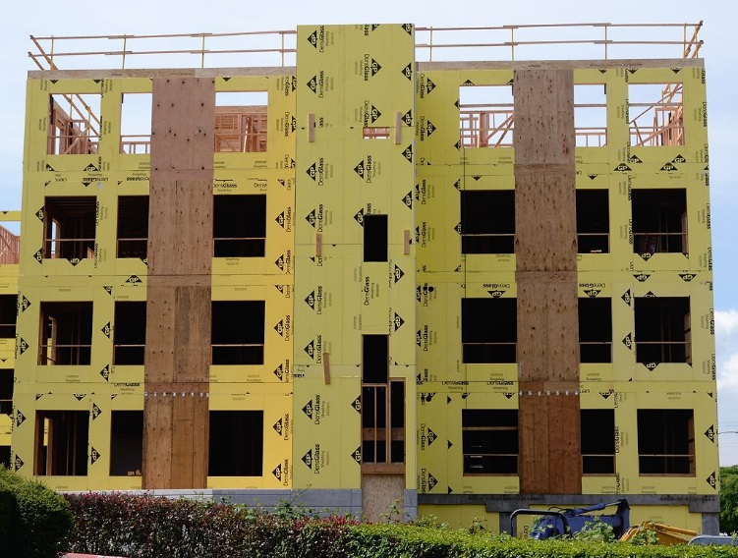
Shear walls resist wracking:
Plywood sheathing

Slide 44
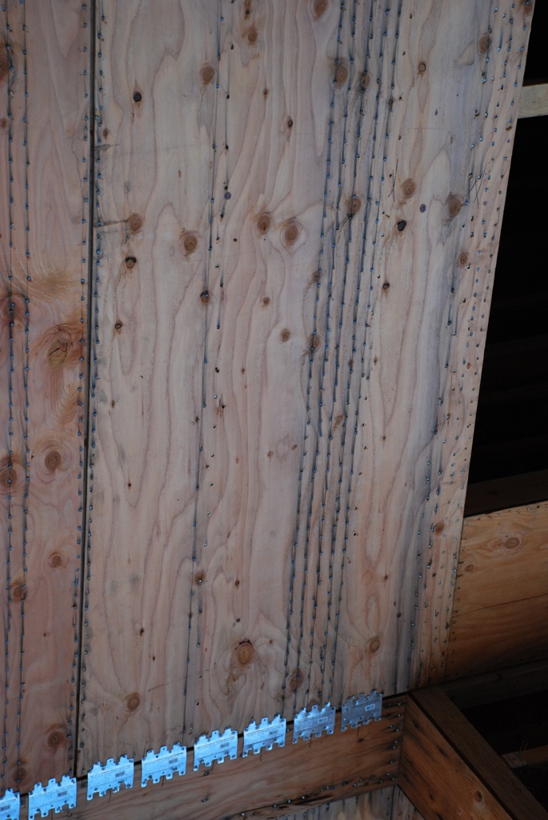
With high lateral forces, special nailing is required to ensure adequate load transfer.

Slide 45
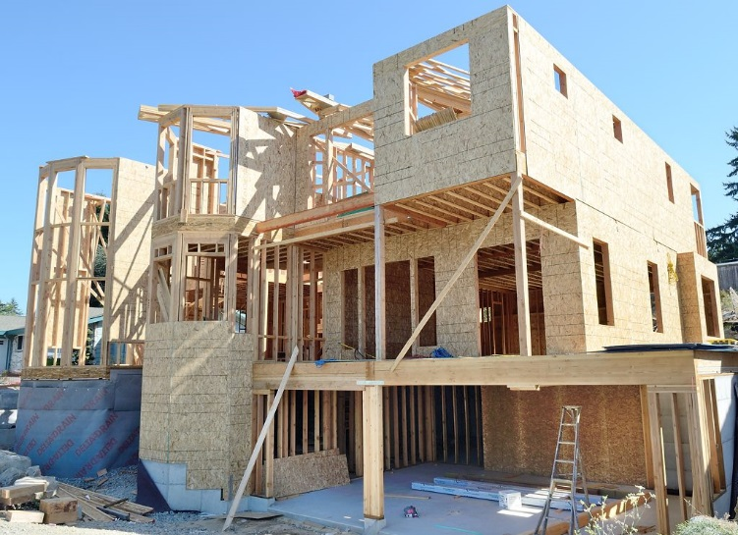
Any solid sheathed area may act as a shear wall.
Interior walls, properly constructed, can also act as shear walls.

Slide 46
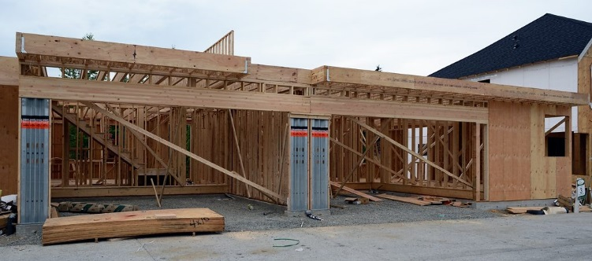
Higher strength prefabricated assemblies may be used where solid wall area is limited.

Slide 47
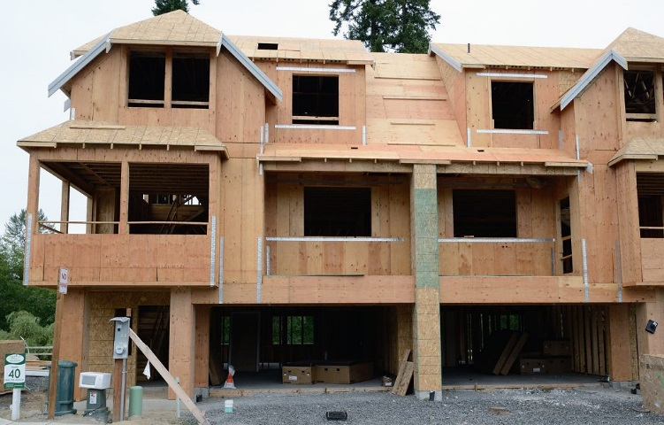
Metal strapping is one form of collector used to transfer forces between parts.

Slide 48
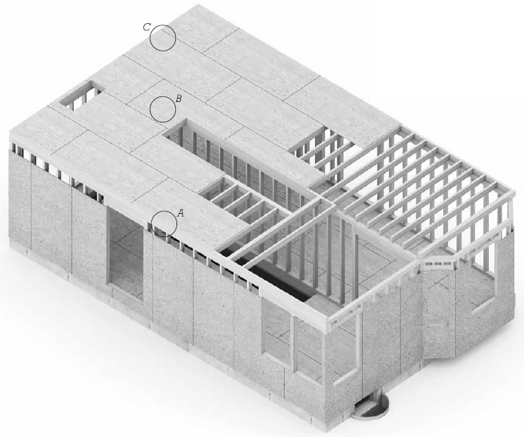
Upper Floor Platform
Upper floor framing much the same as ground floor.

Slide 49
Section
Rim joists and interior blocking close off joist spaces and prevent the joists from tipping.

Slide 50
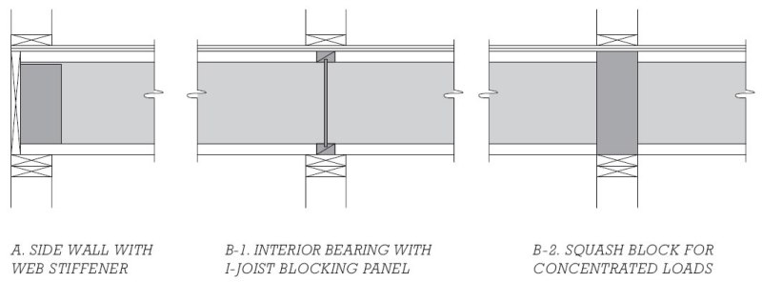
With I-joists, the thinber webs require stiffeners, blocking, or squash blocks to support loads from above.

Slide 51
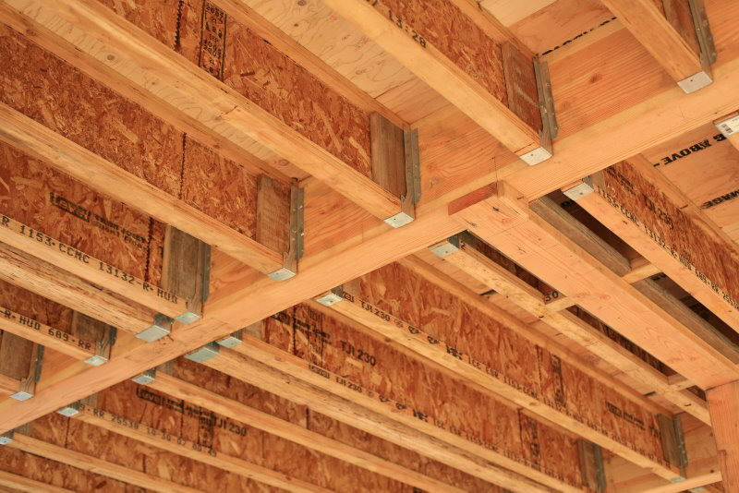
I-joist framing seen from below.
Note web stiffeners at joist ends.

Slide 52
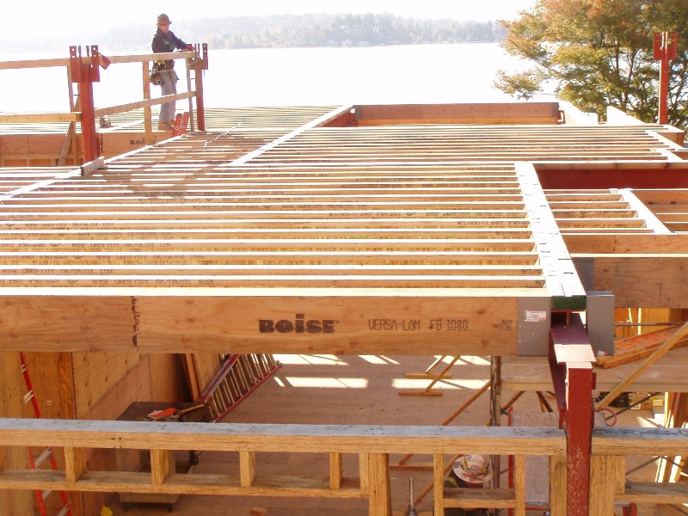
I-joist framing seen from above.

Slide 53
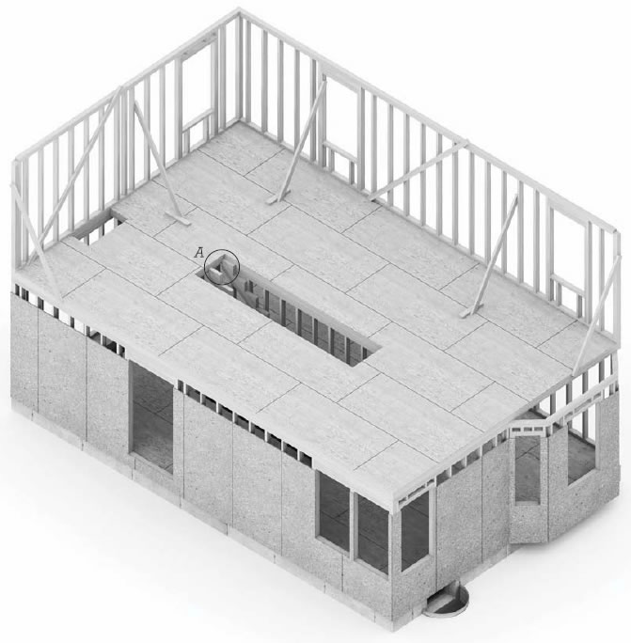
Upper Floor Walls
Each floor platform makes a convenient work surface for building the next set of walls.

Slide 54
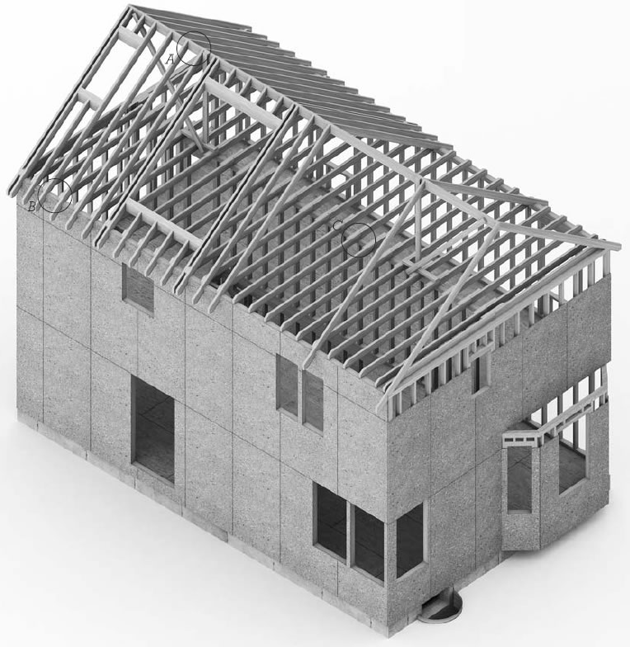
Roof Framing
Ceiling joists and roof rafters are erected on top of the upper floor walls.

Slide 55
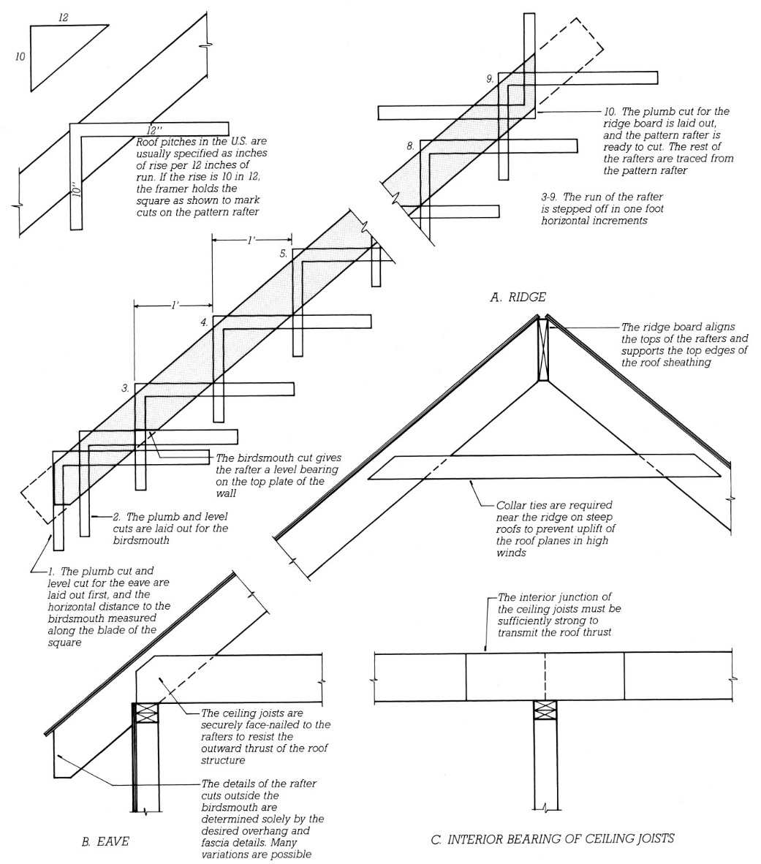
A knowledgeable framer can lay out all cuts on a sloped rafter with nothing more than a traditional framing square and pencil.

Slide 56
Collar ties, close to the upper ends of the rafters, resist wind uplift forces.
Ceiling joists, close to the lower ends of rafters, resist the rafter horizontal spreading forces that could cause the walls to spread outward.

Slide 57
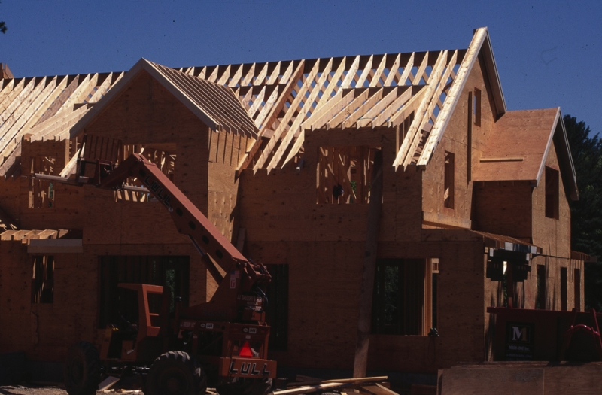
Solid lumber rafters in a gable roof and dormer.

Slide 58
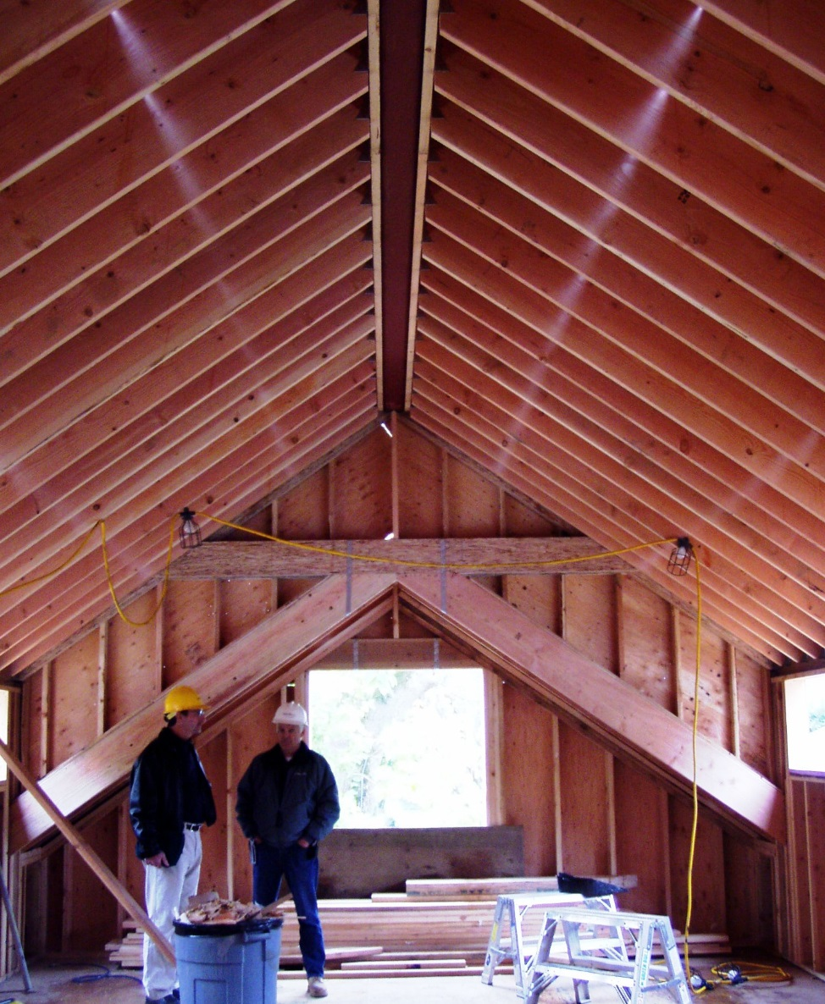
When rafters are not tied at the lower ends, a structural ridge beam (steel in this example) is required to prevent the ridge from sagging and the rafters from pushing outward on the tops of the walls.

Slide 59
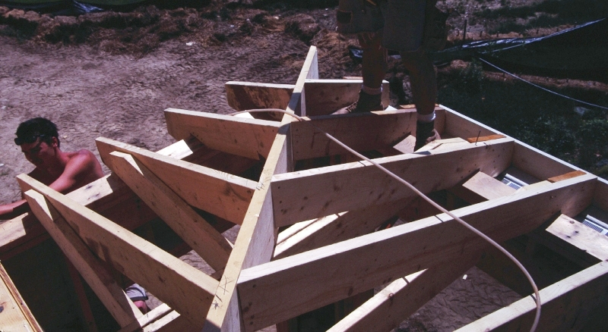
The complex cuts required for hip or valley framing can also be laid out with just a framing square.

Slide 60
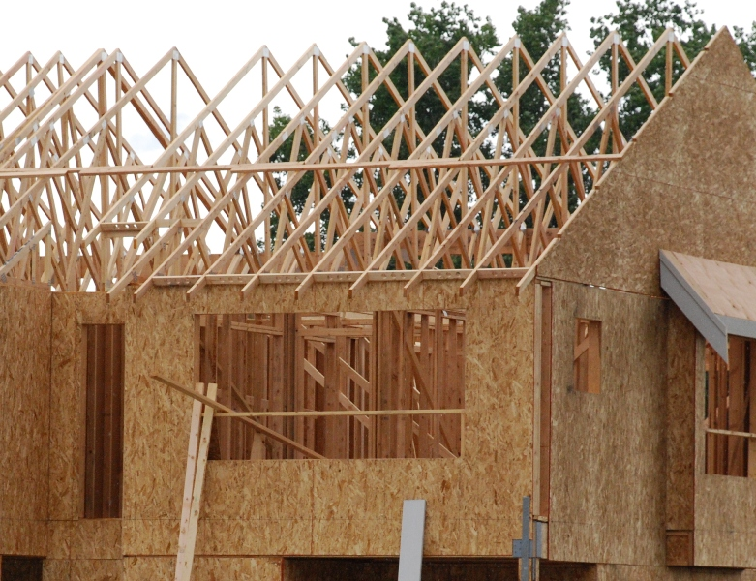
Pre-fabricated roof trusses with temporary bracing

Slide 61
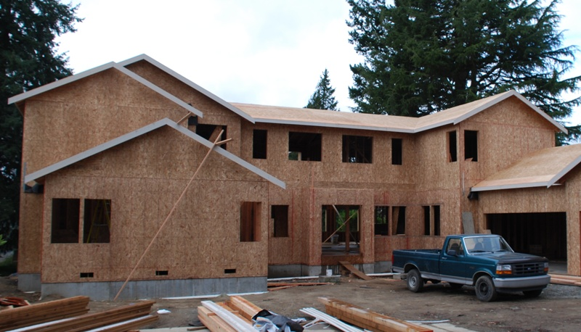
A fully framed and sheathed structure.
Finish carpentry work at the roof eaves has begun.

