Slide 1
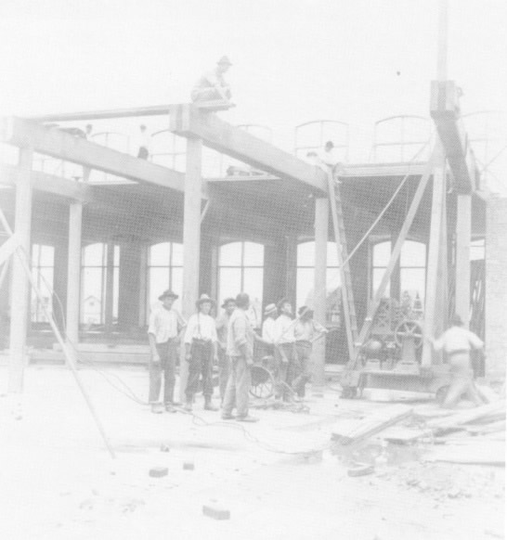
FIRE-RESISTIVE HEAVY TIMBER CONSTRUCTION

Slide 2
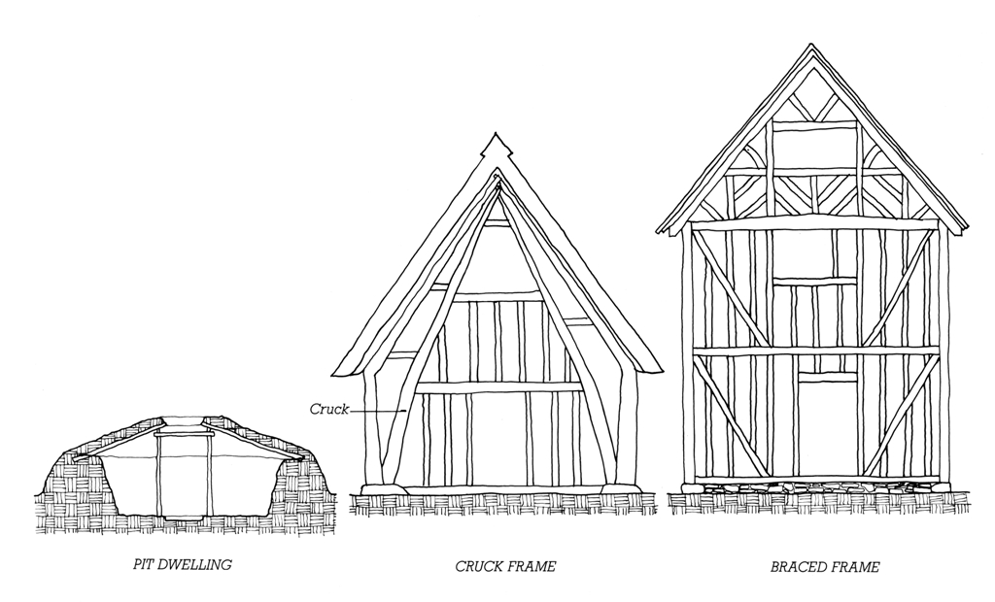
History
Simple timber-framed structures appear with the oldest know civilizations.
Traditional braced frame structure: First appears in the middle ages.

Slide 3
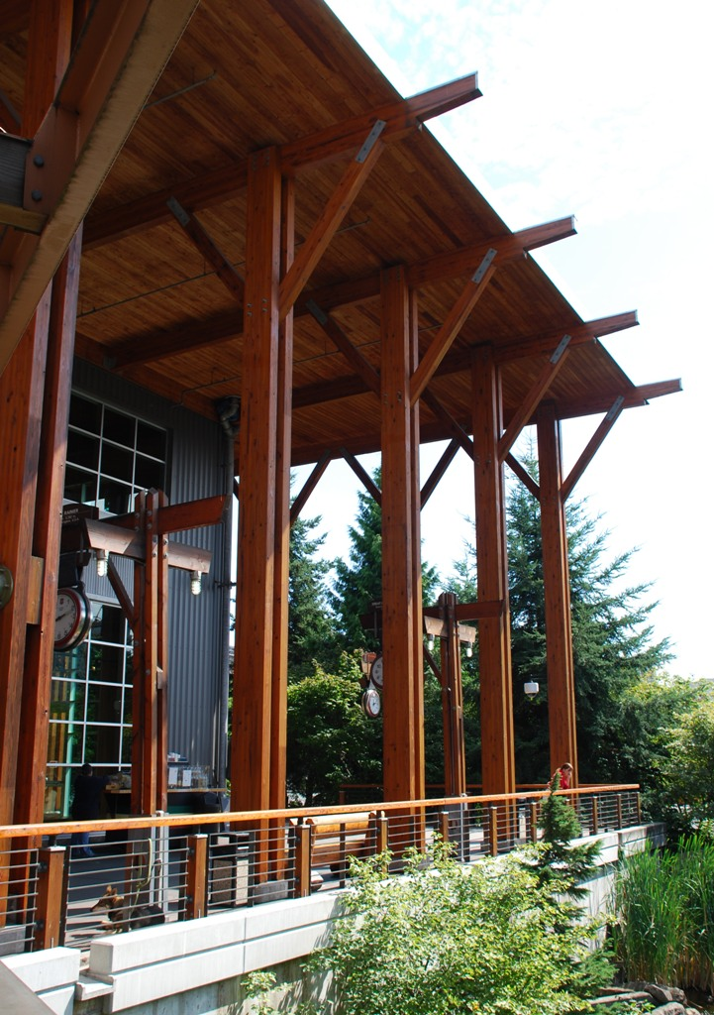
Contemporary timber frame construction: Used for both residential and nonresidential structures.

Slide 4
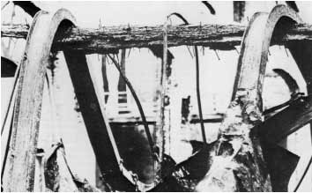
Fire-Resistance
Large wood members have greater resistance to fire than unprotected steel.

Slide 5
Large timbers are slow to absorb heat, slow to catch fire, and slow to burn.

Slide 6
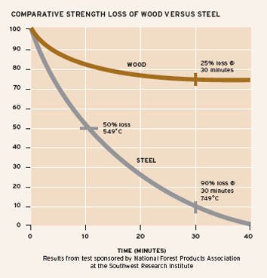
The charred outer layer of a partially-burned timber insulates and protects the inner portion, preserving partial structural capacity.

Slide 7
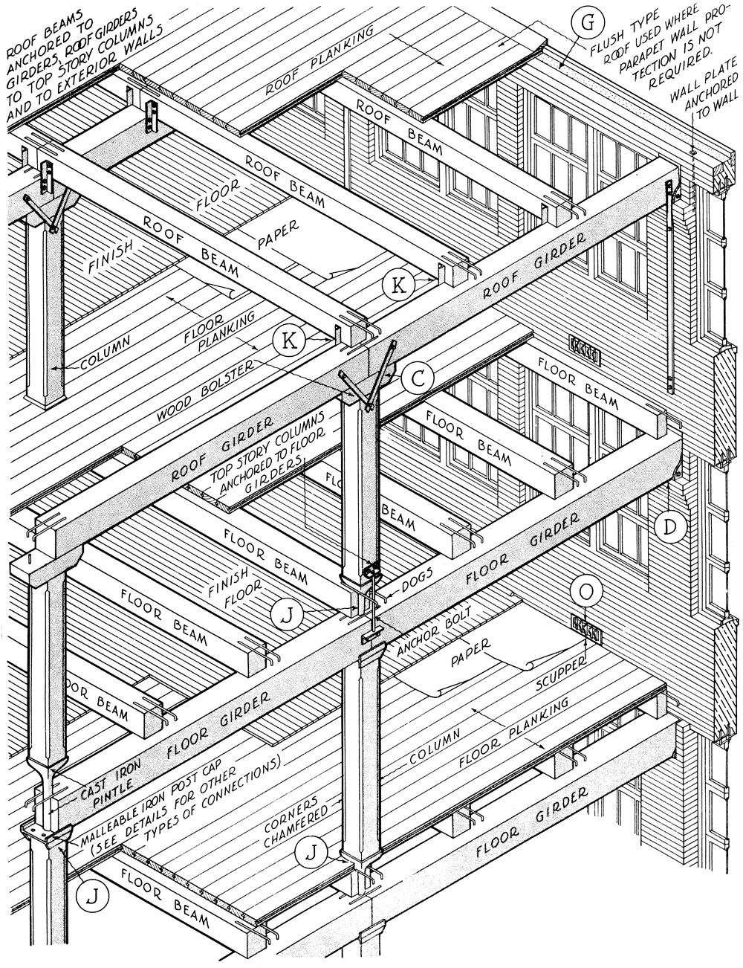
Fire-resistive, traditional Mill Construction consists of heavy timber framing within brick masonry exterior walls.

Slide 8
Contemporary Type IV Heavy Timber construction requires heavy timber framing within noncombustible—masonry, steel, or concrete—exterior walls.

Slide 9
Type IV Heavy Timber
Timbers must meet minimum size requirements.
Members with lesser dimensions are classified as wood light frame (Type V) construction.
 | Supporting Floor Loads | Supporting Roof and Ceiling Loads Only
Columns | 8 x 8 (184 x 184 mm) | 6 x 8 (140 x 184 mm)
Beams and Girders | 6 x 10 (140 x 235 mm) | 4 x 6 (89 x 140 mm)
Trusses | 8 x 8 (184 x 184 mm) | 4 x 6 (89 x 140 mm)
Decking | 3 decking plus 1" finish (64 mm decking plus 19 mm finish) | 2" decking, or 1 1/8" plywood (38 mm decking, or 29 mm plywood)

Slide 10
Type IV Heavy Timber
In IBC, allowable heights and areas for Heavy Timber buildings exceed those for unprotected steel (Type IV-B).

Slide 11
Type IV Heavy Timber
…and roughly equal those for steel, concrete, or masonry with 1-hour of fire protection (Type IV-A).

Slide 12
Managing Wood Shrinkage
Different rates of shrinkage between interior wood framing and exterior masonry, steel, or concrete walls can lead to differential settling of upper floors and roofs.
Wood connection details should minimize the cumulative effects of cross-grain shrinkage.

Slide 13
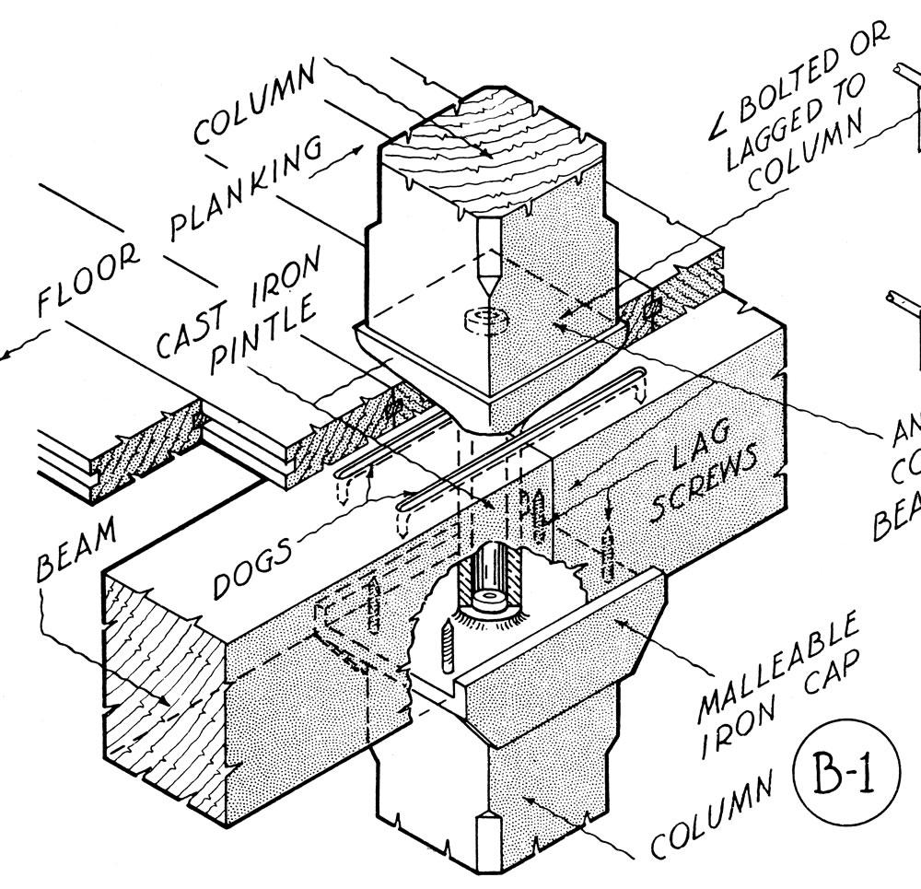
Traditional cast iron pintle
Upper-story columns are isolated from cross-grain shrinkage in wood beams and girders at each floor level.

Slide 14
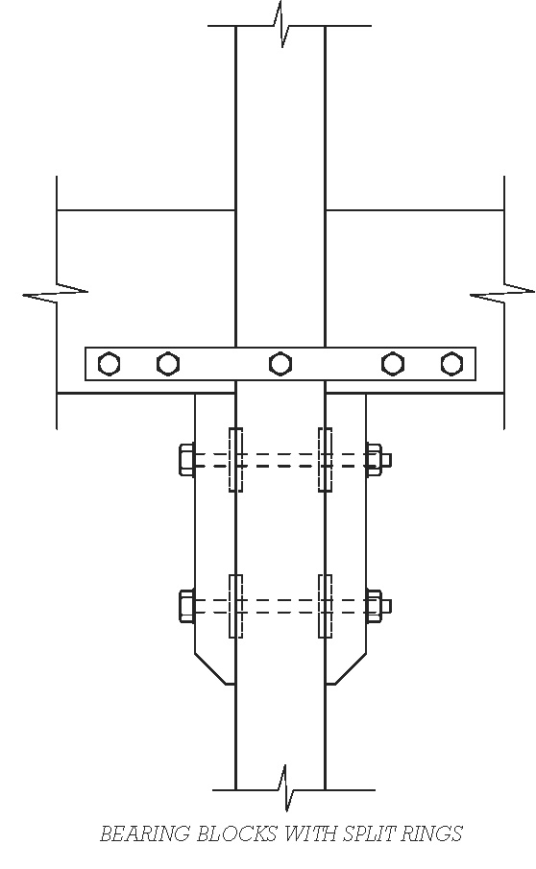
Contemporary Connections
Columns should not bear on beams or girders, so that they are unaffected by shrinkage in the floor frame.
In this example, column is continuous.

Slide 15
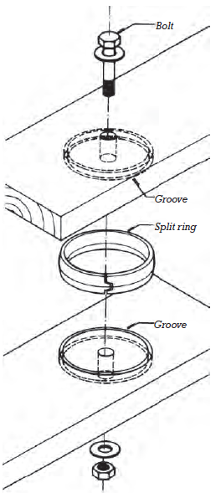
Example use of split-ring connectors (greater bearing capacity than bolted connections)

Slide 16
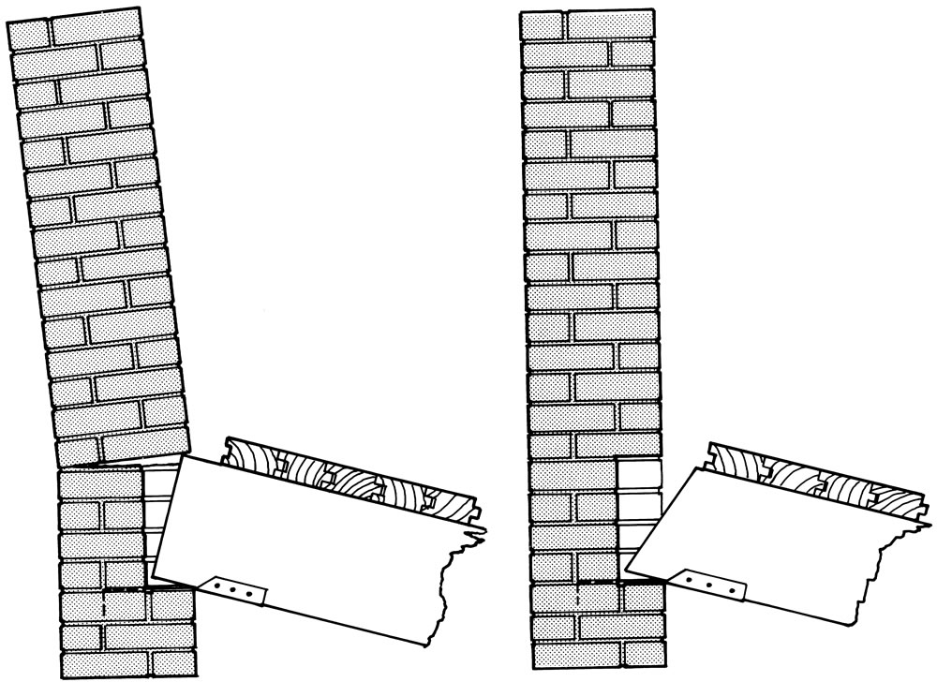
Beam/Wall Anchorage
Traditional fire cut beam ends: Prevent collapse of wall in event of beam failure in fire.

Slide 17
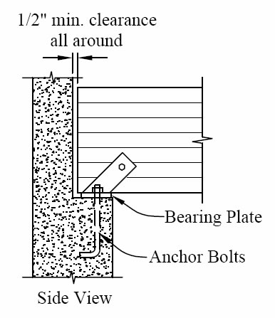
A ventilating air space around the beam end prevents moisture in the masonry wall from seeping into the beam.

Slide 18
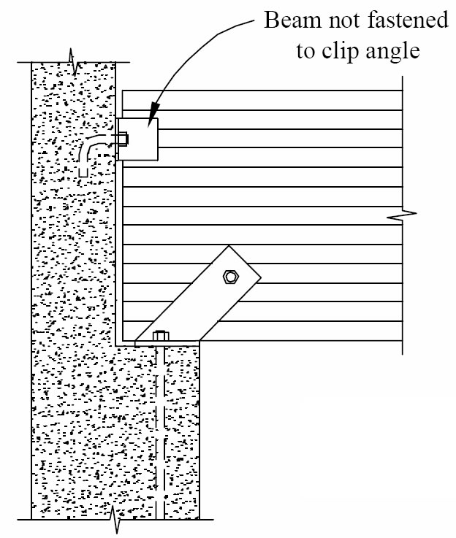
Upper clip restrains beam from side-to-side movement while allowing rotation due to structural deflection or beam collapse in a fire.

Slide 19
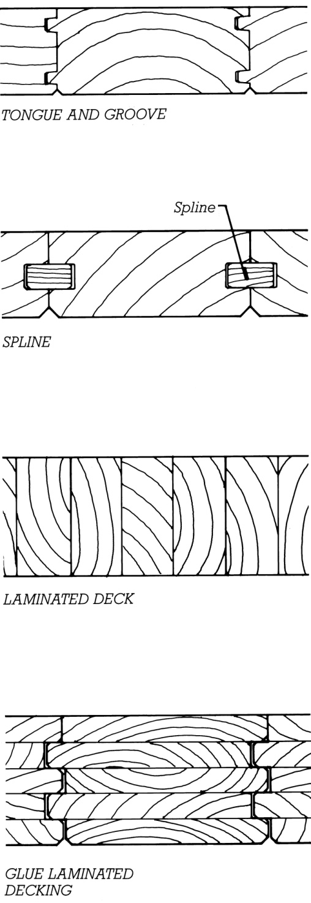
Floor and Roof Decks
Heavy decking comes in depths of 2" to 8", capable of spanning roughly from 5' to more than 20'.
To achieve the required fire-resistance, floor decking must be covered with tongue-and-groove boards or plywood.

Slide 20
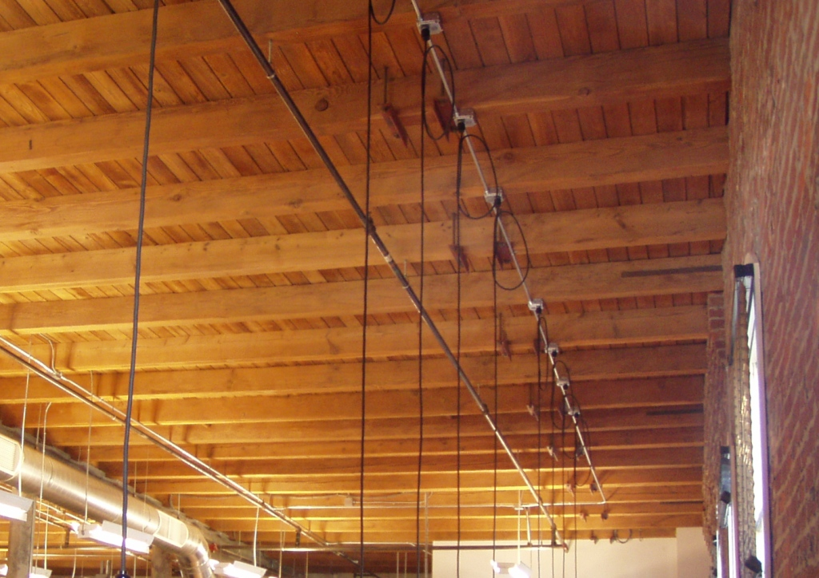
Concealed combustible spaces, where fire could develop undetected must be avoided.

Slide 21
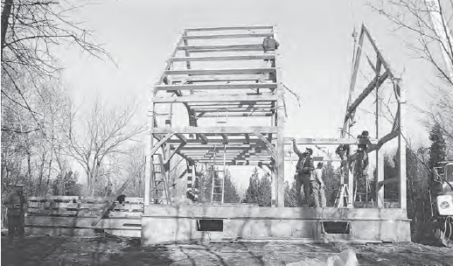
HEAVY TIMBER IN OTHER CONSTRUCTION TYPES

Slide 22
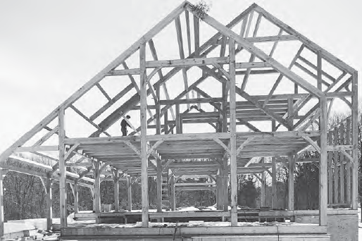
Type V Construction
When HT is used in Type V construction, it is subject to this Type’s reduced height and area limits.
(Type V construction permits combustible members of any size and combustible exterior walls.)

Slide 23
Heavy Timber Roof Framing
HT roof framing is permitted in any construction type requiring no more than a 1-hour fire-resistance rating.
For example, heavy timber framing can substitute for 1-hour protected steel or concrete roof framing in Type I and II noncombustible buildings.

Slide 24
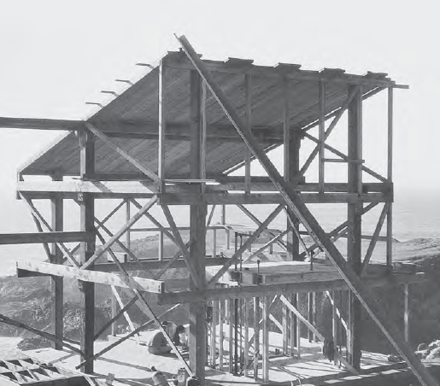
LATERAL BRACING

Slide 25
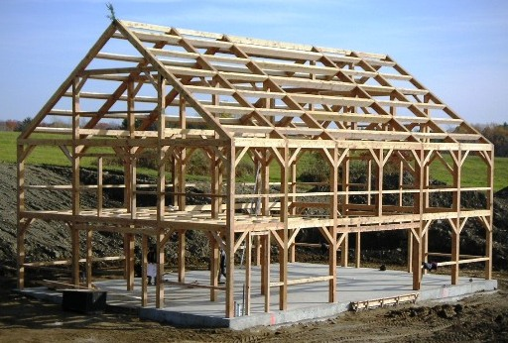
Knee Bracing
Stiffens column/beam connection and adds lateral stiffness to the heavy timber frame.

Slide 26
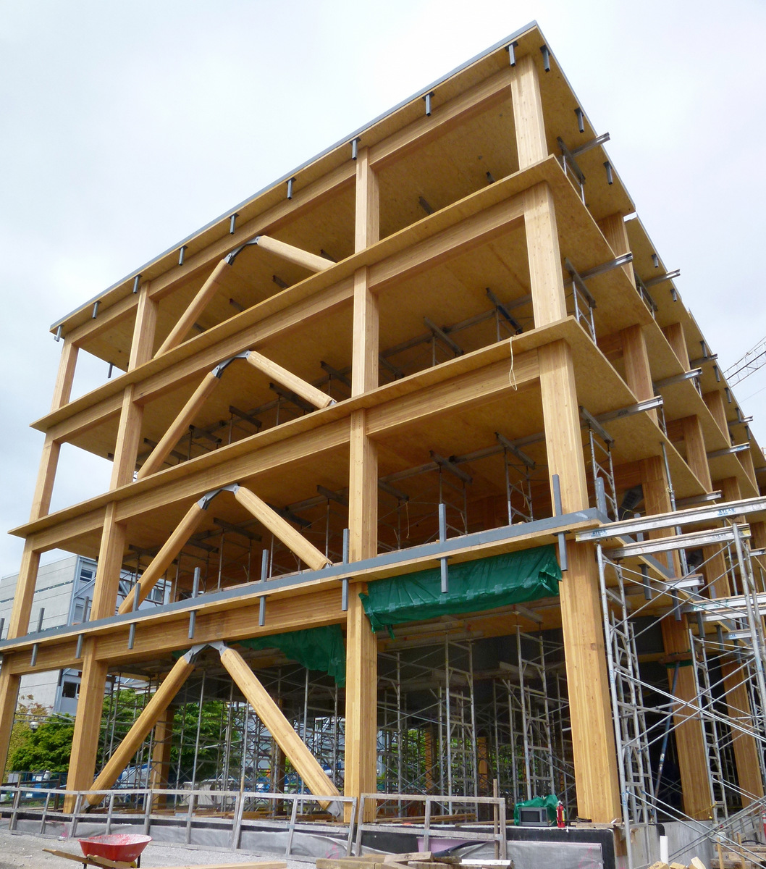
Full-Bay Cross Bracing
Provides greater lateral stiffness and strength.
(Wood or steel)

Slide 27
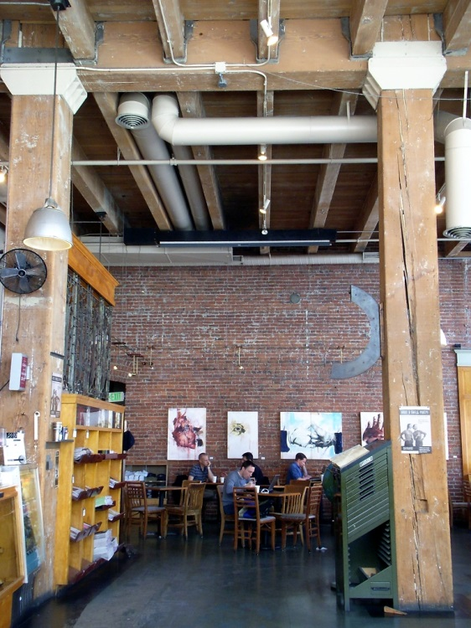
Shear Walls
Masonry or concrete walls can act as shear walls to provide lateral stability.

Slide 28
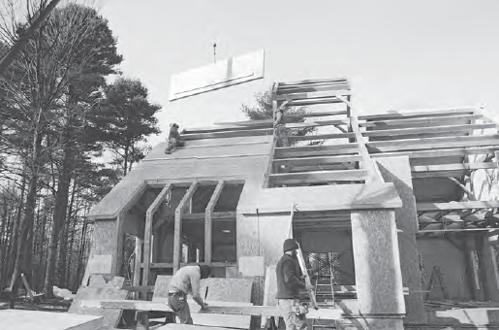
Structural Wood Panels
Panels attached to the frame act as shear walls.

Slide 29
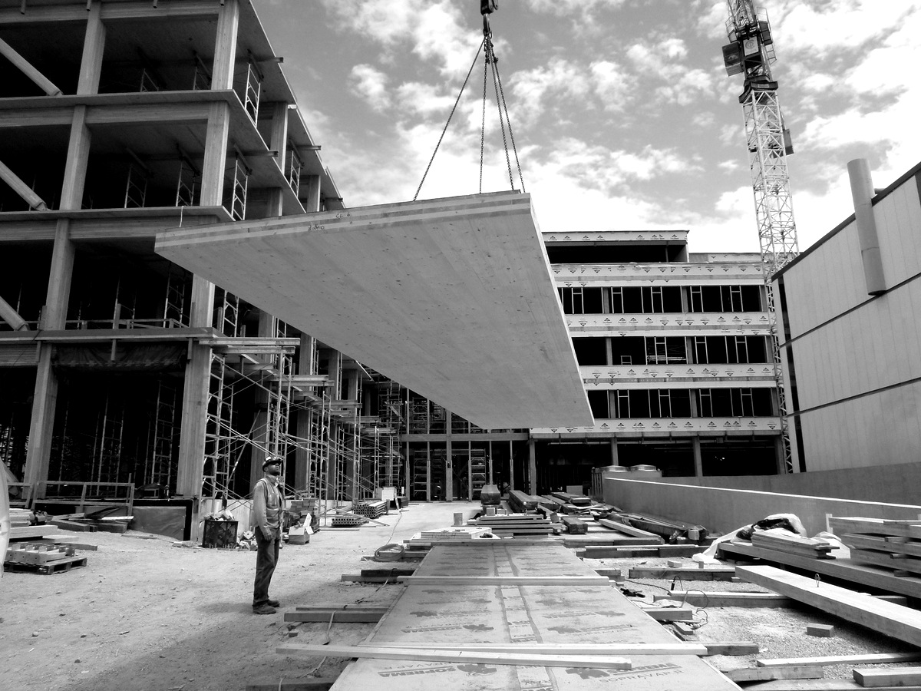
CROSS-LAMINATED TIMBER CONSTRUCTION

Slide 30
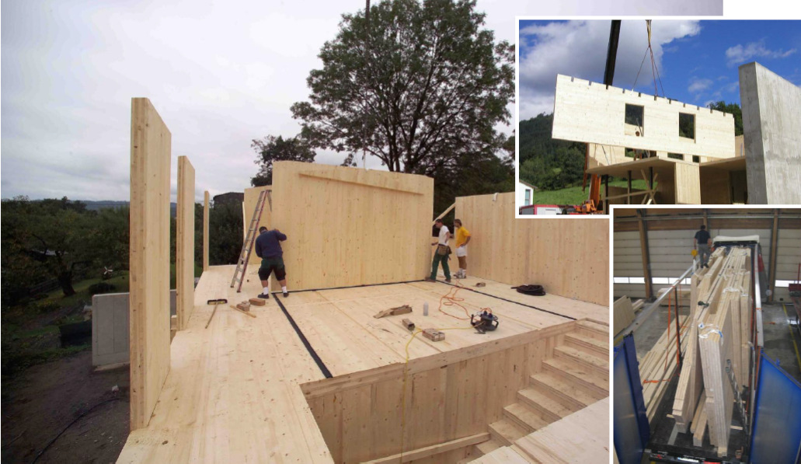
Fabricated panels are shipped to construction site then lifted into place.

Slide 31
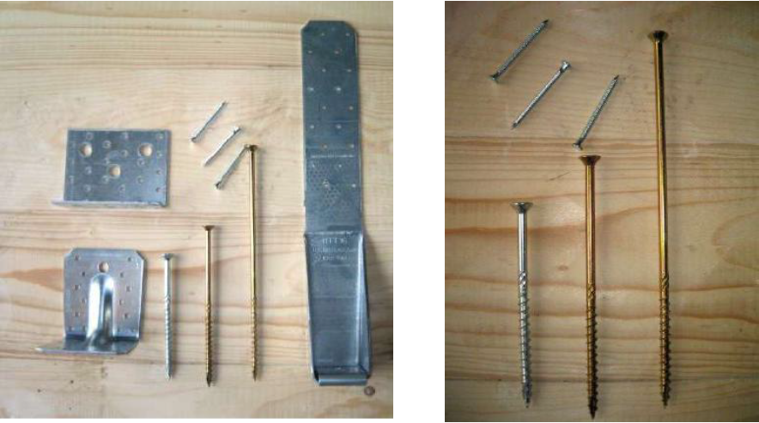
Simple connection hardware

Slide 32
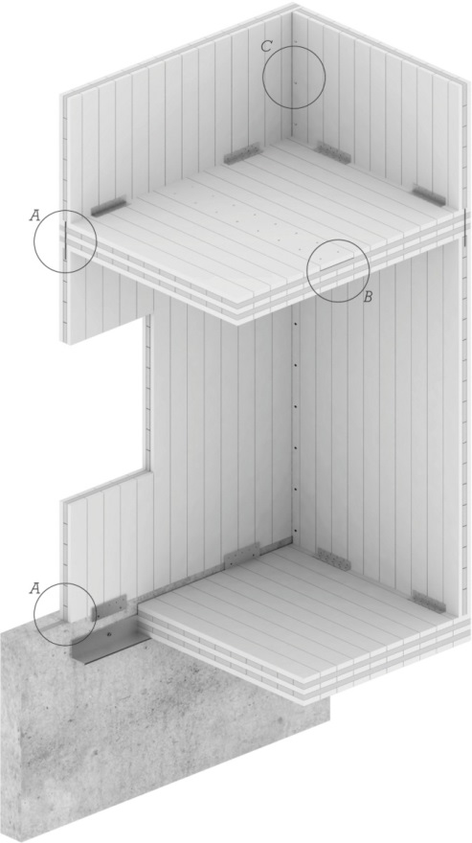
Simple assembly concepts.
Panels can act as loadbearing walls, floors, and roof decks.

Slide 33
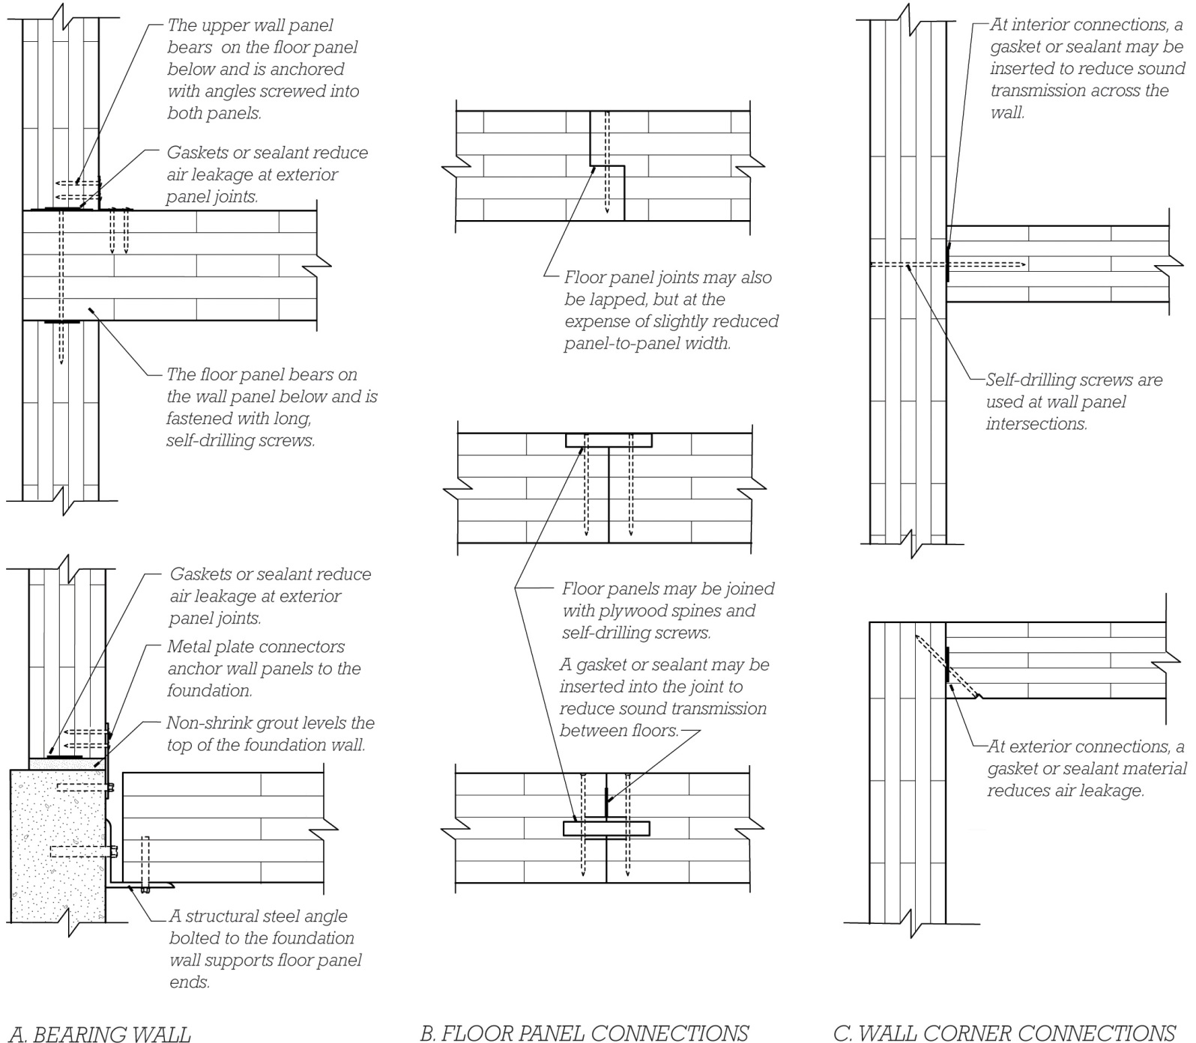

Slide 34
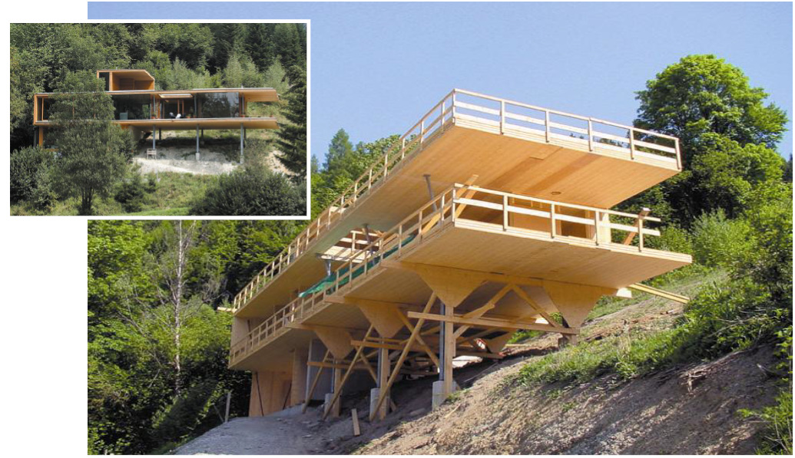
Low weight/high strength
2-way structural capacity
Rapid assembly
Minimal construc-tion site waste
Negative carbon footprint
Design: DI Ulli Koller, Ing. Thomas Stiegler

Slide 35
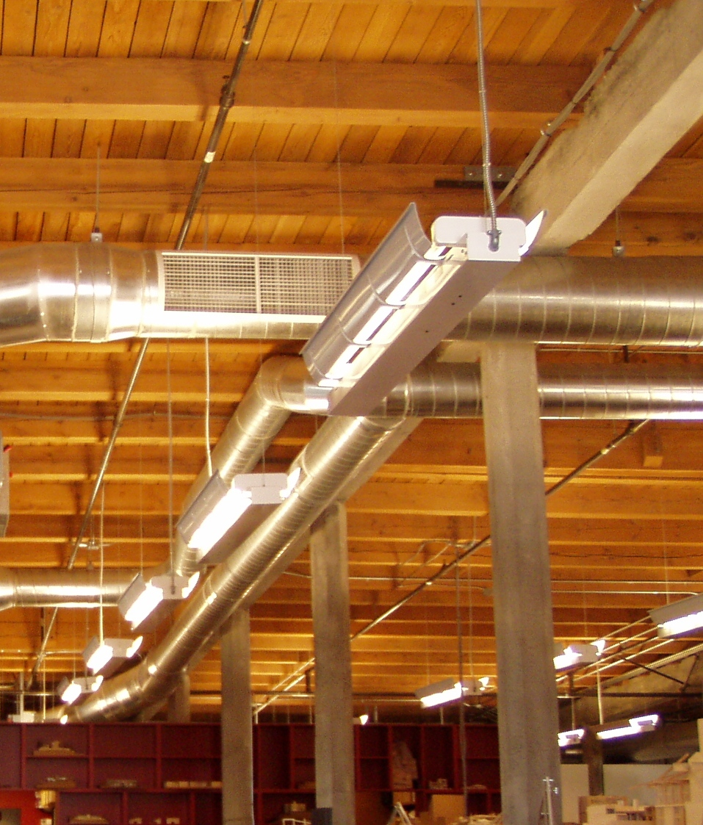
Exposed Services
Without concealed spaces, power, lighting, ductwork, sprinklers, and other services frequently are routed in the open.

Slide 36
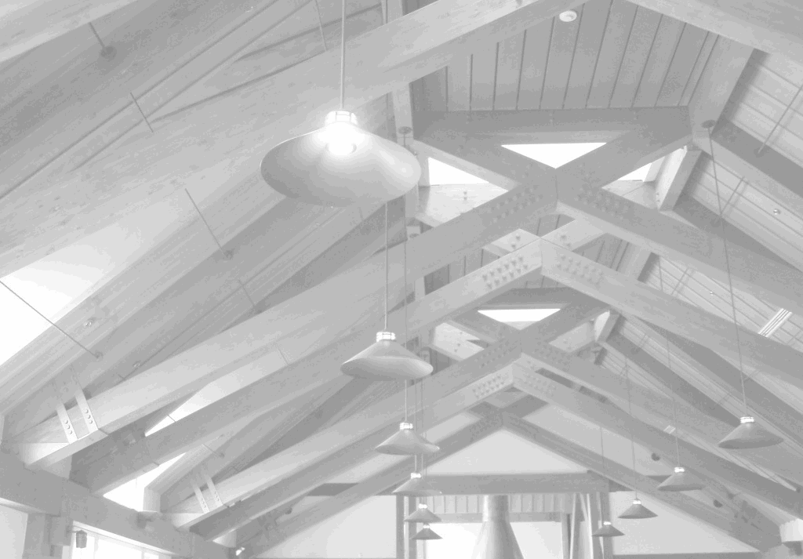
CONNECTIONS

Slide 37
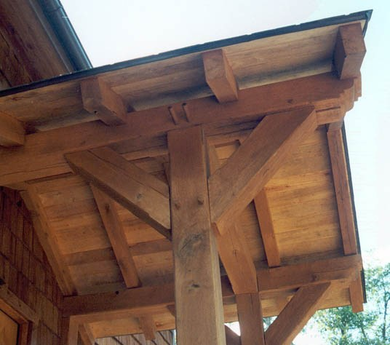
Traditional, pegged, mortise and tenon joinery

Slide 38
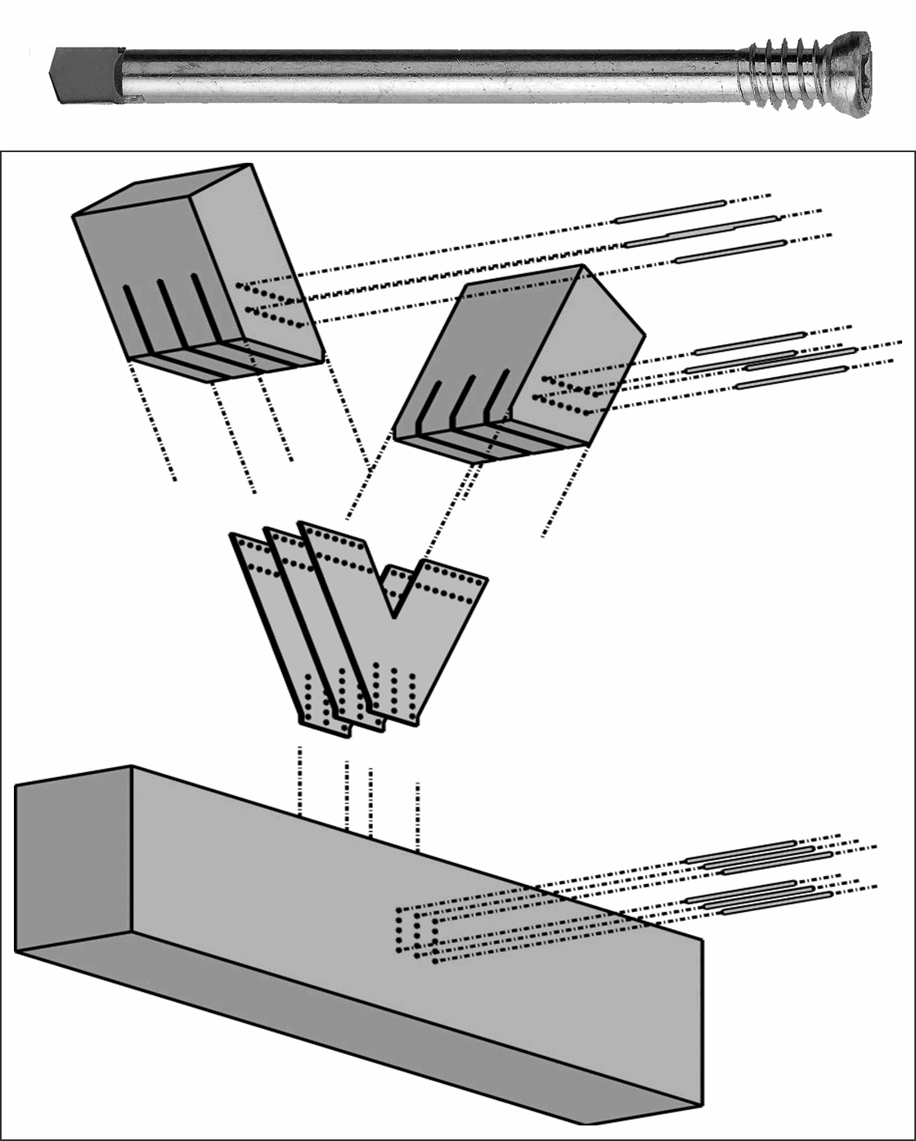
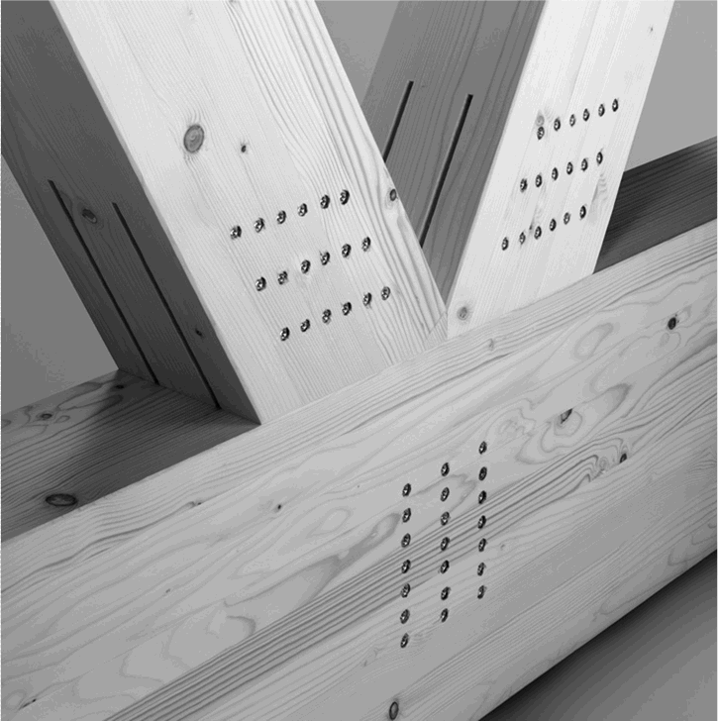
Proprietary fastening system with self-drilling steel dowels and concealed steel plates

Slide 39
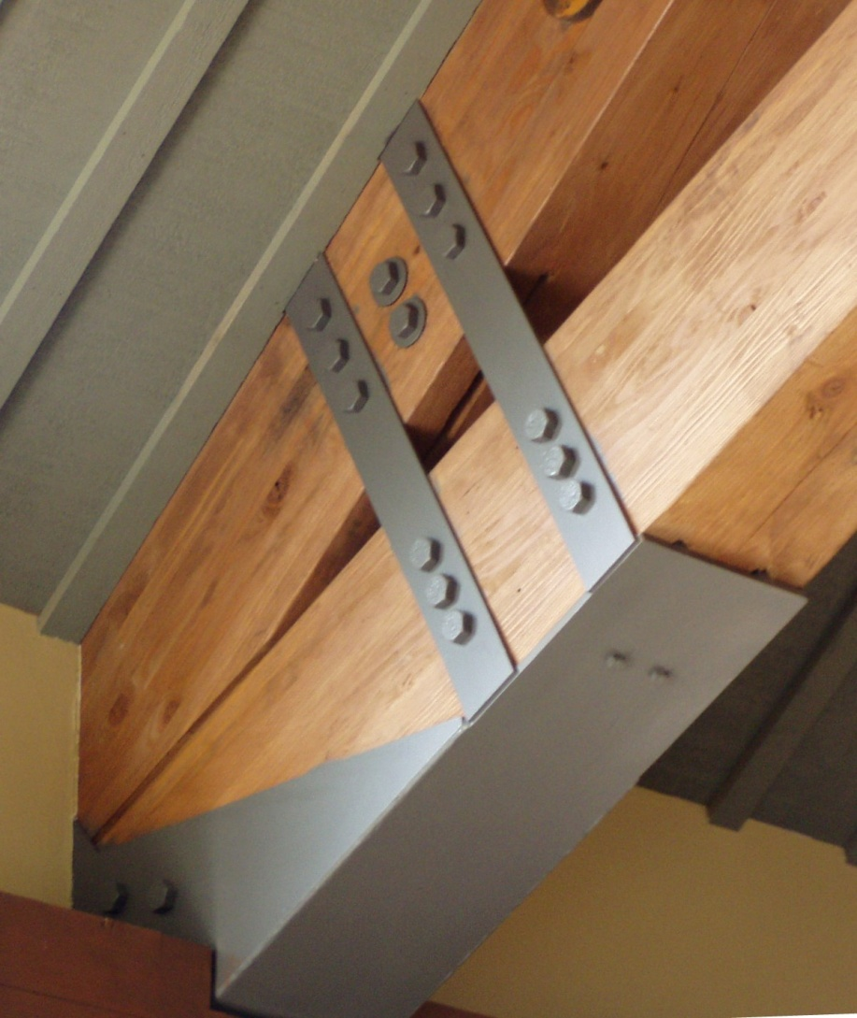
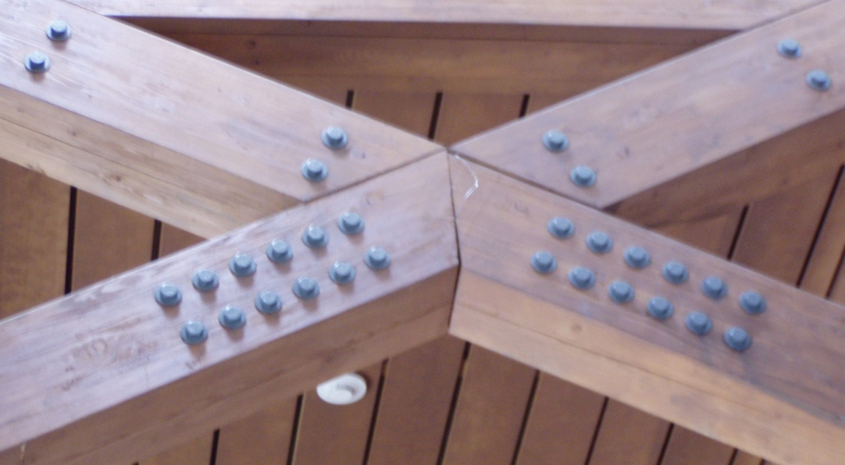
Fabricated steel seat, concealed plates, and exposed through-bolts

Slide 40
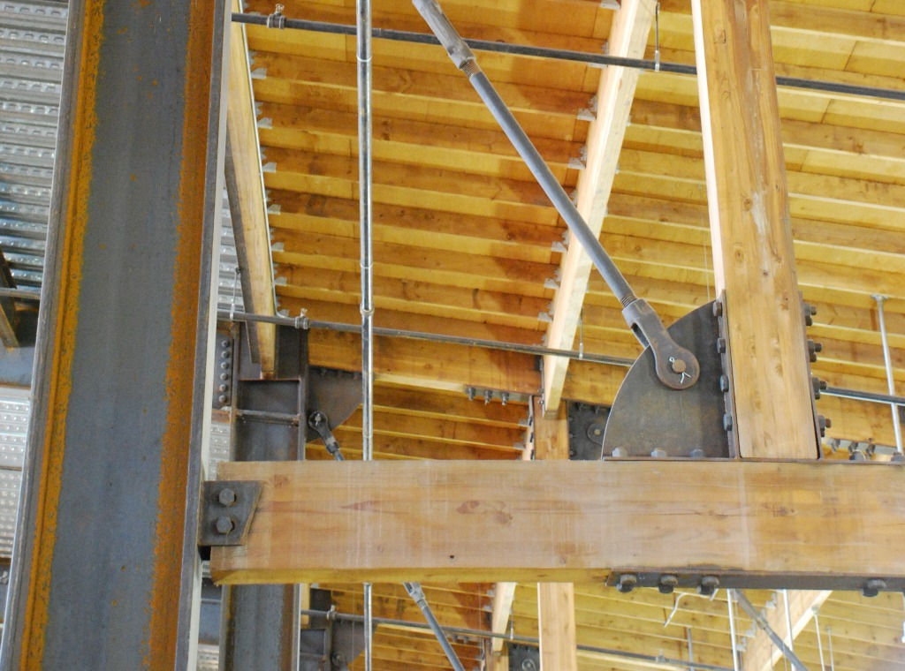
Steel plate gusset with tie rod and through-bolts

Slide 41
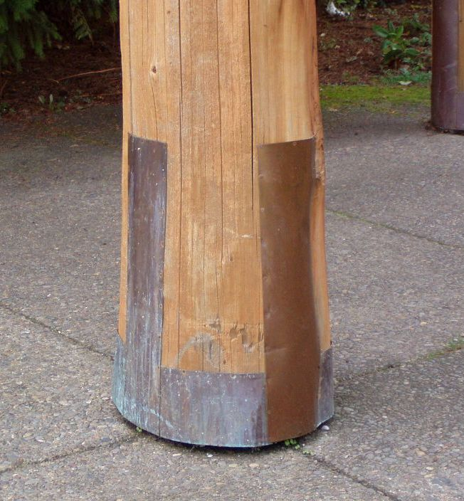
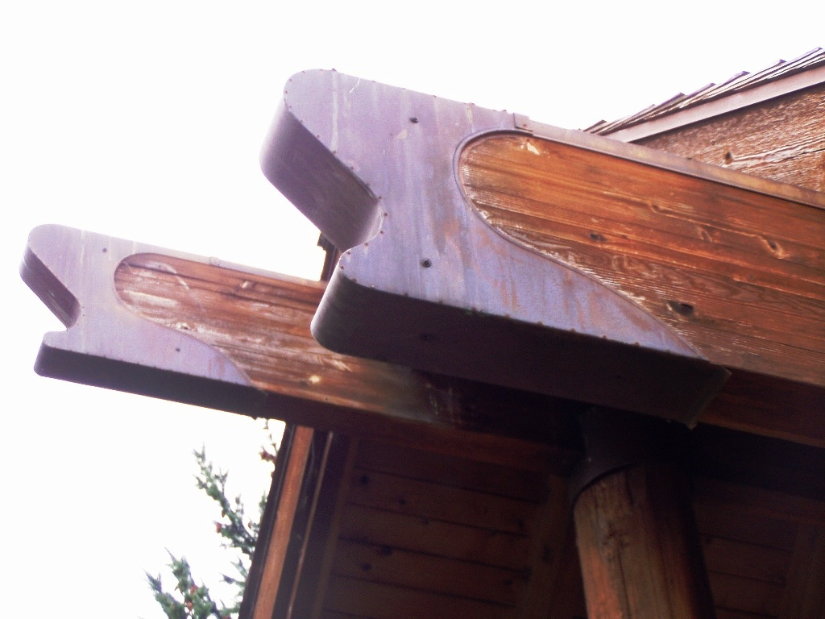
Copper sheet metal flashing protects the open-grain ends of beams and columns from absorbing moisture

Slide 42
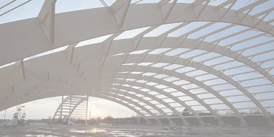
LONGER SPANS IN HEAVY TIMBER

Slide 43
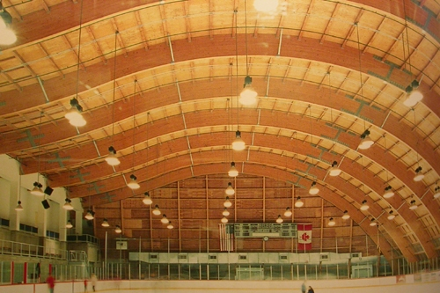
Large Beams
Glulam beams can span over 80', and arches even further.

Slide 44
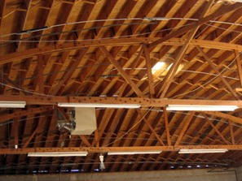
Trusses
Heavy timber trusses can span beyond 200'.

Slide 45
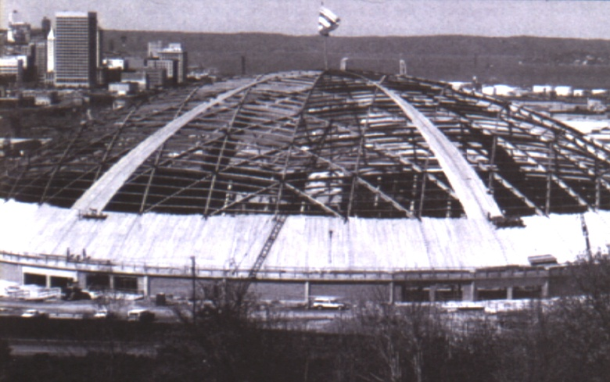
Domes
The Washington State Tacoma Dome spans 530'.

Slide 46
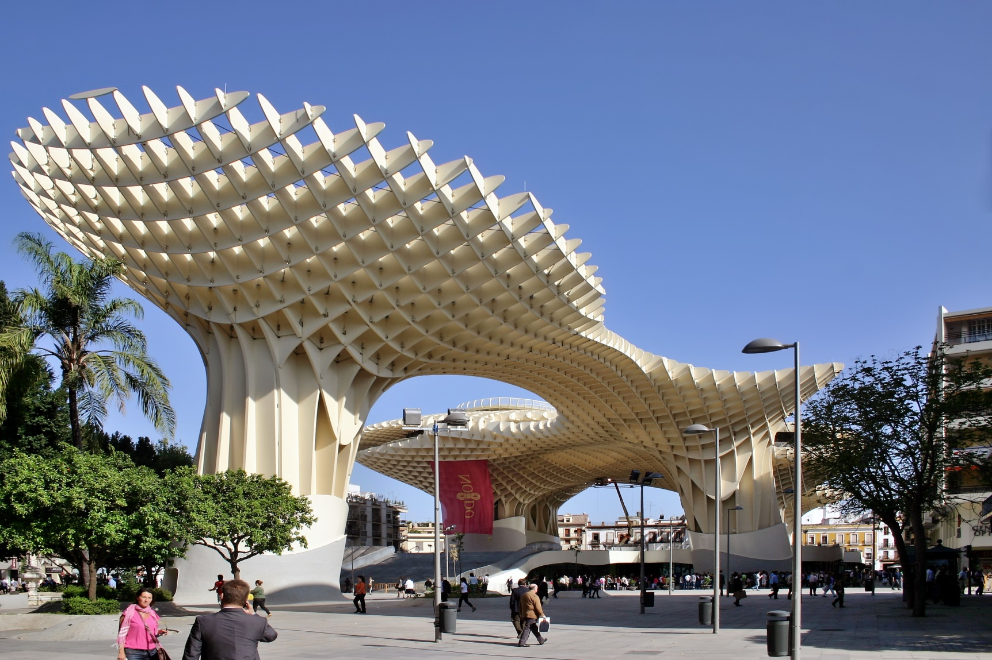
Metropol Parasol, Seville
Covers area 490’ by 245’

