Slide 1
TREES

Slide 2
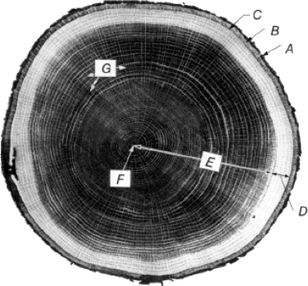
Tree Growth
Bark: Outermost protective layer (A: dead, B: living)
Cambium layer (C): Source of new cells
Sapwood (D): Living cells that store and transport nutrients

Slide 3
Tree Growth
Heartwood (E): Dead cells that contribute to structural strength
Pith (F): Innermost, first year’s growth
Annual growth rings: Result from differences in rate of tree growth and density of cells, from spring to summer

Slide 4
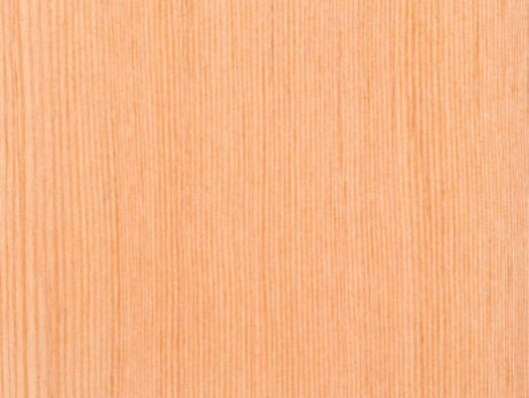
Softwoods
From cone-bearing (coniferous) trees
Relatively simple cell structure
Generally, plain figure (pattern of grain and surface features)
(top: pine; bottom: fir)

Slide 5
Softwoods
Mostly originating from North American forests
Fast-growing, plentiful, relatively inexpensive
Generally soft, easily worked
Used for structural wood products, finish trim, shingles, siding, flooring
But not all softwoods are soft. For example, Douglas Fir is harder than some hardwoods.

Slide 6
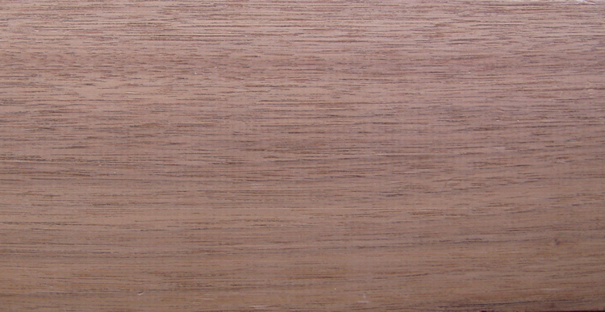
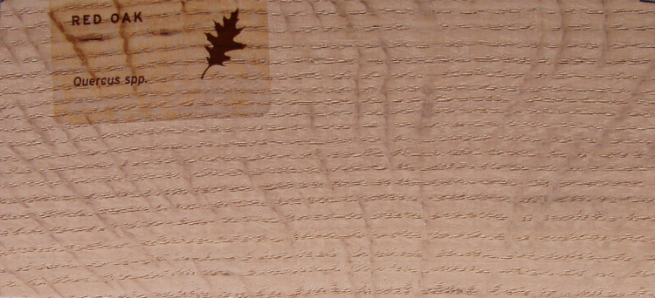
Hardwoods
From broadleafed (deciduous) trees
More complex cell structure
Often more interesting figure (Top: walnut, with readily apparent pores; bottom: red oak, with pores and rays)

Slide 7
Hardwoods
Harvested from around the world
Slower growing, generally more expensive than softwoods
Denser, with greater variety of colors and figure
Used for fine trim, paneling, flooring, fine cabinet work, furniture

Slide 8
Certified Wood
Sustainable forestry management
Protect forest ecosystem
Maintain long term forest economic viability
Some programs also address social responsibilities, for example, the land rights of indigenous peoples.

Slide 9
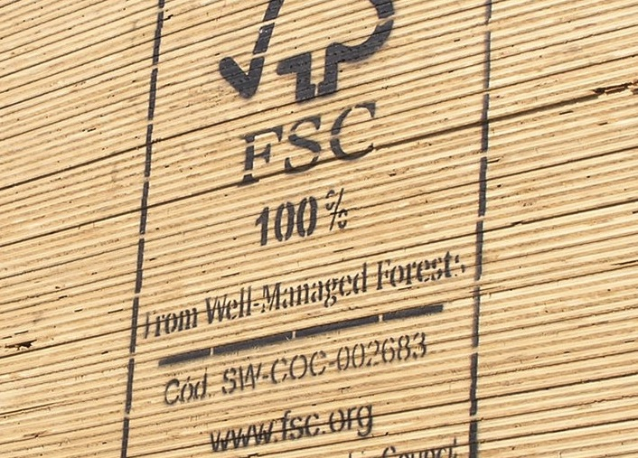
Certified Wood
Forest Stewardship Council (FSC): Only certifying organization currently recognized for LEED certification

Slide 10
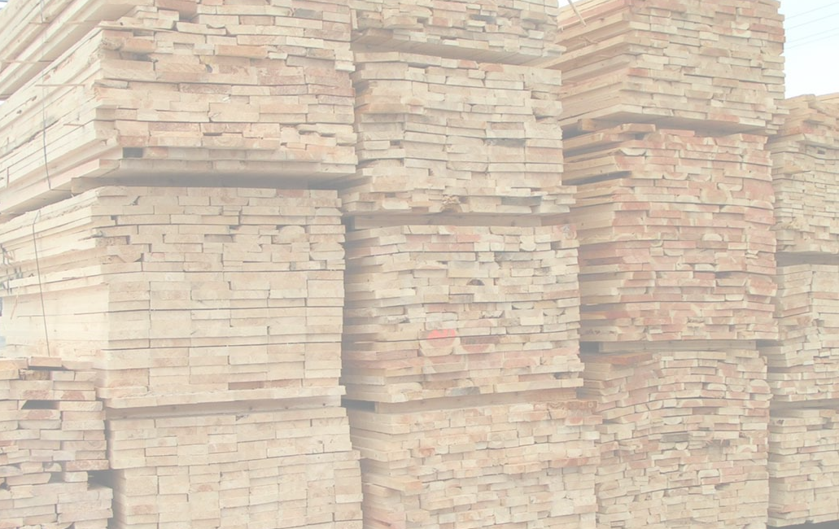
LUMBER

Slide 11
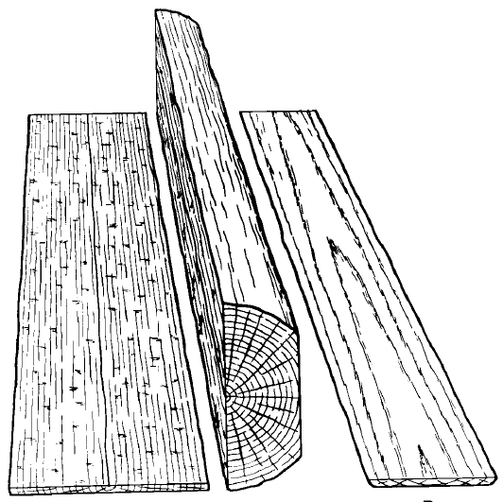
Sawing
Plainsawn: growth rings roughly parallel to wider face of board (right)
Quartersawn: growth rings close to perpendicular to wider face of board (left)

Slide 12
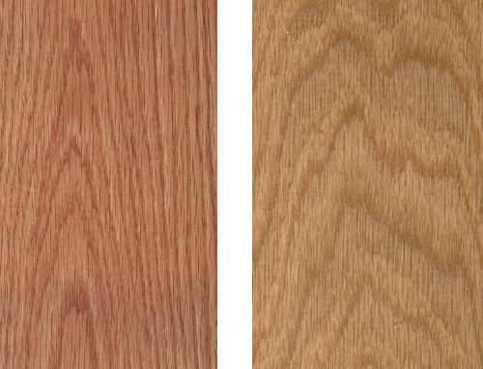
Plainsawn Lumber
Broader grain pattern on wide face
Greater distortion during drying
More uneven surface erosion or wear

Slide 13
Plainsawn Lumber
More efficiently sawn from log; less costly
Also called flatsawn, flat grain
(left: red oak; right: white oak)

Slide 14
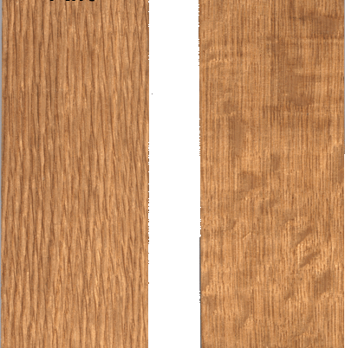
Quartersawn Lumber
More narrowly spaced grain pattern on wide face
Less distortion during drying
More even surface erosion or wear
More costly to saw from log

Slide 15
Quartersawn Lumber
Also called edge sawn, edge grain, vertical grain
Riftsawn (left): angle of grain falls between perfectly quarter sawn and plainsawn
(red oak)

Slide 16
Seasoning
After lumber is sawn, it is seasoned (dried), either in air or in kilns.
Seasoned lumber is lighter, stronger, and stiffer than green (unseasoned) lumber.
Decay causing fungi cannot survive in wood with a moisture content (MC) below ~20%.

Slide 17
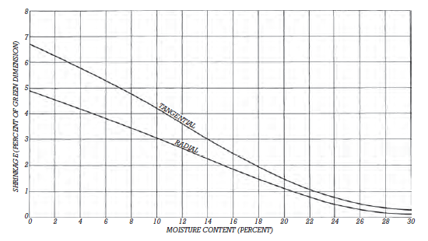
Seasoning
As wood dries below approximately 30 percent MC, it shrinks, mostly in cross section, and only slightly in length.

Slide 18
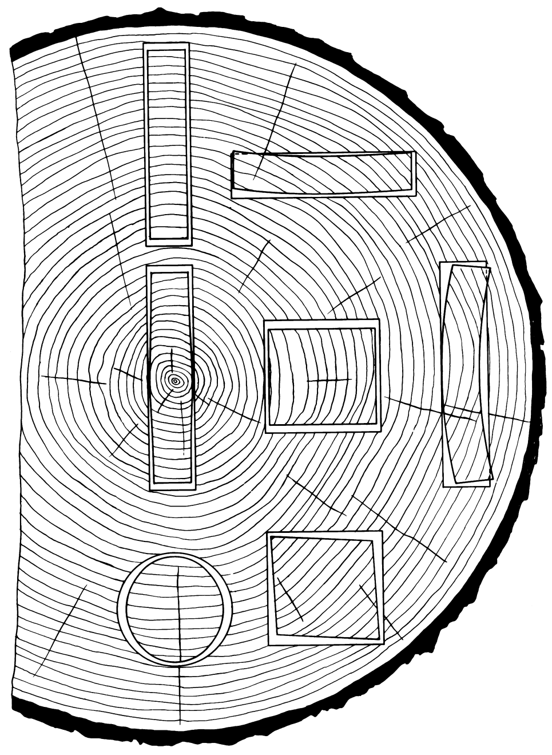
Seasoning
Difference between rates of tangential and radial shrinkage cause distortions in shape, especially in flatsawn lumber.

Slide 19
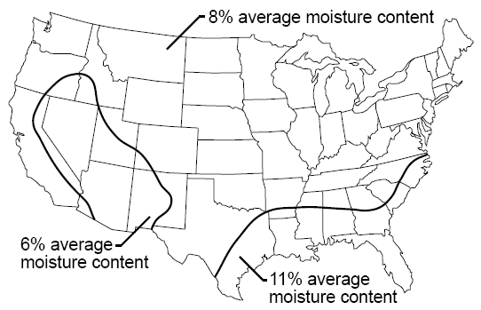
Seasoning
Wood eventually dries to equilibrium with the surrounding air, reaching its equilibrium moisture content (EMC).
EMC for exterior uses: 15% - 19%
EMC for interior uses: 6%-11% (figure at right)

Slide 20
Surfacing
Lumber is surfaced to make it smooth and more dimensionally precise.
Framing lumber: usually surfaced four sides (S4S)
Finish lumber: may be S4S, or surfaced two sides (S2S), the other sides to be sawn and surfaced by the woodworker

Slide 21
Surfacing
Surfacing after seasoning (S-DRY): removes some drying distortions
Surfacing before seasoning (S-GRN): sometimes more economical; best for wood species that don't distort excessively as they dry
Construction planking: unsurfaced; Plank is stronger (no material has been removed) and more slip-resistant.

Slide 22
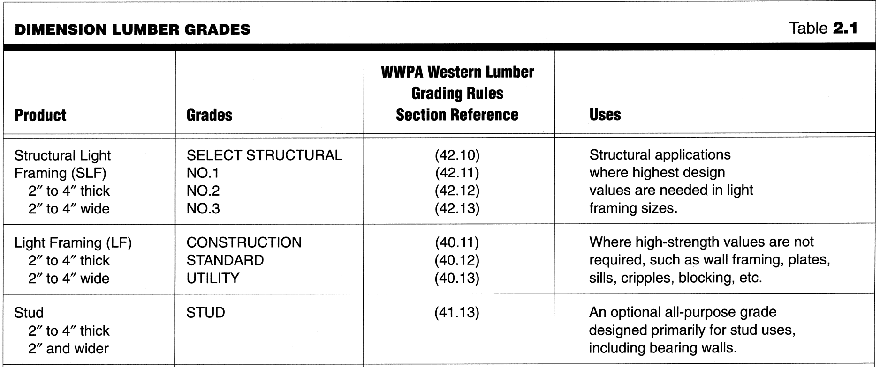
Structural Grading
Framing lumber pieces are graded and stamped for structural strength and stiffness.

Slide 23
Structural Grading
Higher structural grades have fewer defects, and when left exposed, are generally also more attractive.
Grading is most commonly performed visually, by trained inspectors, or it may be done by machine.

Slide 24
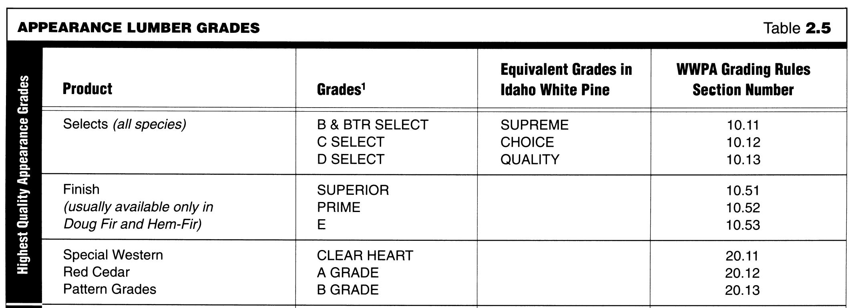
Appearance Grading
Finish lumber is graded for the extent of visible , such as knots, and other appearance characteristics.

Slide 25
Appearance Grading
Appearance grading is always performed visually.

Slide 26
Structural Properties of Wood
Wood has both useful tensile and compressive strength.
Strength varies significantly with direction of grain, species, and presence of knots or other defects.
Strength also varies with duration of load, moisture content, chemical treatments, temperature, size and shape of piece.

Slide 27
Structural Properties of Wood
Defect-free wood is comparable to the strength of steel on a per-weight basis. But average grades are weaker.
Material | Tensile strength | Density | Specific strength
Steel | 24,000 psi | 0.284 lb/in³ | 84,500 lb-in/lb
Wood | 1500 psi | 0.017 lb/in³ | 88,200 lb-in/lb

Slide 28
Lumber Dimensions
Actual sizes are less than nominal size. E.g.:
1x4 actual size is approximately ¾" x 3½"
2x4 is 1½" x 3½"
2x10 is 1½" x 9¼"

Slide 29
Lumber Dimensions
In U.S., lumber is priced by the board foot, based on nominal, not actual dimensions:
12 sq. in. nominal cross-section, 1 foot long = 1 board foot
E.g., an 8-foot 2x12 = (2x12)/12 x 8 = 16 board feet

Slide 30
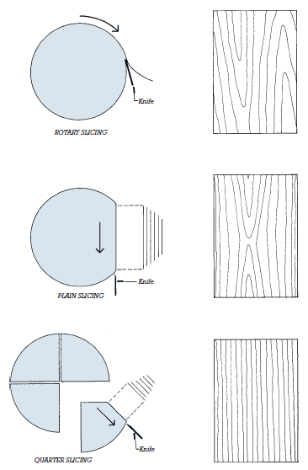
Veneer
Thin sheets sliced from logs
Used in laminated panels
High quality veneers adhered over common woods maximize efficient use the more costly wood

Slide 31
Veneer
A series of veneers all taken from the same flitch (log or section of log) are used where matching of adjacent panels is important.

Slide 32
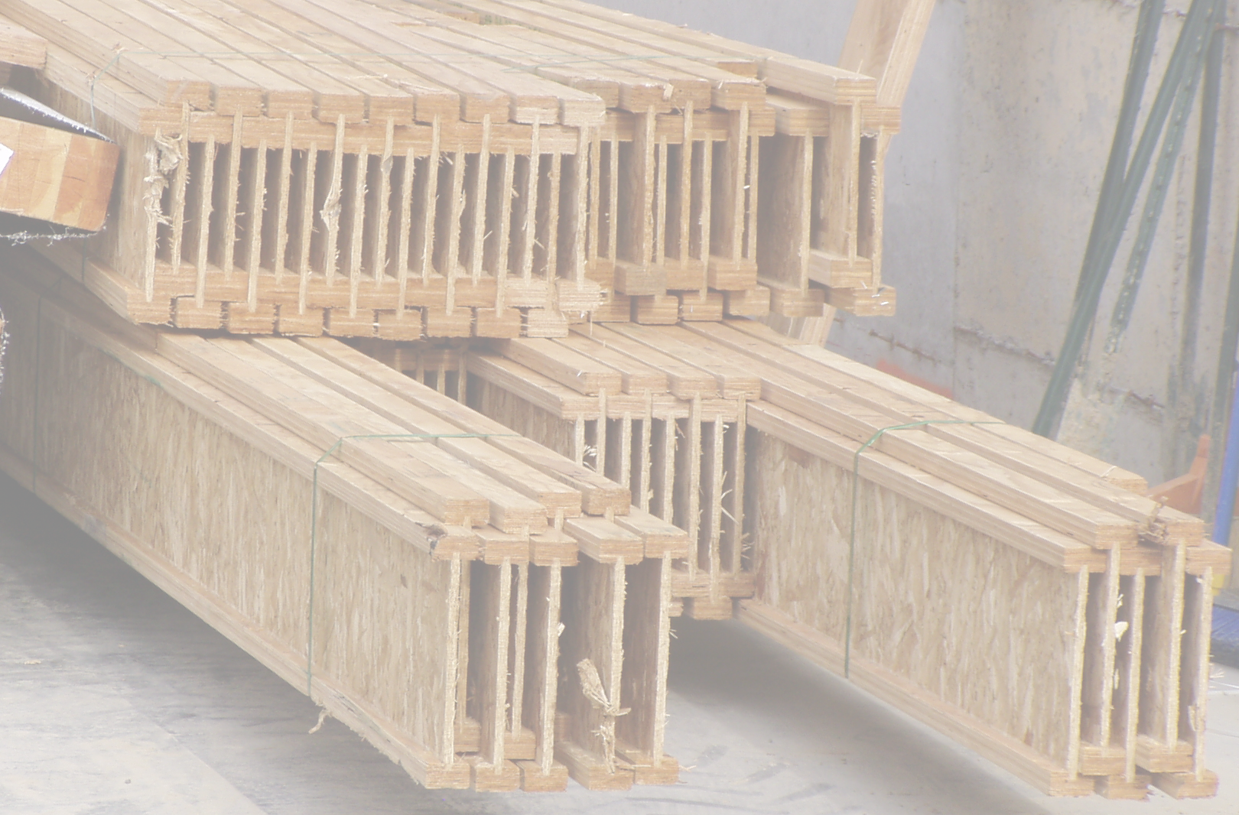
WOOD PRODUCTS

Slide 33
Manufactured Wood Products
Solid scrap and fibers can be used in the manufacture of various wood products.
More sizes and shapes
Fewer defects
More consistent quality
More efficient use of wood materials
In some cases, stronger and stiffer than solid wood members

Slide 34
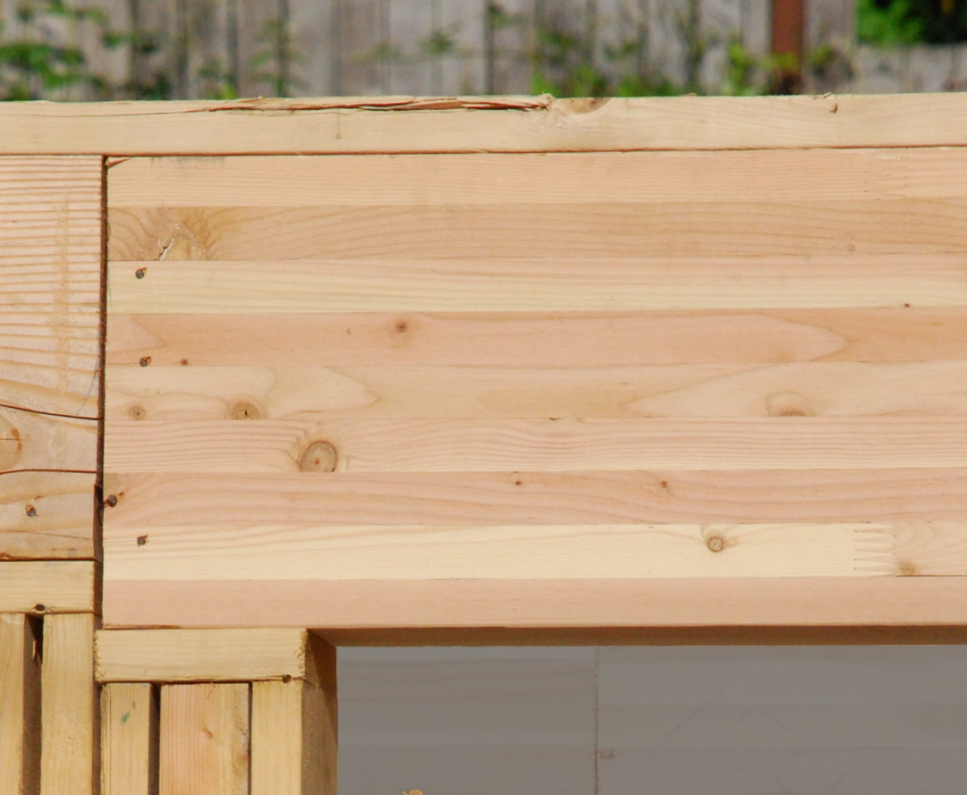
Glue-Laminated Wood
Beams made from glued, solid lumber pieces
Available in larger sizes, stronger and stiffer, than solid wood

Slide 35
Glue-Laminated Wood
Can be curved
Uses high-grade pieces efficiently, only in the parts of the beam with high stresses, while using lower grade materials in other areas

Slide 36
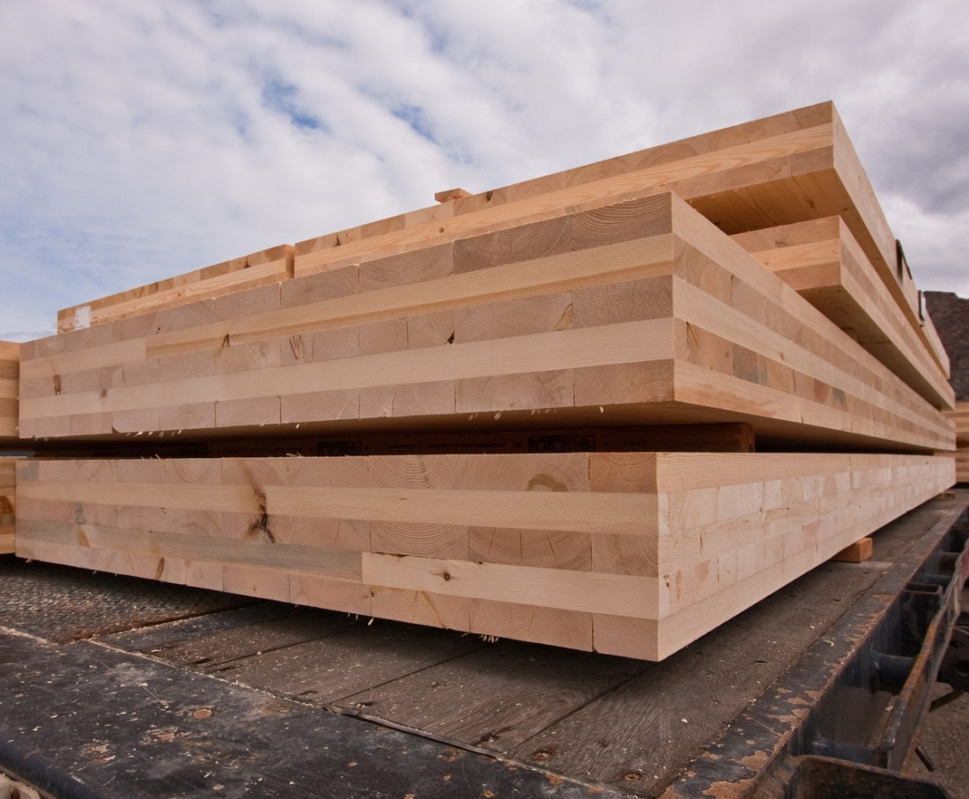
Cross-Laminated Timber
Solid lumber pieces laminated into structural panels
Lumber pieces alternate direction in each layer

Slide 37
Cross-Laminated Timber
Used for walls, floors, and roofs
Structurally competitive with concrete structures.

Slide 38
Structural Composite Lumber
Made from wood veneers or fiber strands and glue
Used as beams, headers (short beams over openings), studs, nonstructural rim boards, etc.

Slide 39
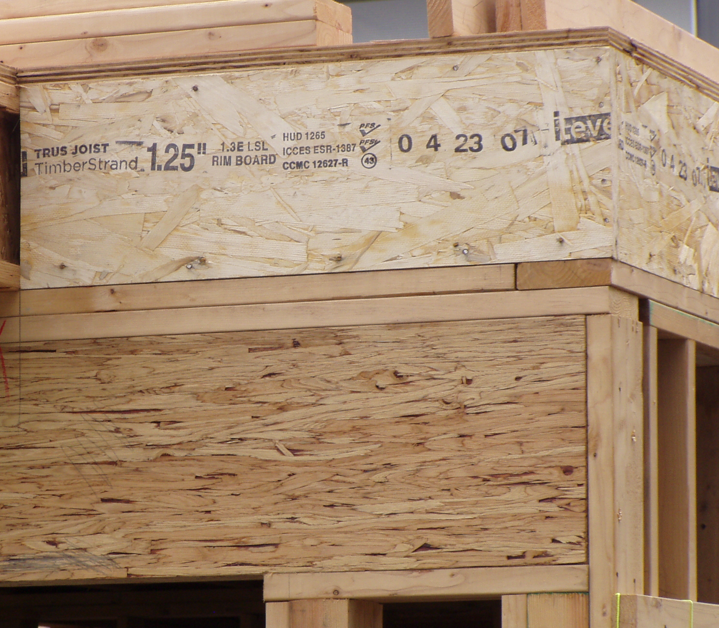
Structural Composite Lumber
Parallel strand lumber (PSL)
thin strips of veneer
(bottom member)

Slide 40
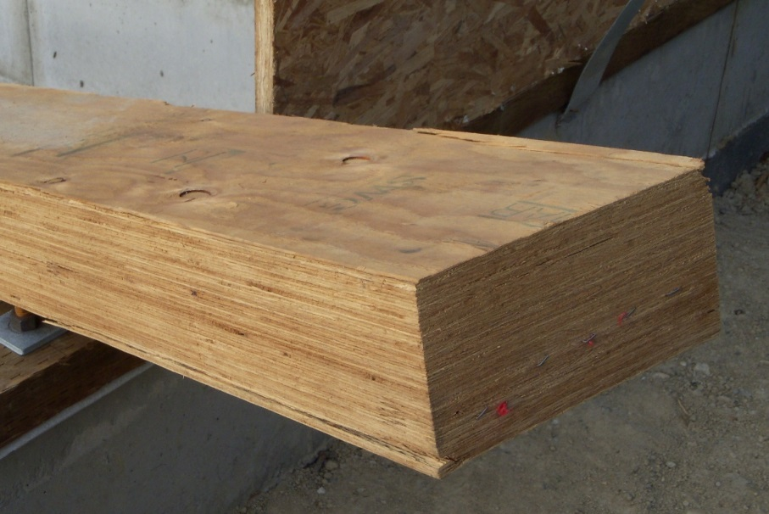
Structural Composite Lumber
Laminated veneer lumber (LVL)
full-depth veneers
(example here is lying on its side)

Slide 41
Structural Composite Lumber
Laminated strand lumber (LSL) and oriented strand lumber (OSL)
shredded wood strips
(top member)

Slide 42
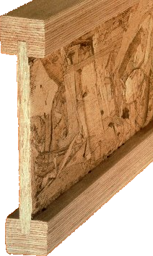
I-Joists
Can span further than solid lumber, using less raw material
Top and bottom flanges of solid lumber, or composite material (LVL shown here)
Webs of OSB or plywood

Slide 43
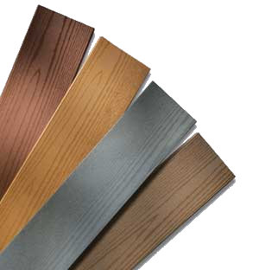
Wood-Plastic Composites (WPCs)
Made from mixtures of wood fibers and plastics
May be prefinished
Less stiff and greater thermal expansion and contraction than solid lumber
Exterior decking, wood trim, etc.

Slide 44
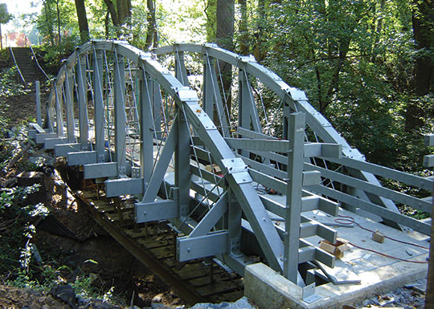
Plastic Lumber
Greater than 50% plastic
Both finish and structural applications
Durable, maintenance free, decay-resistant

Slide 45
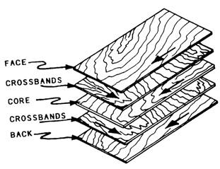
Structural Wood Panels
Plywood
Laminated softwood veneers

Slide 46
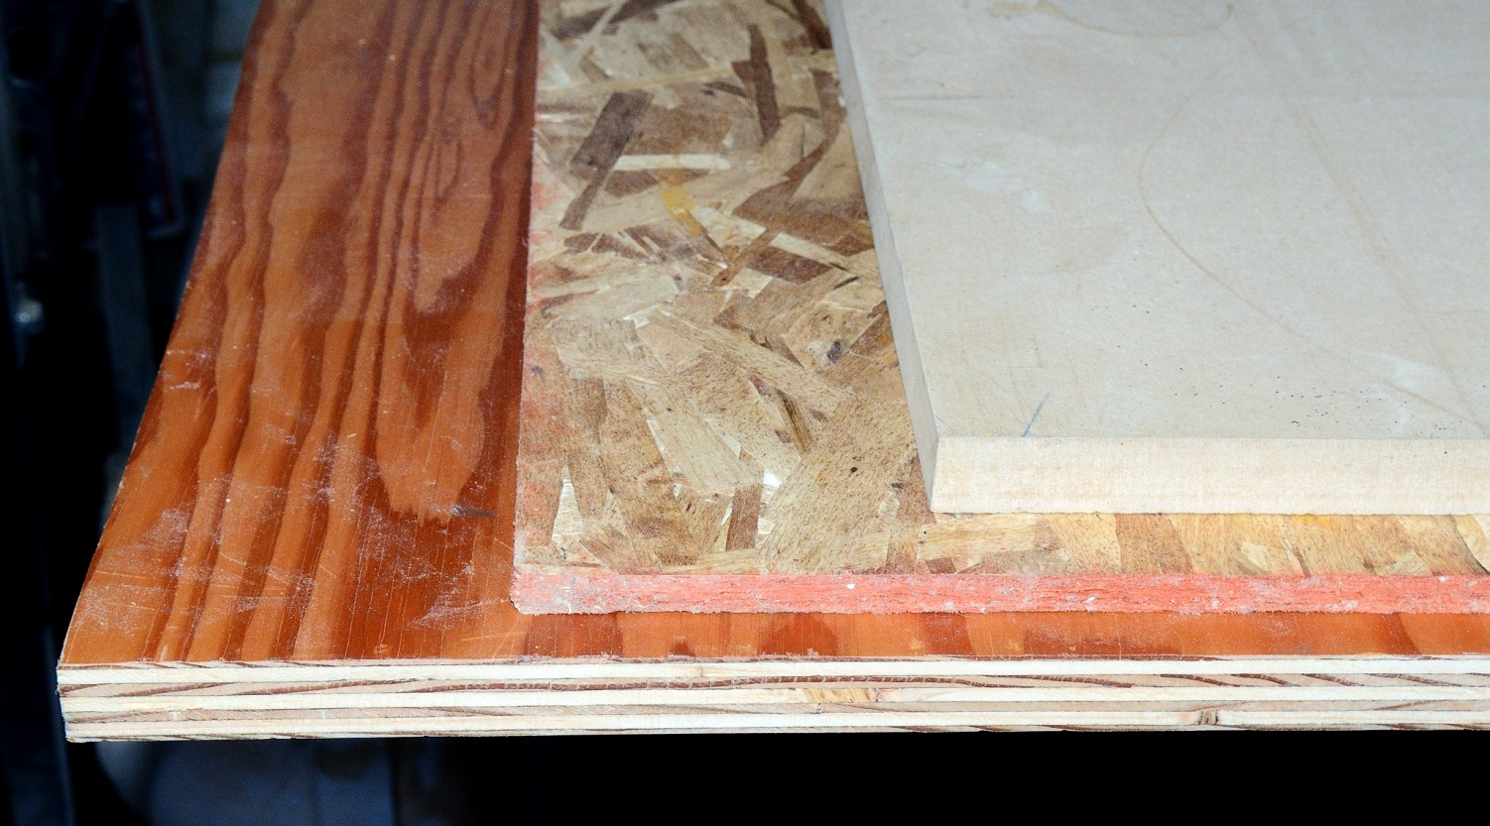
Structural Wood Panels
Plywood
(bottom)

Slide 47
Structural Wood Panels
Oriented strand board (OSB)
shredded strands, like LSL
(middle)

Slide 48
Structural Wood Panels
Fiberboard
very fine-grained wood particles
(top)

Slide 49
Structural Wood Panels
Composite panels: face veneers bonded to solid core
Particleboard: glued particles, smaller than OSB strands but larger than fiberboard particles

Slide 50
Structural Wood Panels
Standard sizes: 4' x 8', 5/16" to 1 1/8" thick
Used as sheathing on framed walls and roofs, and subflooring over floor framing

Slide 51
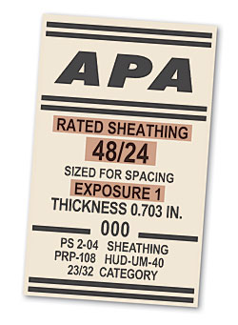
Structural Wood Panels
Span Rating
E.g., 48/24
May be used as roof sheathing over rafters spaced at 48" or as subflooring over joists spaced at 24"

Slide 52
Structural Wood Panels
Exposure Durability Classification: Exposure 1
Exterior glue
Medium quality veneers
For interior use
Prolonged exposure to moisture permitted during construction.
MOST COMMON

Slide 53
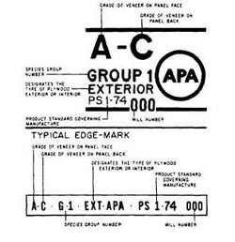
Structural Wood Panels
Exposure Durability Classification Exterior
Exterior glue
Most durable veneers
For permanently exposed exterior siding

Slide 54
Structural Wood Panels
Plywood Veneer Grades A through D
Lower grades (like D) have more defects than higher grades

Slide 55
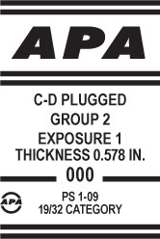
Structural Wood Panels
CDX: C and D faces, with exterior glue; for exterior sheathing
C-D plugged flooring underlayment: C-plugged face provides an especially smooth surface beneath carpet or resilient flooring materials

Slide 56
Wood Chemical Treatments
Fire-retardant treated wood: Chemical salts pressure-impregnated into wood to reduce its combustibility
Used where building code restricts the use of combustible materials
Preservative-treated wood: Protect wood from decay and insect attack
Exposed to the weather, in contact with the ground, or in areas of high termite risk

Slide 57
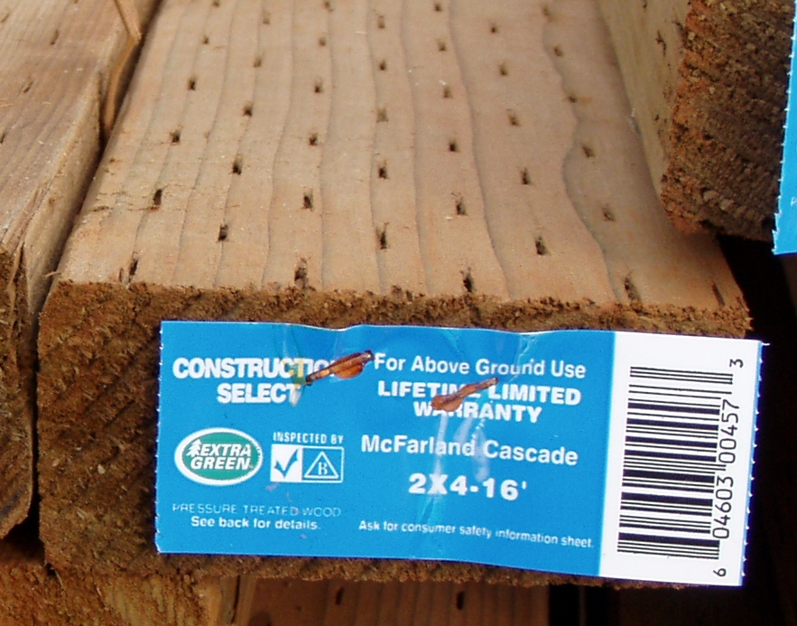
Preservative-Treated Wood
Pressure-impregnated waterborne salts are most common:
ACQ, CBA, CA: High concentrations of copper; most common, require corrosion resistant fasteners and hardware

Slide 58
Preservative-Treated Wood
CCA: Contains arsenic; common in the past, but use has become restricted
SBX and other borate compounds: noncorrosive, nontoxic; primarily for insect resistance; not for exterior exposure or ground contact

Slide 59
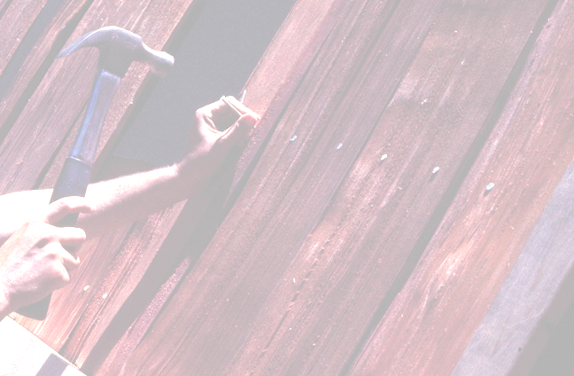
WOOD FASTENERS

Slide 60
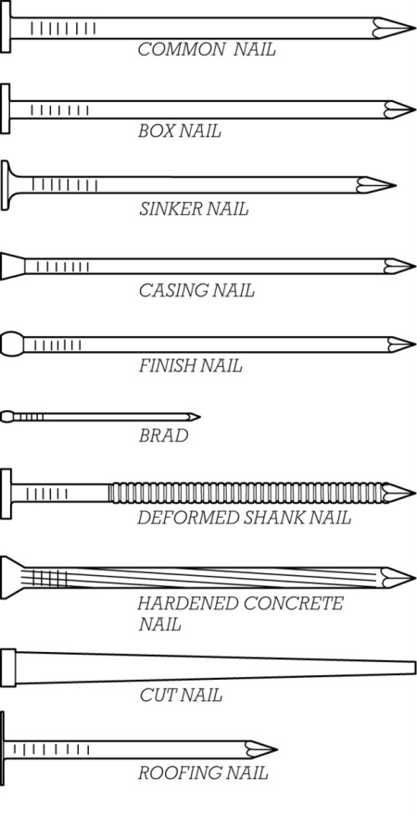
Nails
Inexpensive, fast and easy to install
May be driven by hand or nail gun
Sized in pennies (d), e.g.:
16d: 3½“
8d: 2½“
2d: 1"

Slide 61
Nails
Materials
bright (plain steel)
galvanized (zinc-coated for corrosion resistance)
stainless steel
aluminum, copper, etc.

Slide 62
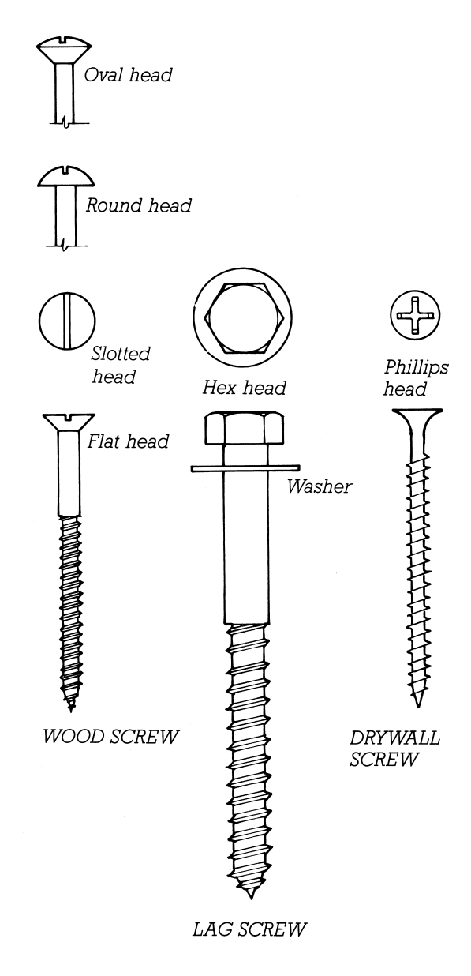
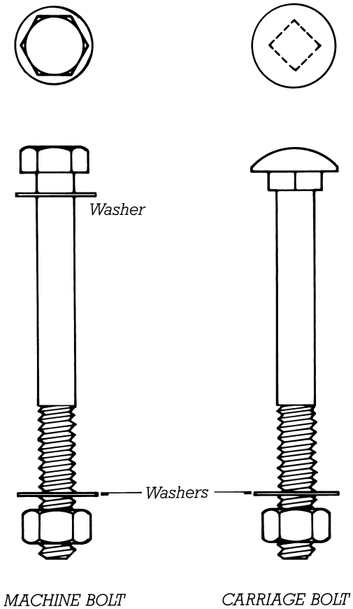
Screws & Bolts
Threaded fasteners
Greater holding power than nails
More expensive and time-consuming to install

Slide 63
Screws & Bolts
Bolts require pre-drilled holes.
Some screws require pilot holes, some are self-drilling.
Great variety of shapes, sizes, head styles, driver shapes

Slide 64
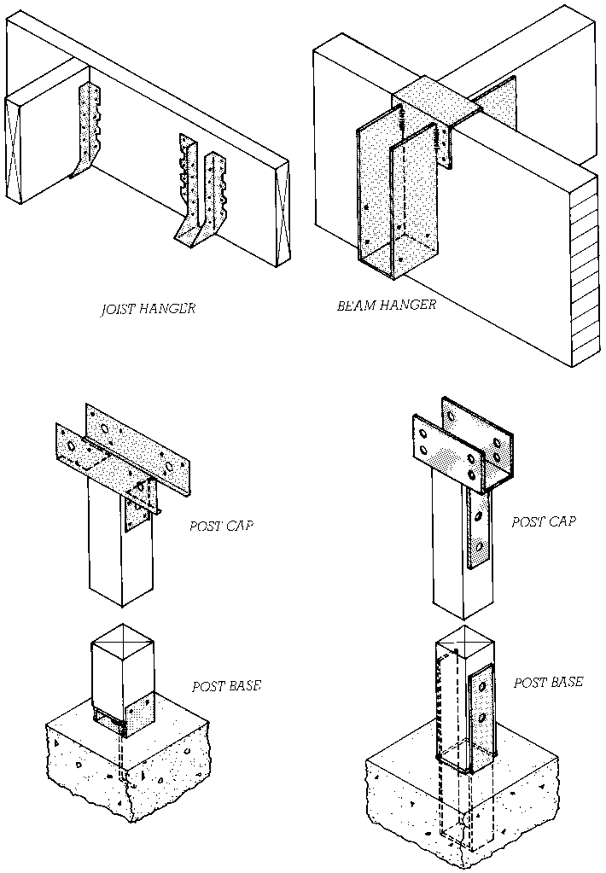
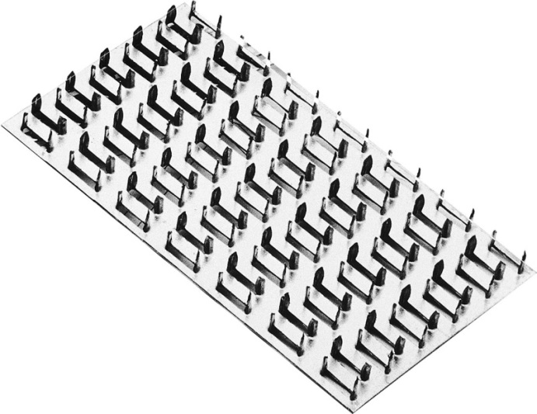
Toothed plates (left)
Metal framing hardware (middle)
Split ring connectors (right)
Adhesives

Slide 65
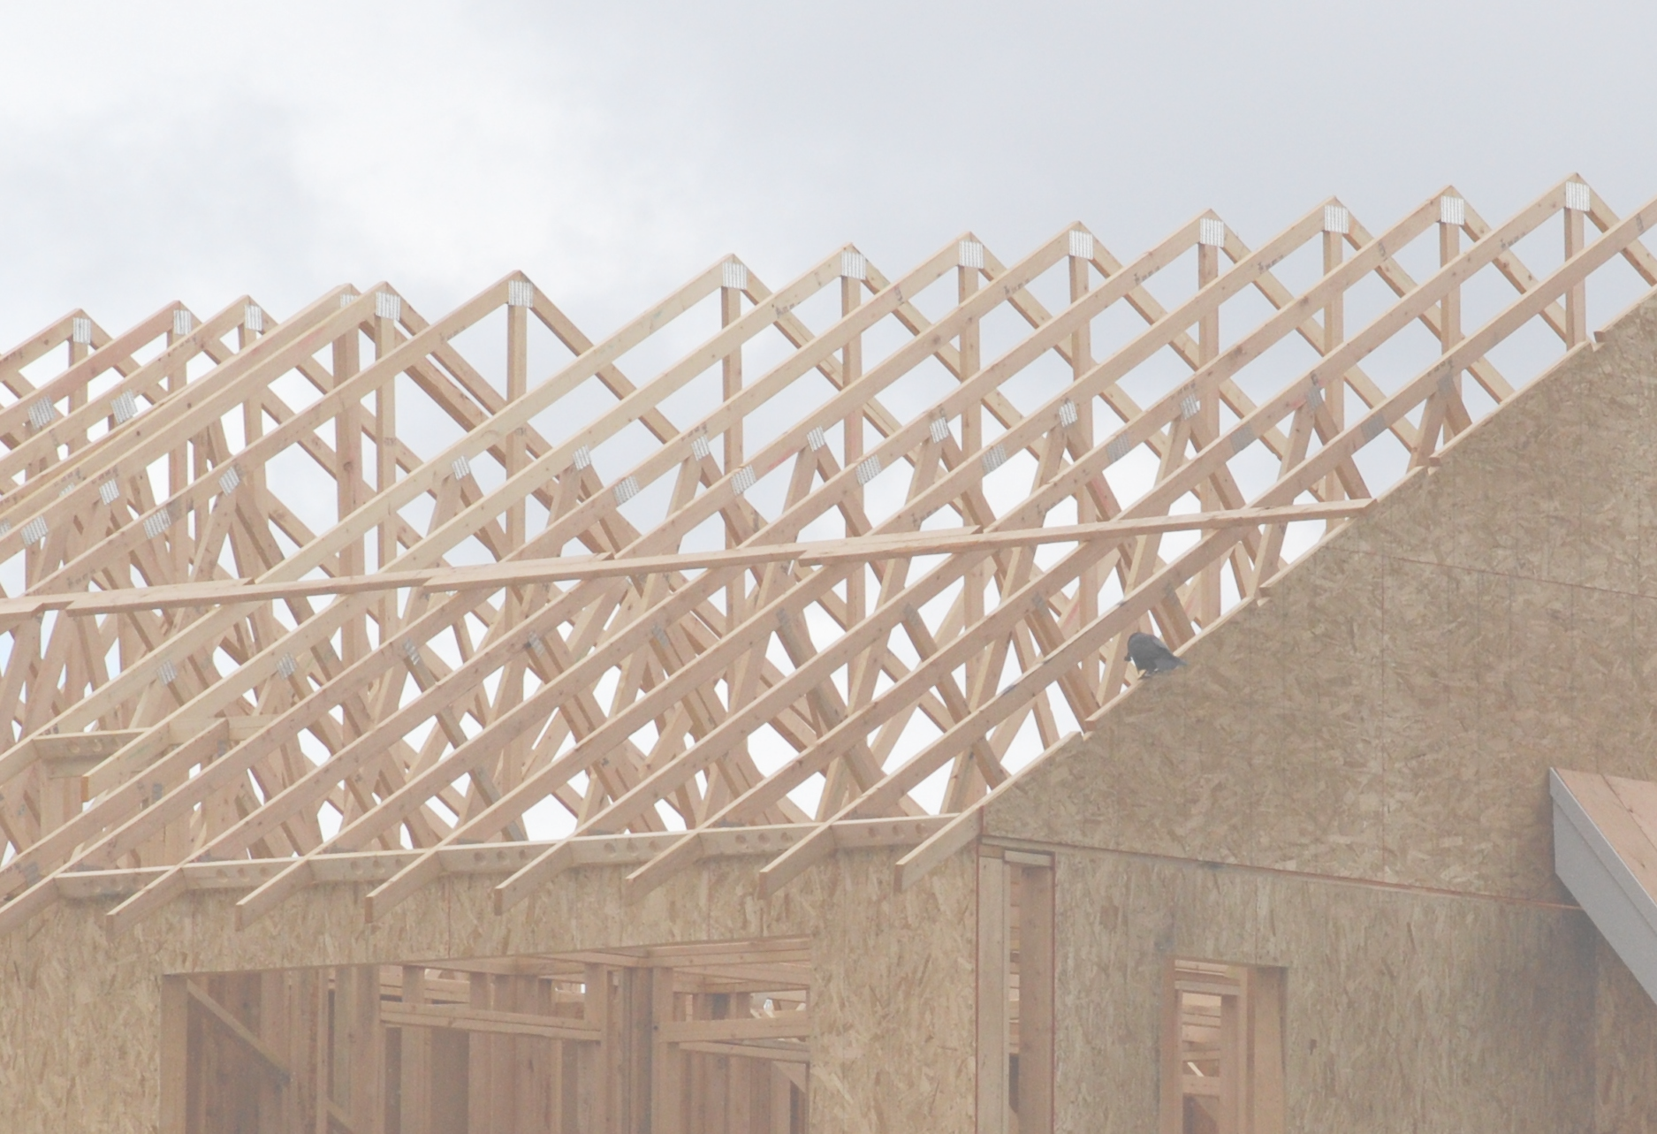
PREFABRICATED WOOD PRODUCTS

Slide 66
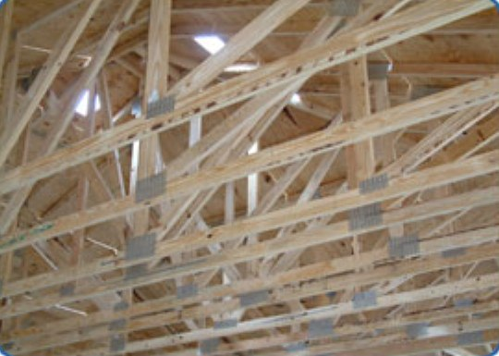
Trusses
Light wood members (2x4, 2x6) joined with toothed plates
Long-span capability
Rapidly erected on site using light-duty cranes
Congested attic space

Slide 67
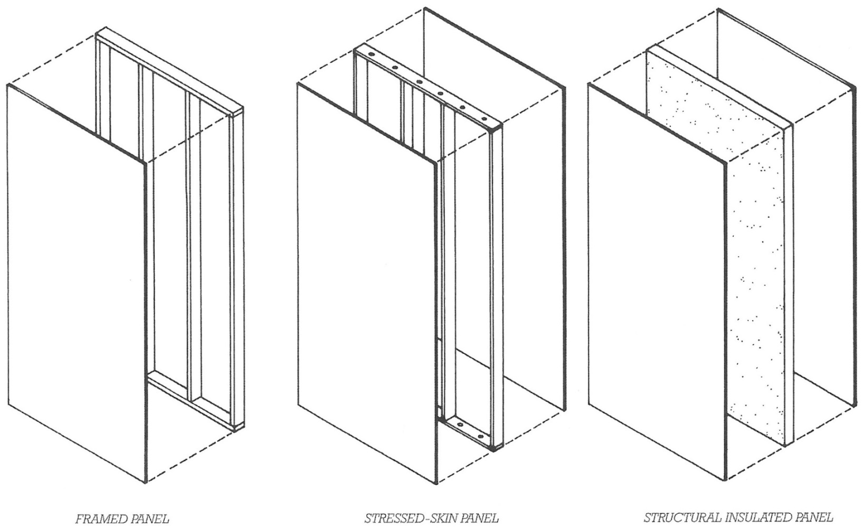
Prefabricated Panels
Can act structurally, or be attached to a structural frame

Slide 68
Factory-Built Housing
Manufactured homes (mobile homes): Built on towable chassis, to U.S. HUD standards

Slide 69
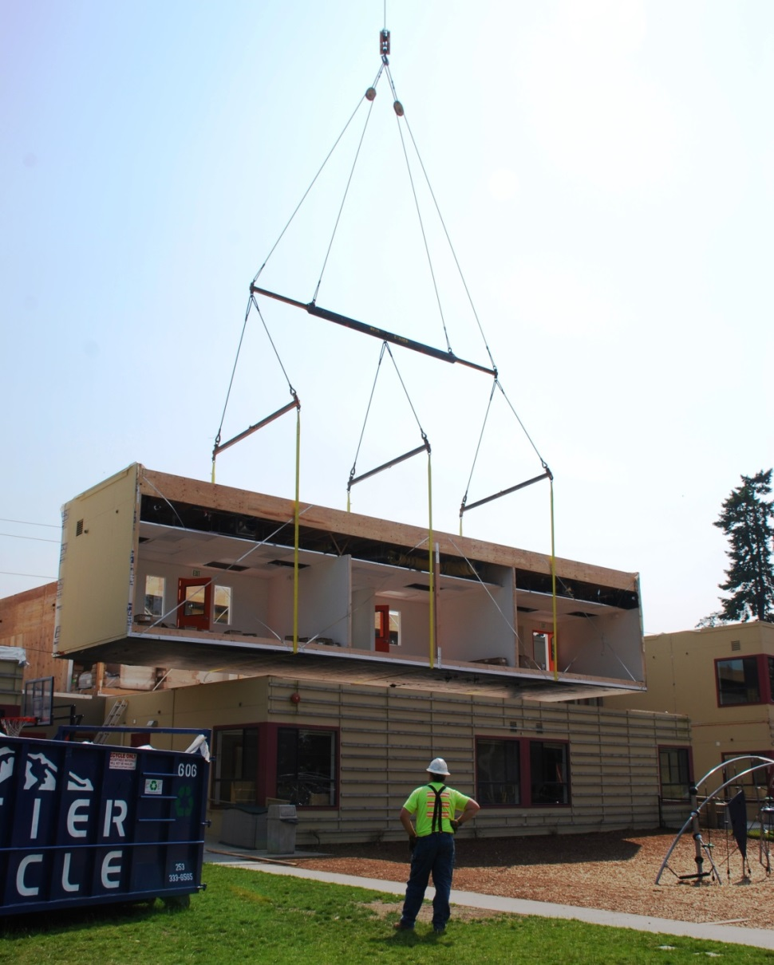
Factory-Built Housing
Modular Construction
Constructed to local building code requirements, but factory-built and trucked to construction site

