Slide 1
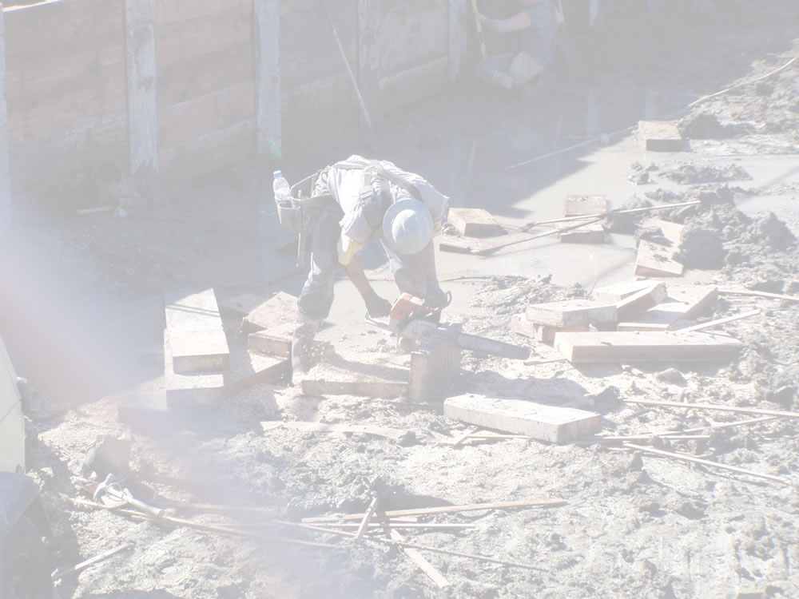
FOUNDATION REQUIREMENTS

Slide 2
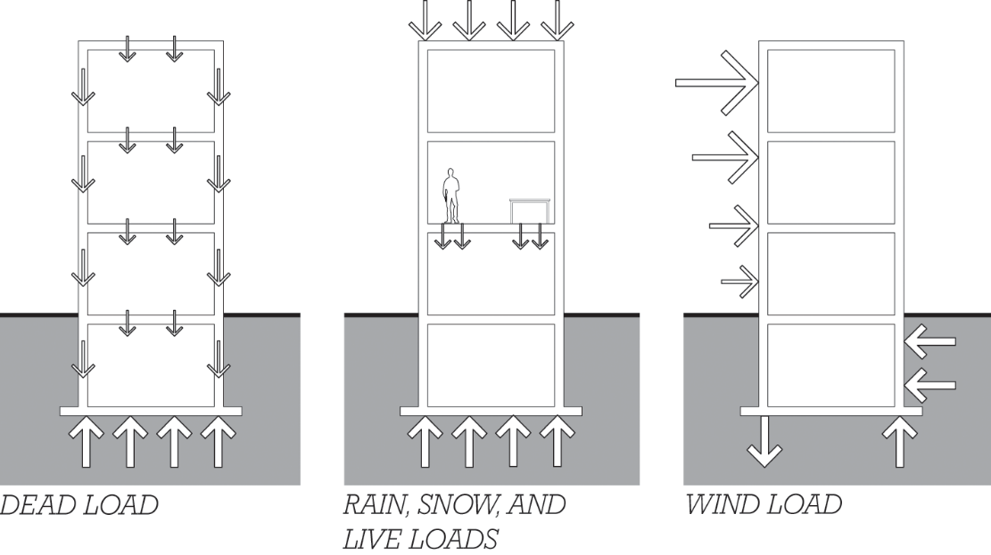
Foundations
Must transmit building loads to the rock or soil on which it rests

Slide 3
Foundations
Deal loads are permanent.
Live loads change over time.

Slide 4
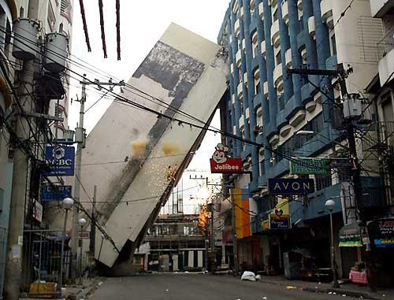
Foundations
Must not allow building collapse
July 2004
SAI building, Manila

Slide 5
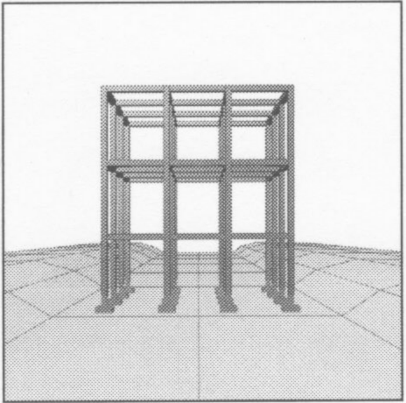
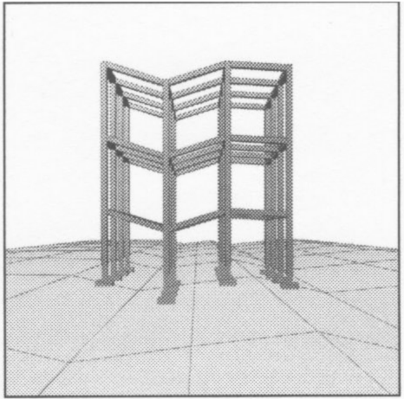
Foundations
Must control settling
Uniform settlement: May disrupt building services entrances or site elements at the building/site interface
Differential settlement: May cause damage to finishes, cladding, and other components where building becomes distorted.

Slide 6
Foundations
Must be economically and technically feasible
Must not have adverse affects on surrounding structures

Slide 7
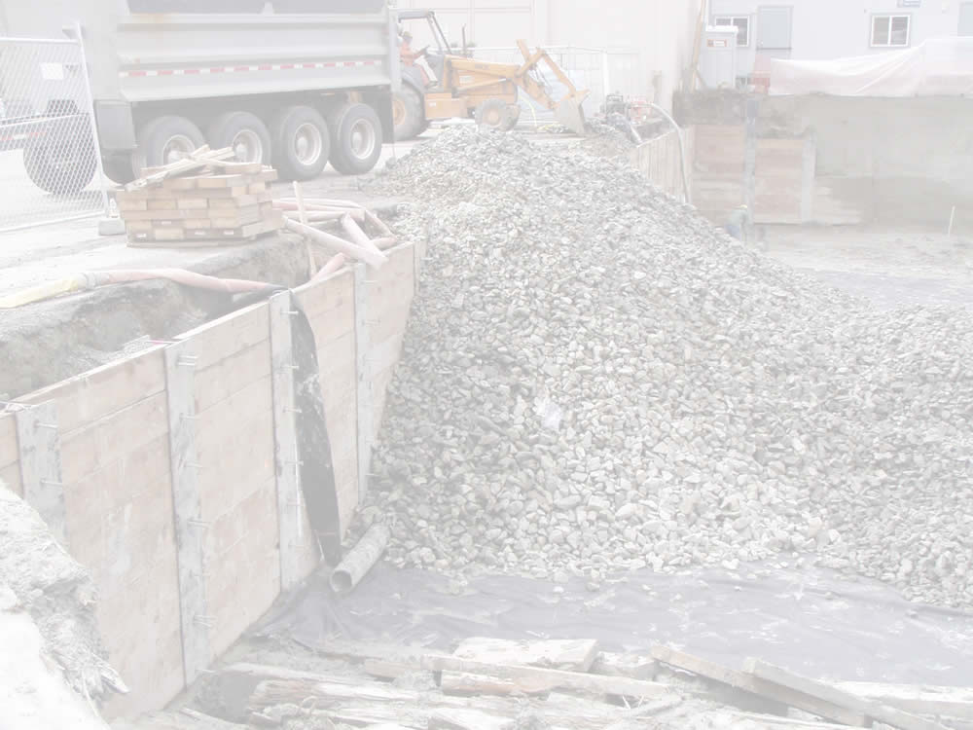
EARTH MATERIALS

Slide 8
Classifying Earth Materials
Particle size
Moisture content
Presence of organic content

Slide 9
Classifying Earth Materials
Rock: Continuous mass of solid mineral material
Generally, the strongest, most stable of earth materials
Strength varies with mineral content and physical structure
Soil: Particulate
Properties vary with particle size and shape, mineral content, and sensitivity to moisture content

Slide 10
Particle Size
Boulder: Too big to lift with one hand
Cobble: Can be lifted in one hand
Gravel: individual particles can be lifted between thumb and forefinger
Sand: particles too small to be individually lifted between fingers

Slide 11
Particle Size
Sand and gravel: coarse-grained soils

Slide 12
Particle Size
Individual silt and clay particles are too small to see with the unaided eye.
Silt: Roughly spherical in shape
Clay: Smaller than silt, plate-shaped

Slide 13
Particle Size
Silt and clay: fine-grained soils

Slide 14
Organic Soils
Peat, topsoil and other soils with plant matter and other organic content
Generally weak, unstable, and not suited for supporting building foundations

Slide 15
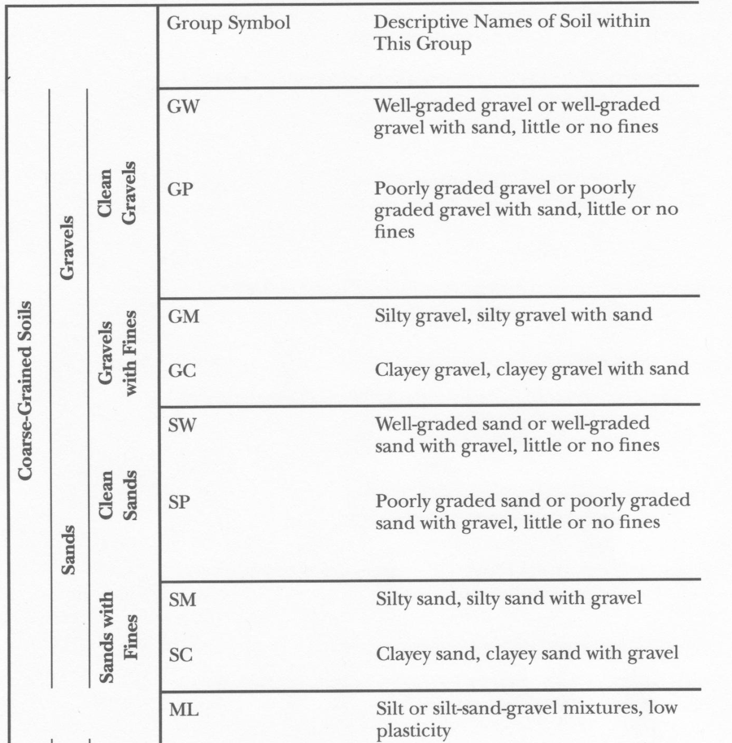
Unified Soil Classification System
Coarse-grained sands and gravels

Slide 16
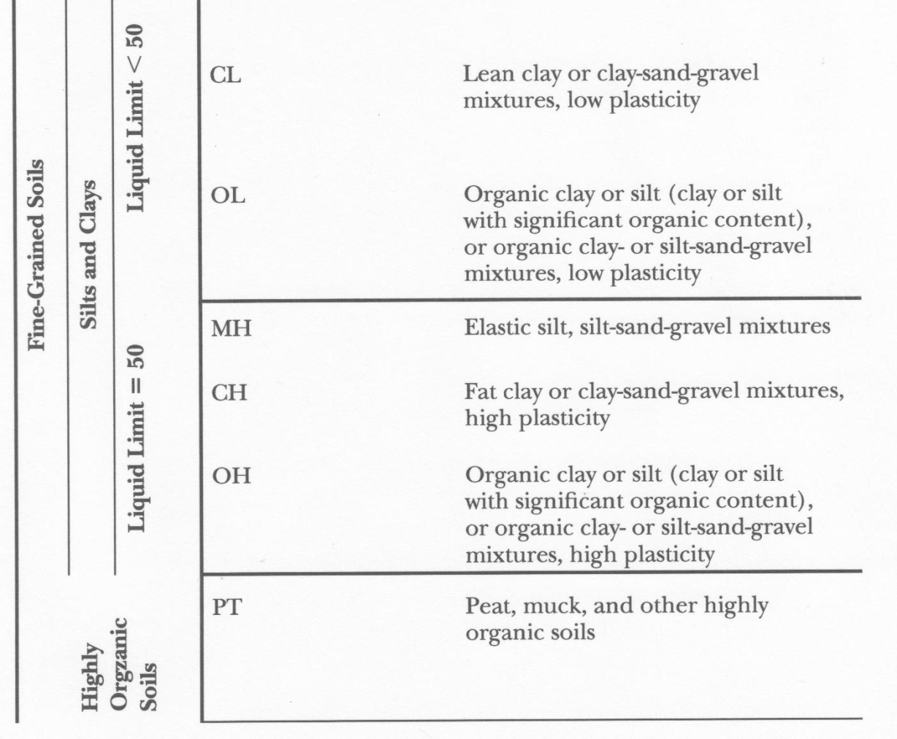
Unified Soil Classification System
Fine-grained silts and clays
Organic soils

Slide 17
Soil Properties
Coarse-Grained Soils
Cohesionless, strength depends on friction and interlocking of adjacent particles or shear strength
When unconfined, have little strength

Slide 18
Soil Properties
Coarse-Grained Soils
Properties little affected by moisture content
Free-draining: Good for draining water away from foundations and substructures or from under slabs on grade and pavements

Slide 19
Soil Properties
Fine-Grained Soils
Smaller particle size makes them less free draining
More sensitive to moisture: Properties and strength vary with moisture content

Slide 20
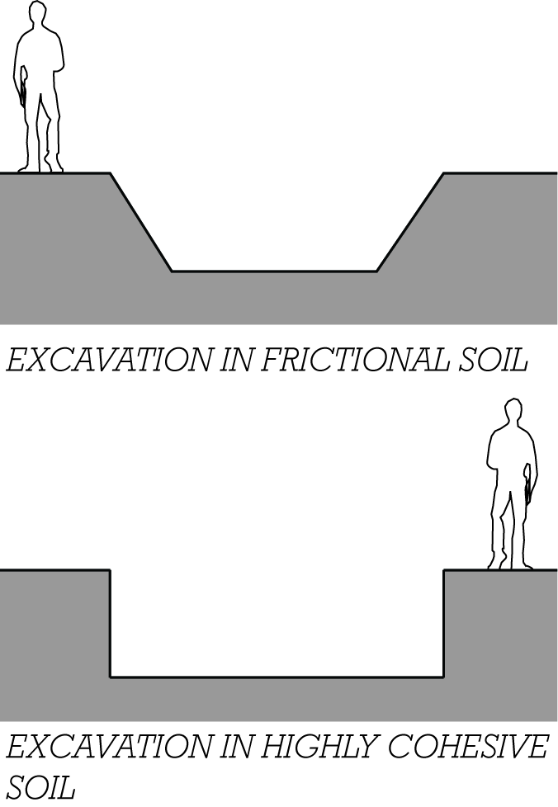
Soil Properties
Clays
Very small particles
Electrostatic forces cause particles to stick together: cohesive

Slide 21
Soil Properties
Clays
Properties vary with moisture content and mineral composition
Some are highly expansive when wetted
Some are virtually impervious to water
Some clays are subject to consolidation, or gradual compression over time

Slide 22
Soil Properties
Liquefaction
Some saturated sands and silts will lose all strength and flow like a liquid when subject to seismic forces

Slide 23
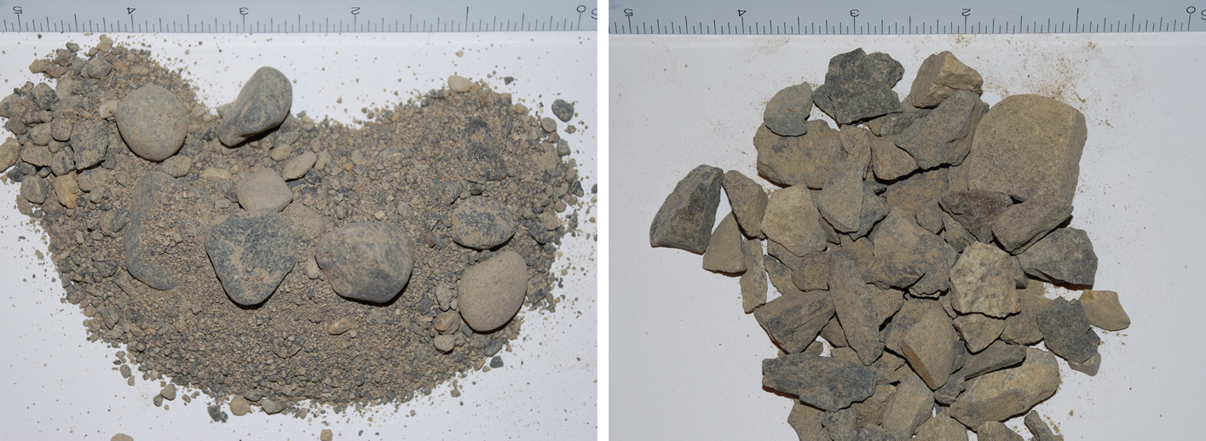
Soil Gradation
Well graded soil (left): wide distribution of particle sizes

Slide 24
Soil Gradation
Well sorted soil (right): Limited range of particle sizes
More void space; more free draining

Slide 25
Soils for Foundations
Strength: Generally, the larger the particle size, the stronger the soil

Slide 26
Soils for Foundations
Moisture sensitivity: Coarse-grained soils, less sensitive to moisture content, are more stable.

Slide 27
Soils for Foundations
Imported soils: Brought from off site
General purpose fill for raising grade: well-graded, coarse grained soil
Drainage fill around foundations or under slabs: Gap graded or uniformly graded gravel with good drainage characteristics

Slide 28
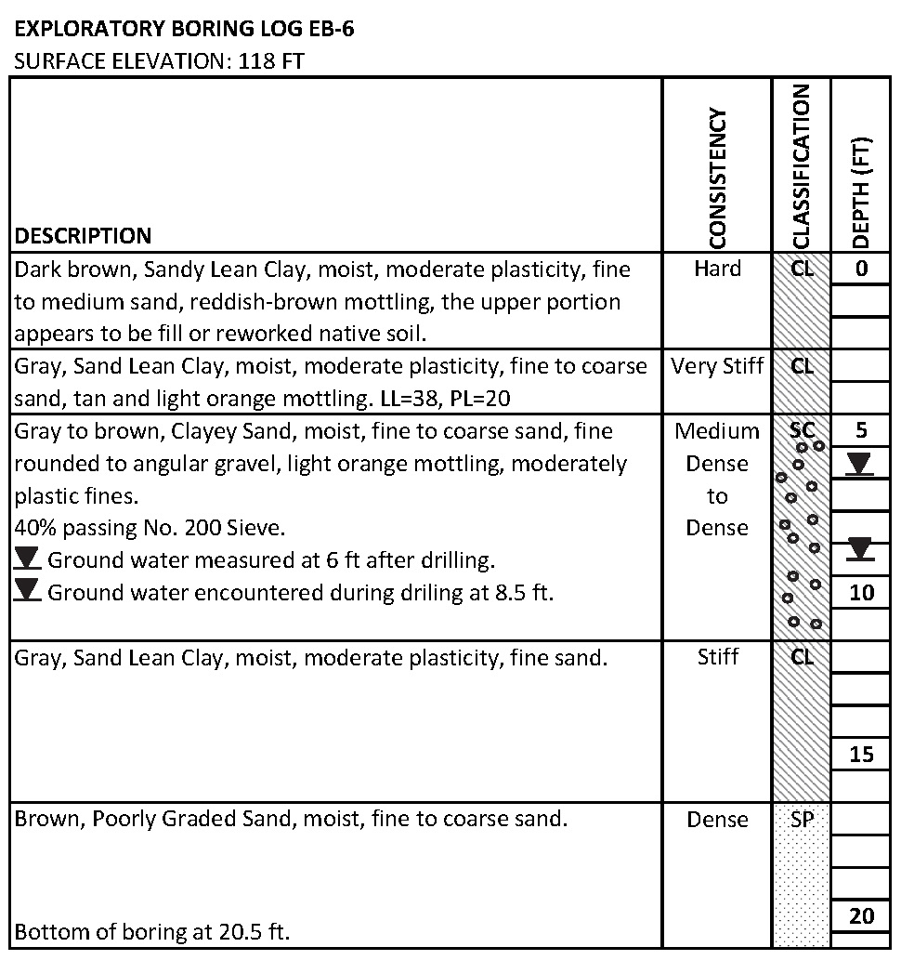
Exploration and Testing
Geotechnical reports describe soils and properties, derived from:
Test pit samples
Boring samples
Laboratory testing

Slide 29
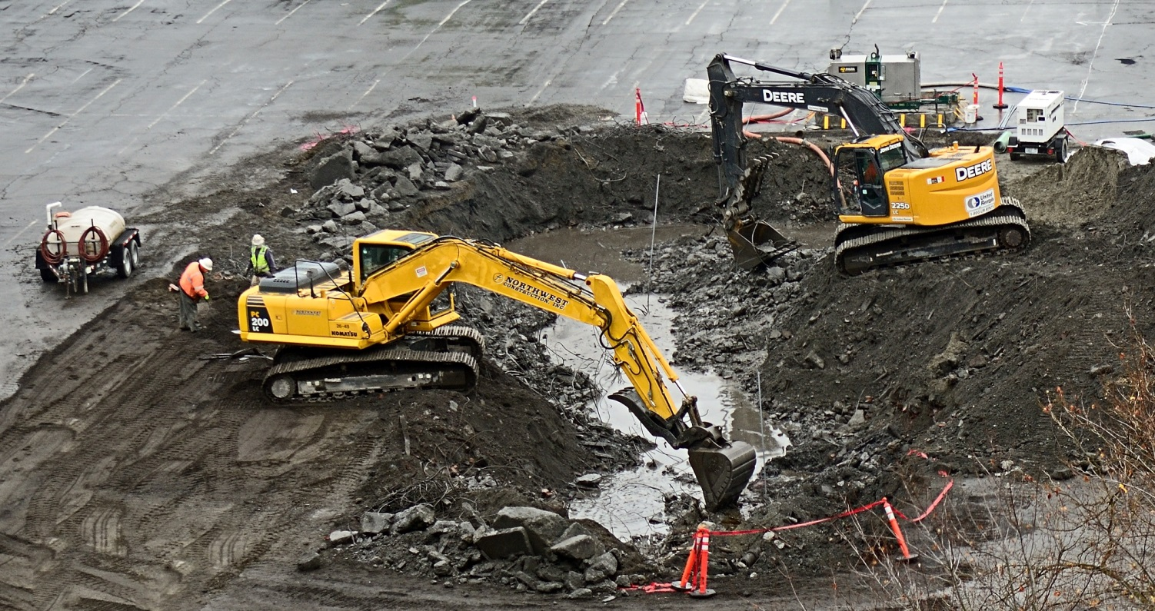
EXCAVATION

Slide 30
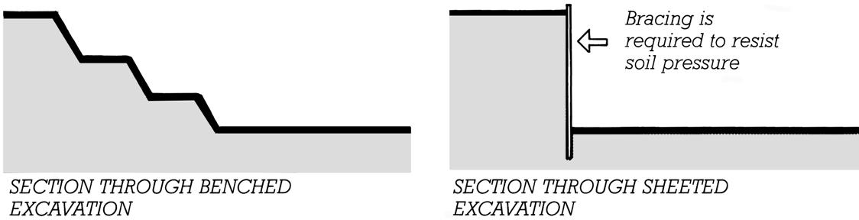
Excavation Support
Sloped or benched excavation is less expensive than sheeted excavation, but requires a site without nearby property lines, adjacent structures, or other limits on excavation.

Slide 31
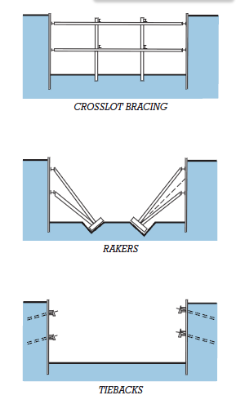
Excavation Support
Tiebacks leave the excavation unencumbered.
Eventually, completed building foundation takes on role of resisting soil pressures.

Slide 32
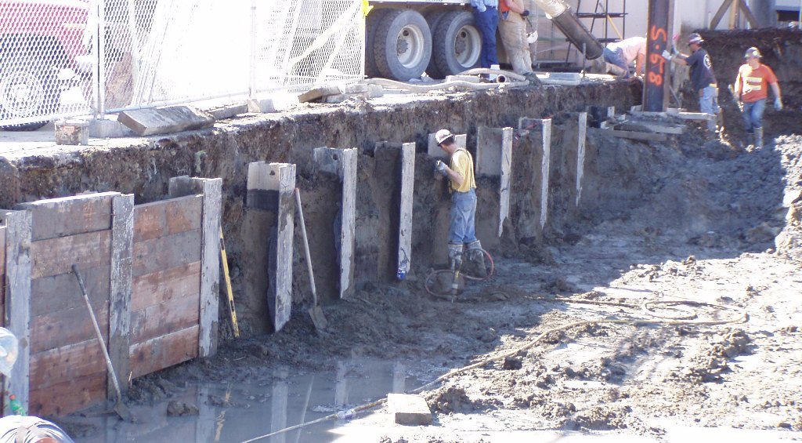
Soldier Beams and Lagging

Slide 33
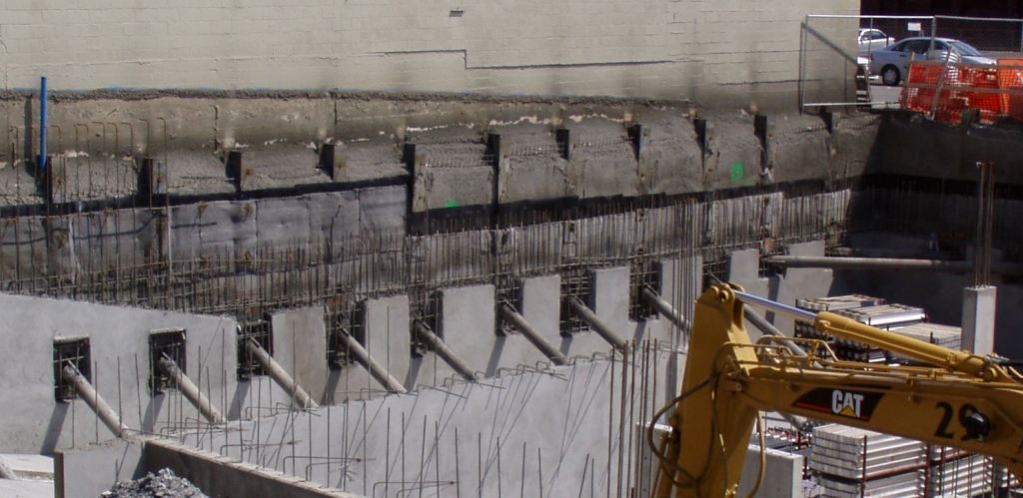
Soldier beams and shotcrete braced by rakers, followed by waterproofing and cast in place concrete foundation wall

Slide 34
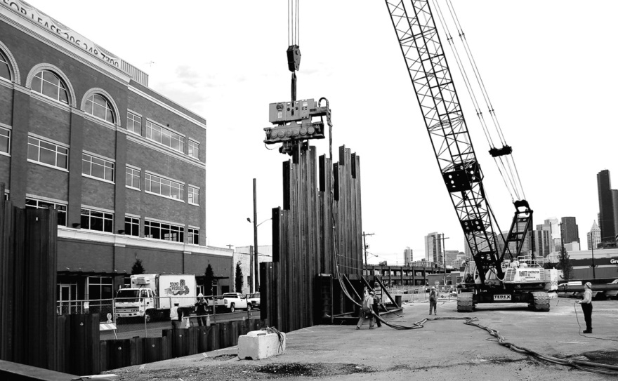
Steel Sheet Piling

Slide 35
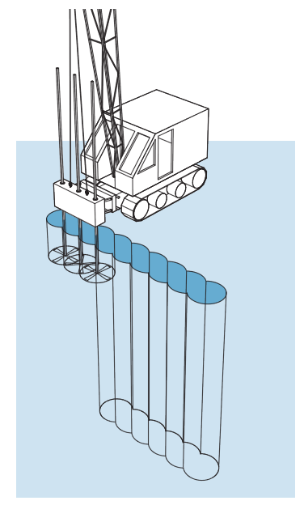
Soil mixing
Columns of soil strengthened with portland cement and water are created prior to excavation.

Slide 36
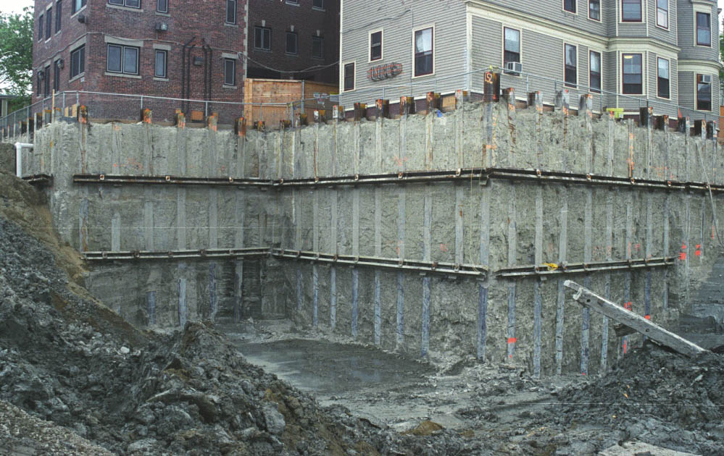
Soil mixed slope support, with soldier beams, walers, and tie backs

Slide 37
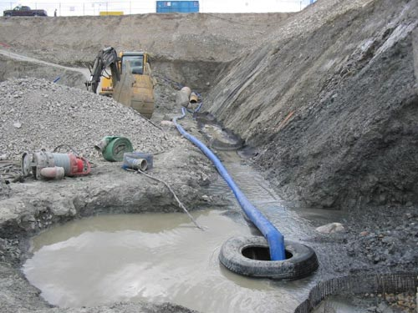
Dewatering
Simple: pump water from pits (sumps) in the excavation

Slide 38
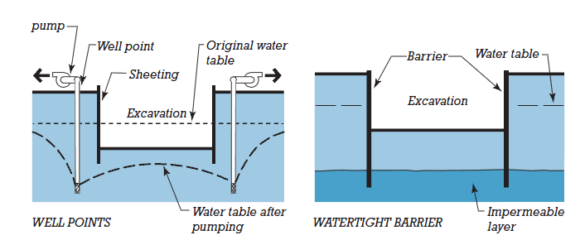
Higher volumes of water: use well points or barrier wall

Slide 39
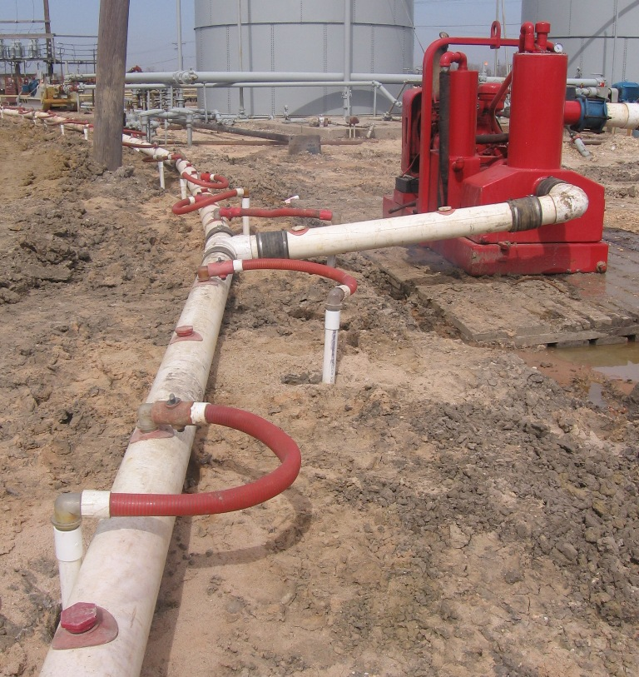
Well points, header pipe, and dewatering pump

Slide 40
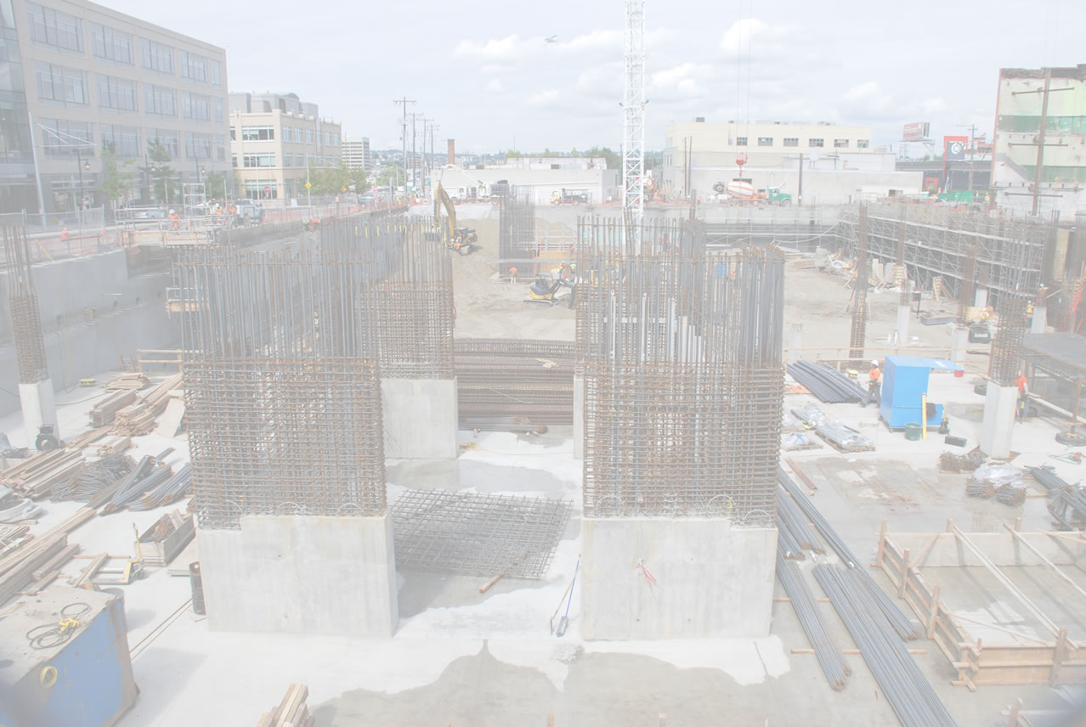
FOUNDATIONS

Slide 41
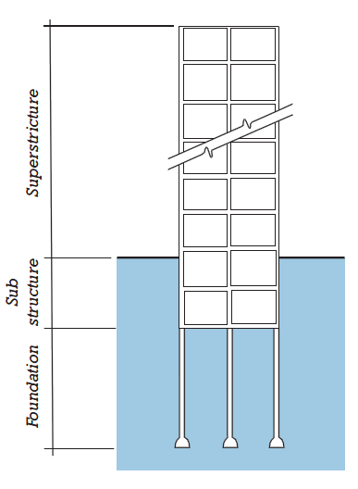
Shallow footings occur close to the bottom of the substructure.
Deep footings extend to deeper, more competent soil.

Slide 42
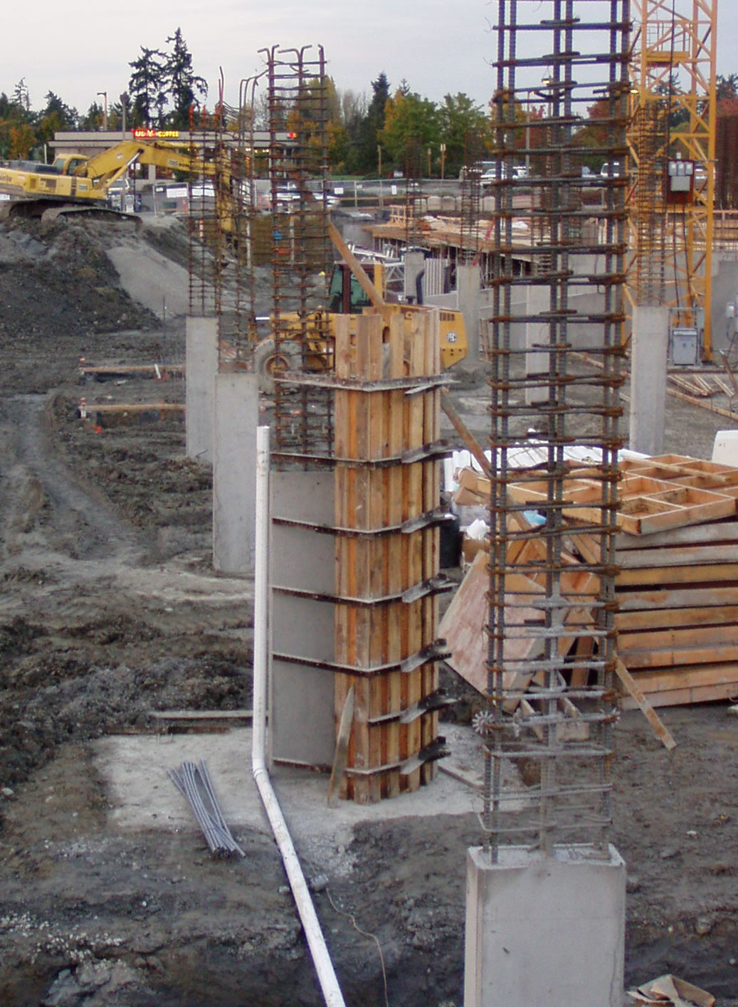
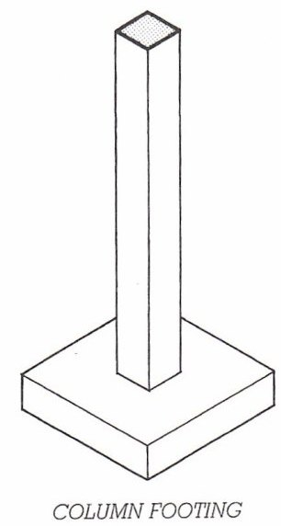
Column Footing

Slide 43
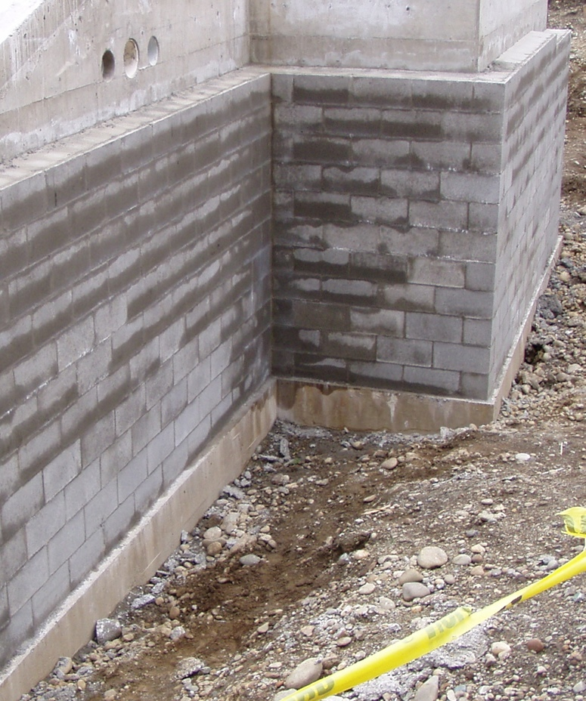
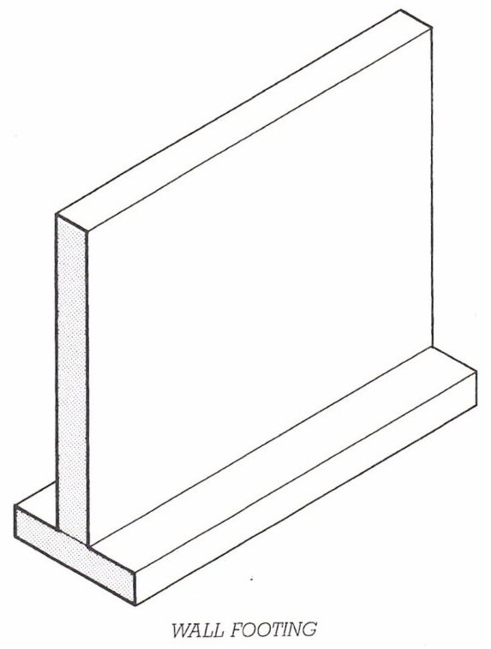
Wall (Strip) Footing

Slide 44
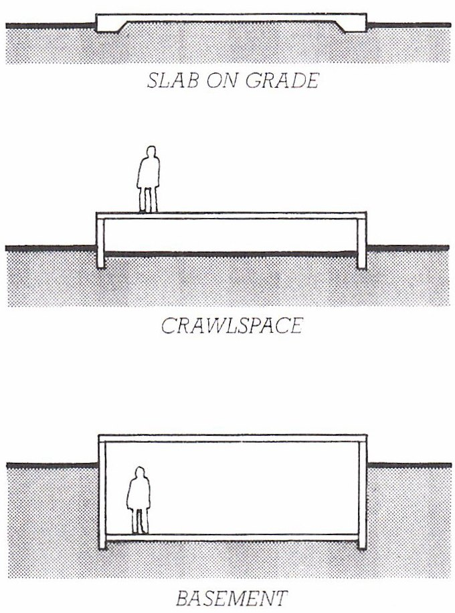
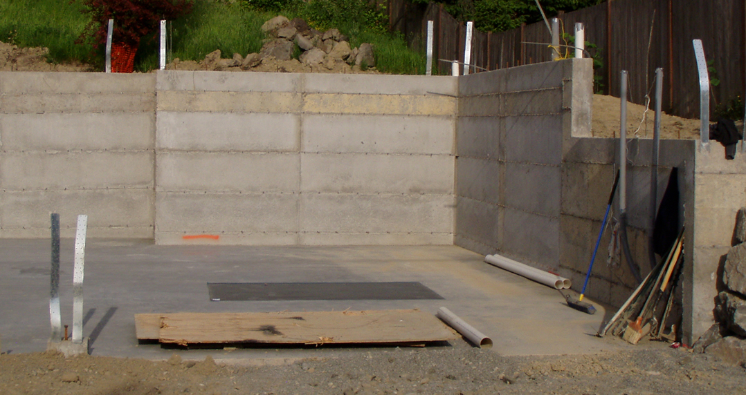
Slab on grade
Crawlspace
Basement

Slide 45
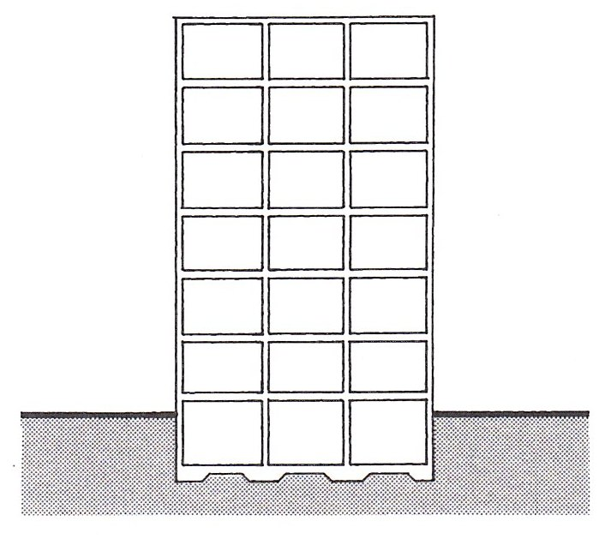
Mat Foundation
Close to bottom of substructure…

Slide 46
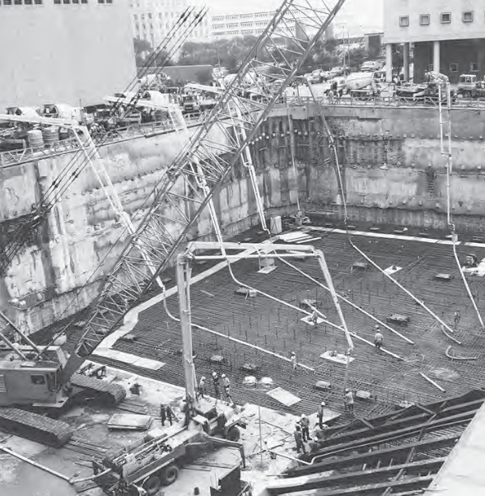
…but often quite deep.
(Note tiebacks and rakers.)

Slide 47
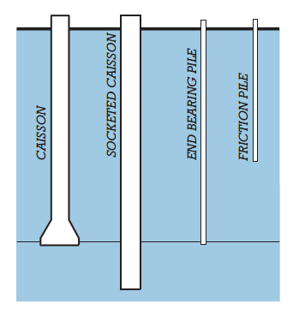
Deep Foundations
Where the soils directly below the building substructure are weak or unstable, deep foundations transmit building loads to deeper, more competent, soils.

Slide 48
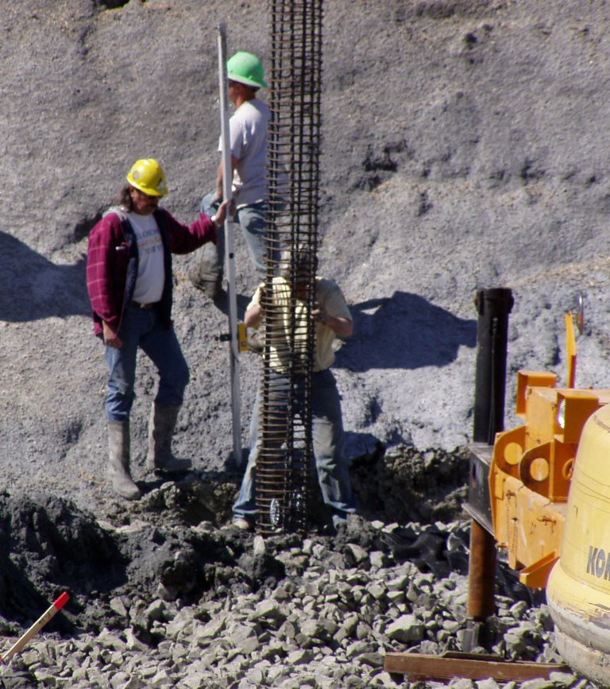
Piers (Caissons)
Drilled into earth
Right: Steel reinforcing is being lowered into the drilled hole. Next, concrete will be poured.

Slide 49
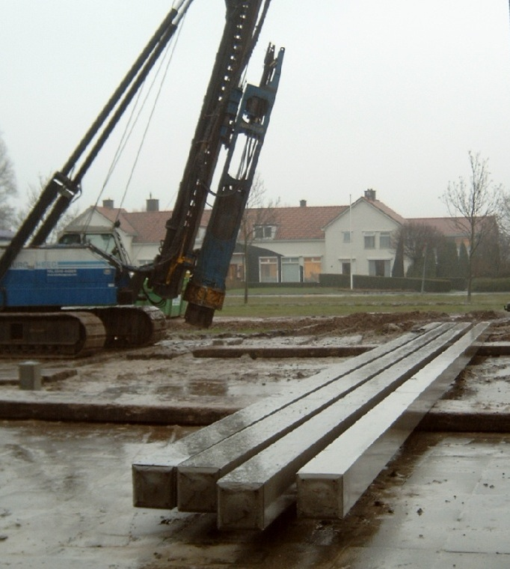
Piles
Driven into the earth
May be made of steel, wood, or precast concrete (pictured here).

Slide 50
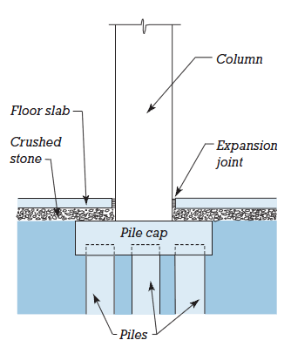
Pile Cap
Share loads among clustered piles

Slide 51
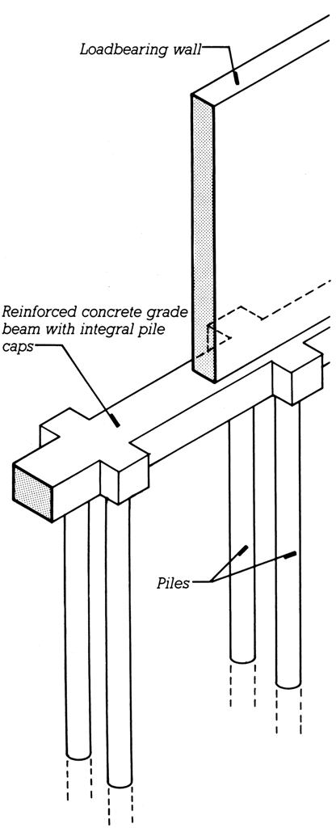
Grade Beam
Spans between the pile caps or piers, to provide continuous support for the wall above

Slide 52
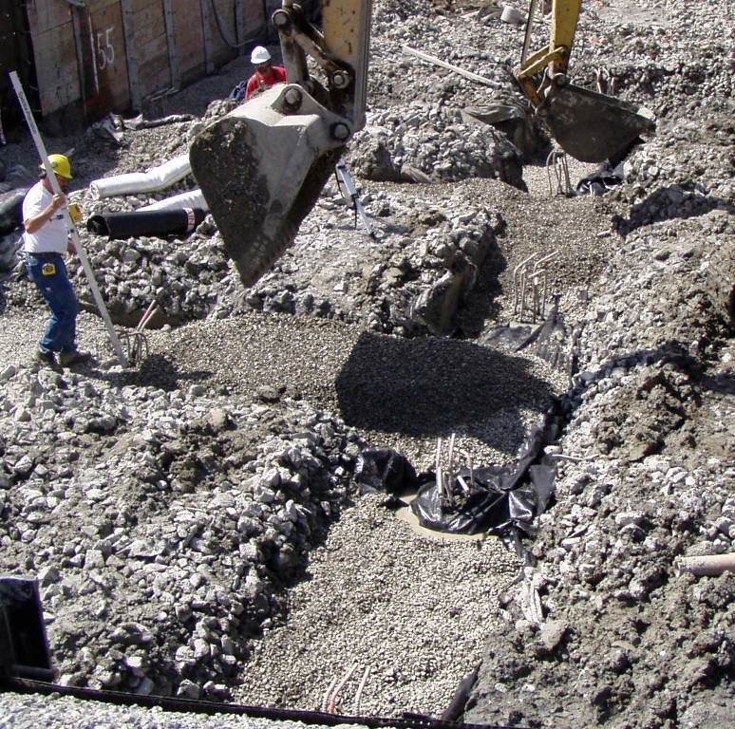
Reinforcing bars project from the tops of completed drilled piers. Gravel is being deposited between the piers, to form a base for concrete grade beams which will span between the piers.

Slide 53
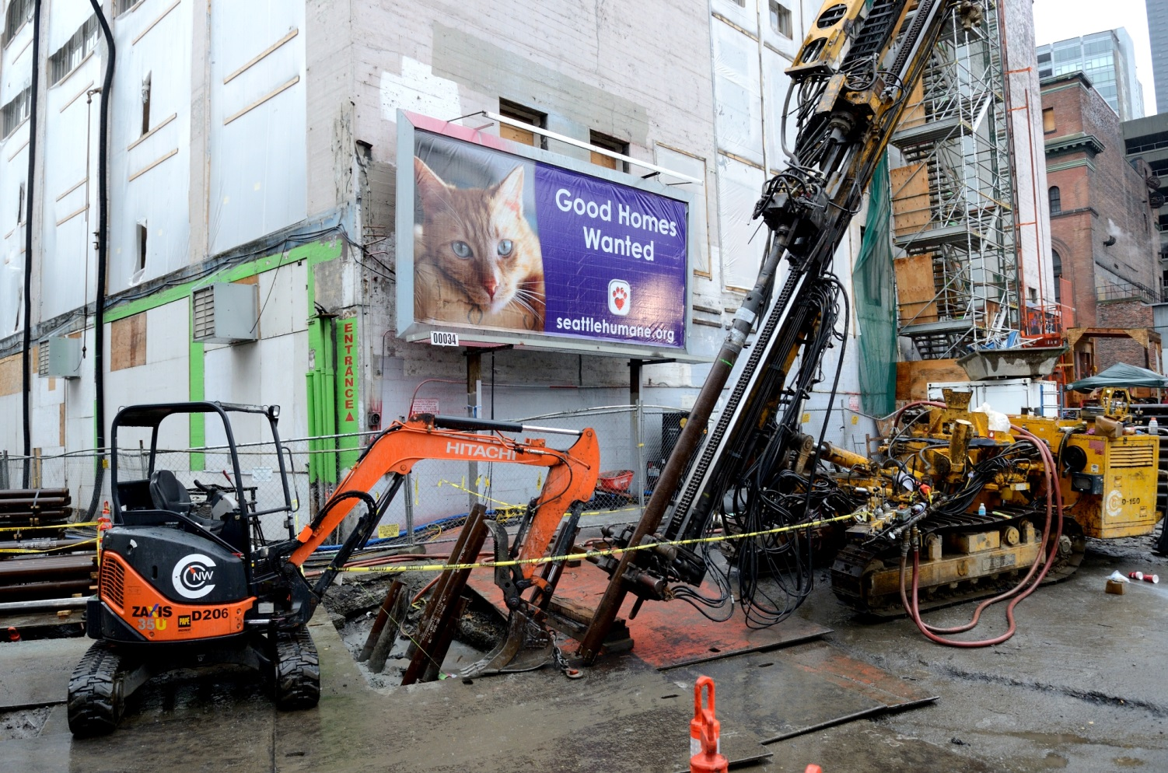
Minipiles (Pin Piles)
Pressed or rammed into place
Used here for soil stabilization.

Slide 54
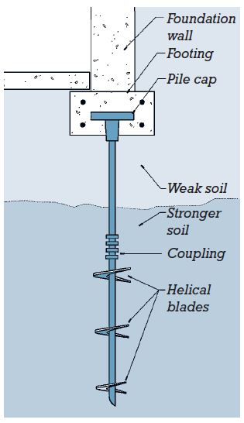
Helical Piles
(Screw Piles)
Augered into place

Slide 55
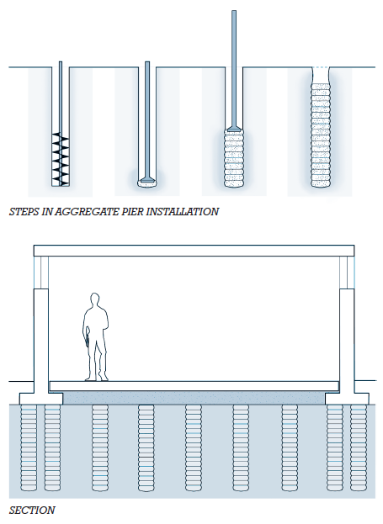
Rammed aggregate piers
Ground improvement
Permits shallow footings to be used where deeper types would otherwise be required.

Slide 56
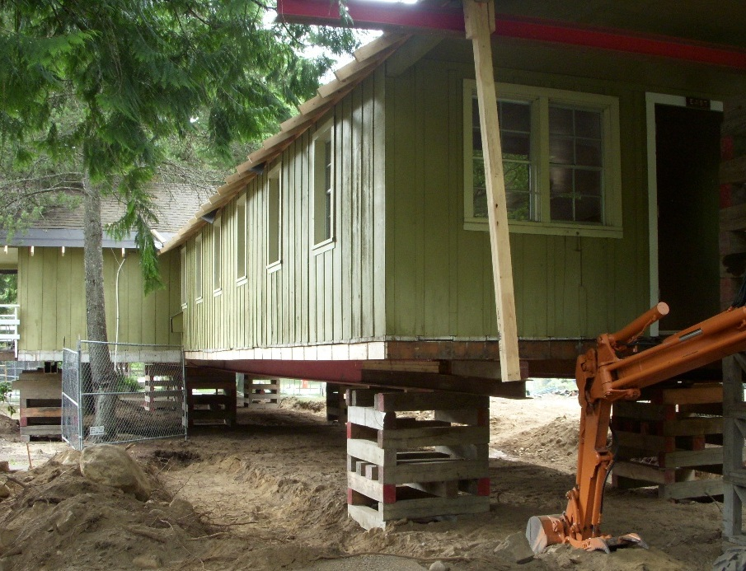
Underpinning
Building super-structure is temporarily supported on cribbing while new foundations are built.

Slide 57
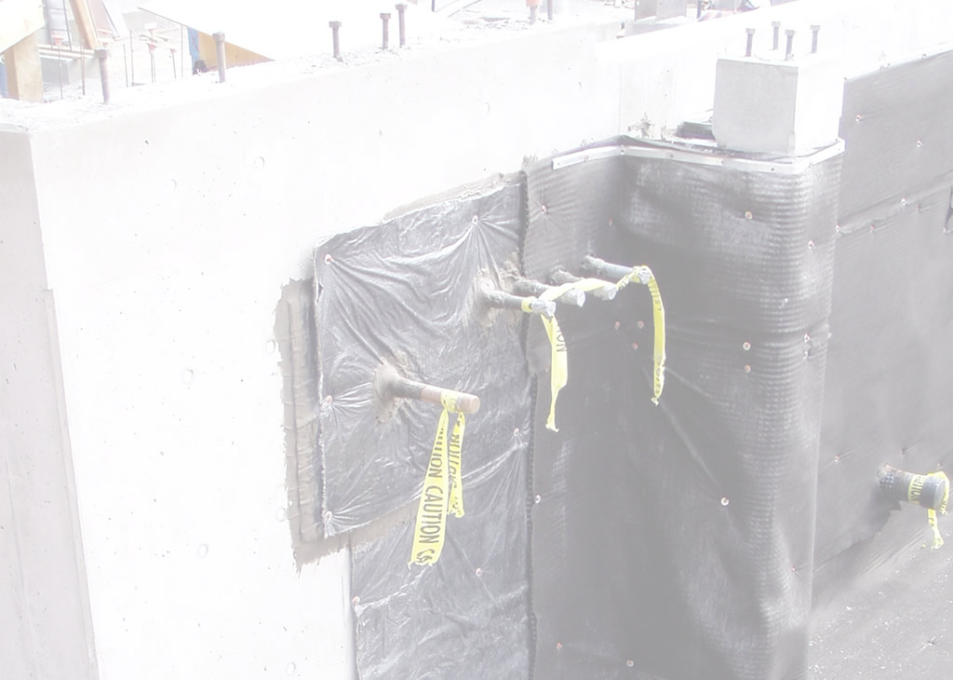
WATERPROOFING
AND
DRAINAGE

Slide 58
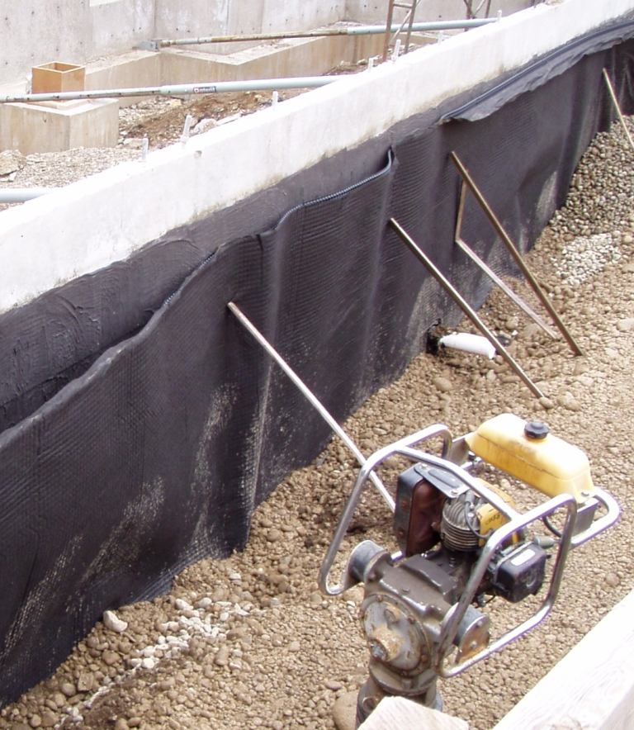
Drainage
Drainage mat and free-draining backfill material allow ground water to flow downward where it is collected by drain piping.

Slide 59
Drainage
The machine in the foreground is used to compact the fill material as it is placed in lifts roughly 6 inches deep at a time.

Slide 60
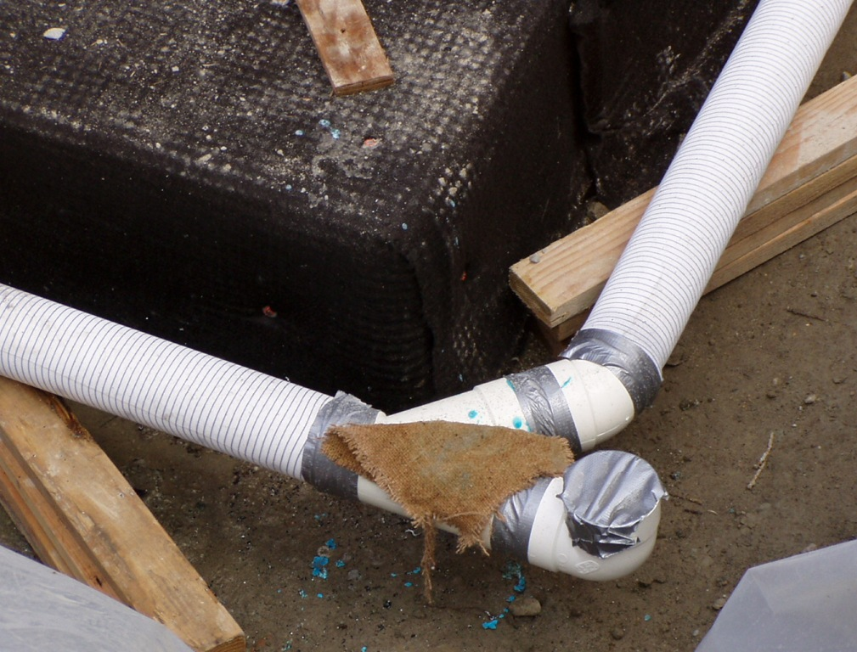
Drain Piping
Perforated piping conducts water away from the substructure.

Slide 61
Filter fabric “socks” cover the piping to prevent soil particles from accumulating in and eventually clogging the pipes.

Slide 62
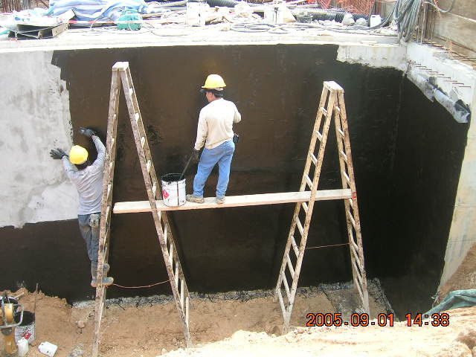
Dampproofing
Moisture-resistant

Slide 63
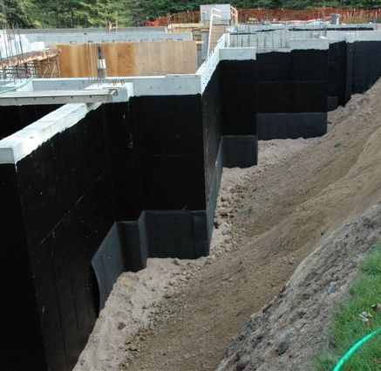
Waterproofing
Prevents passage of water even under hydrostatic pressure.

Slide 64
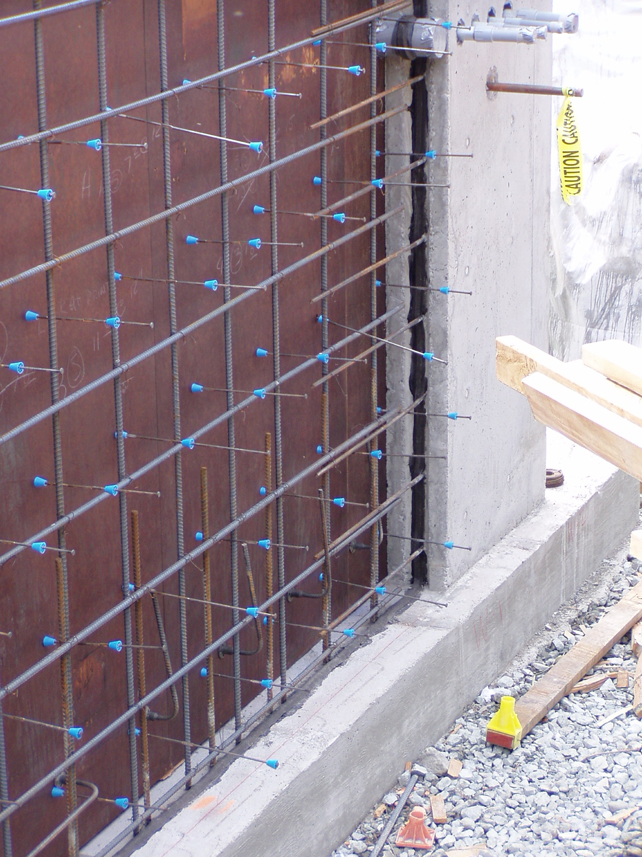
Waterstop
Stops water passage through joints at separate concrete pours.

Slide 65
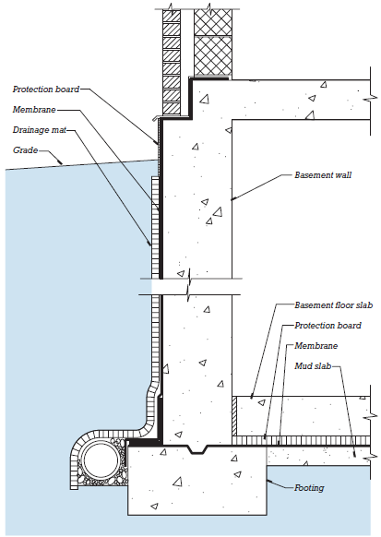
Typical Section
Drainage fill
Drain mat
Drain piping
Waterproofing membrane

