Slide 1

BUILDINGS
AND THE ENVIRONMENT

Slide 2
Building Environmental Impacts
Building construction and operation accounts for 30 to 40 percent of energy use and greenhouse gas emissions worldwide.

Slide 3
Building Environmental Impacts
In the United States:
35 percent of energy use
65 percent of electricity consumption
30 percent of raw materials consumption

Slide 4
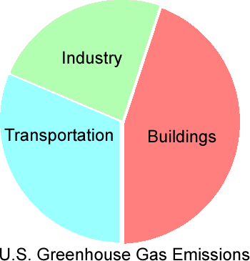
Building Environmental Impacts
Building construction and operation account for 40 percent of U.S. greenhouse gas emissions.

Slide 5
Sustainability
Meeting the needs of the present generation without compromising the ability of future generations to meet their needs…

Slide 6
Sustainable Building Construction
Reduce the depletion of fossil fuels
Preserve arable land
Minimize materials consumption and waste
Protect forests and forest ecosystems
Protect water resources
Minimize air pollution
Maximize the healthfulness of the interior building environment

Slide 7
Sustainable Building Construction
Produce buildings that are healthful for their occupants, protect resources, promote environmental quality, and provide the broadest social benefit.
Green building

Slide 8
Sustainable Building Construction
Green building practices are maturing.
Standards are becoming more focused on verifiable performance outcomes.
Adoption is broadening.
Increasingly integrated with mainstream practices and costs.

Slide 9
Sustainable Building Materials
How can the designer know if use of a particular product or material will:
Deplete nonrenewable resources?
Unnecessarily consume excess energy due to distant transportation?
Cause unhealthful emissions?
Have other harmful effects?
etc.

Slide 10
Environmental Labels
Provide information used in the responsible selection of materials and products. Data must be:
Reliable
Meaningful
Readily available

Slide 11
ISO 14020 Environmental Labeling
Type I Ecolabels
Independent, third-party certifications of environmental performance
Unbiased
Reliable
Allow like-to-like comparisons

Slide 12
ISO 14020 Environmental Labeling
Type I Ecolabels
E.g., Greenseal Standard GS-11 for Paints and Coatings
Performance requirements
Hazardous content restrictions
Responsible application and disposal practices
Allows easy and trustworthy product comparisons

Slide 13
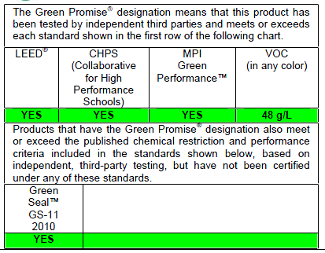
ISO 14020 Environmental Labeling
Example paint manufacturer’s independently verified claims

Slide 14
ISO 14020 Environmental Labeling
Type II Self-Declared Environmental
Claims
Manufacturer claims
Not independently verified
May vary in scope and method of assessment from one manufacturer to another

Slide 15
ISO 14020 Environmental Labeling
Type II Self-Declared Environmental
Claims
E.g., manufacturer-reported recycled materials content
End user must assume more responsibility for understanding manufacturer’s method of reporting and decide its relevance or usefulness

Slide 16
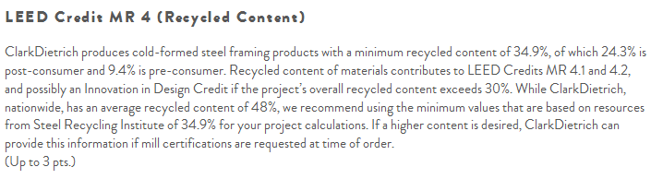
ISO 14020 Environmental Labeling
Example steel stud manufacturer’s self-declared recycled content claims

Slide 17
ISO 14020 Environmental Labeling
Type III Environmental Impact Labels
Comprehensive life-cycle assessments of products and their environmental impacts
Information is independently verified, but may be prepared by the product manufacturer.

Slide 18
ISO 14020 Environmental Labeling
Type III Environmental Impact Labels
E.g., Environmental Product Declaration for Western Red Cedar Deck
Prepared by a private, nonprofit research center for the Western Red Cedar Lumber Association

Slide 19
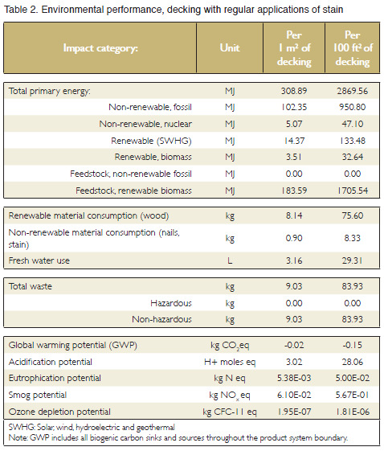
Full life-cycle accounting:
Fuel, power, water, transport, and other resources consumed
Air, water and solid waste emissions

Slide 20
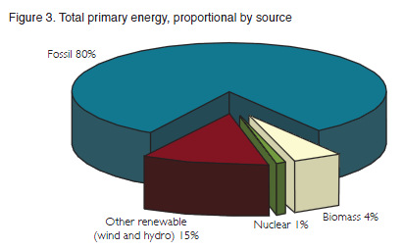
Sources of energy or fuel

Slide 21
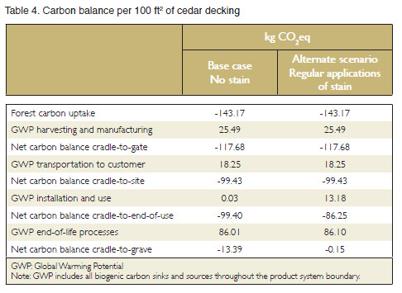
Environmental impacts:
Global warming
Acidification
Smog
Ozone depletion
Carbon balance
etc.

Slide 22
ISO 14020 Environmental Labeling
Type III Environmental Impact Labels
Life-cycle assessment
Not environmental rating or judgment
For example, if a comparable assessment was available for plastic decking, then the environmental impacts of choosing either redwood or plastic decking could be compared.

Slide 23
Life-Cycle Analysis (LCA)
Assessment over full material life from source extraction through manufacture, use, maintenance, and final disposal or repurposing.
Cradle-to-grave analysis

Slide 24
Life-Cycle Analysis (LCA)
E.g., Western Red Cedar life cycle:
Lumber harvest
Transport to mill
Log sorting, debarking, sawing, planing, drying, packaging
Transport to building site
Installation
Maintenance
Landfill disposal at end of life

Slide 25
Life-Cycle Analysis (LCA)
Embodied energy: How much energy is consumed throughout all phases of the material life cycle?
Embodied carbon: How much carbon-related greenhouse gas emissions?
Embodied water: How much fresh water consumed?

Slide 26
Life-Cycle Analysis (LCA)
Cradle-to-gate analysis: Extends from materials extraction through leaving the manufacturer. Ignores delivery to construction site, installation, use, maintenance, and end-of-life disposition.
Easier analysis
Often, the majority of embodied impacts occur during these phases

Slide 27
Assessing Sustainable Buildings
LEED: Leadership In Energy and Environmental Design
Voluntary program developed by U.S. Green Building Council (USGBC), an independent, private, not-for-profit organization
Most broadly implemented green building program in North America

Slide 28
LEED
LEED is voluntary.
USGBC does not itself compel or enforce the adoption of LEED.
Implementation depends on private owners or public agencies choosing to participate.

Slide 29
LEED
Programs for different types of construction:
New Construction LEED-NC
Existing Buildings LEED-EB
Commercial Interiors LEED-CI
Building Core and Shell LEED-CS
Homes LEED-H
Schools, Retail, Healthcare, Neighborhood Development

Slide 30
LEED
LEED-NC for New Construction & Major Renovations, Categories:
Sustainable sites
Water efficiency
Energy & atmosphere
Materials & resources
Indoor environmental quality
Innovation in design or operation
Regional priority

Slide 31
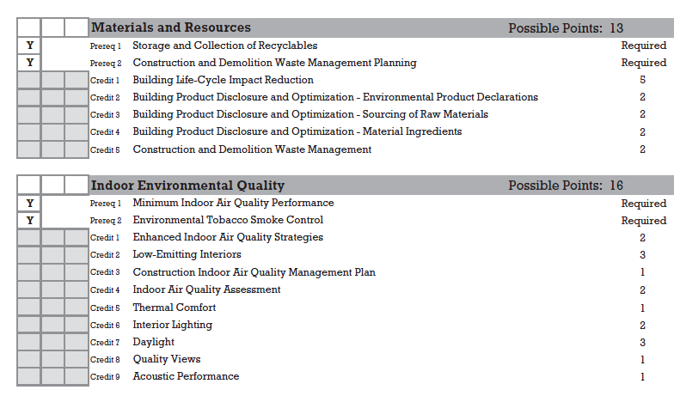
LEED-NC
Example prereq.s & credits

Slide 32
LEED
Prerequisites: Required
Credits: Earn points
Certifications:
Platinum: 80-110 points
Gold: 60+ points
Silver: 50+ points
Certified: 40+ points

Slide 33
Assessing Sustainable Buildings
Living Building Challenge
Go beyond buildings that do less harm to buildings that do no harm or even improve the environment.

Slide 34
Living Building Challenge
For example, a Certified Living Building:
Obtains 100% of fresh water from precipitation or closed loop systems
Obtains 100% of energy from on-site renewable sources (annualized)
Emits 0 carbon (including purchased offsets)

Slide 35
Living Building Challenge
7 Categories or Petals
Site
Water
Energy
Health
Materials
Equity
Beauty

Slide 36
Living Building Challenge
20 Imperatives, e.g.:
Limits to growth
Net zero water
Net zero energy
Healthy air
Materials from responsible industry
Democracy & social justice
Beauty & spirit

Slide 37
Living Building Challenge
Materials Red List restricts unhealthful chemical content. No:
Cadmium
Neoprene
Formaldehyde
Pthalates
PVC
etc.

Slide 38
Assessing Sustainable Buildings
Many other standards and programs:
U.S. National Green Building Standard (residential building types)
International Green Building Code (model code)
Green Globes (similar to LEED)
BREEAM (European program)
etc.

Slide 39
Assessing Sustainable Buildings
Energy performance standards:
ASHRAE high-performance building standards
U.S. EPA green building programs
Passive House
etc.

Slide 40
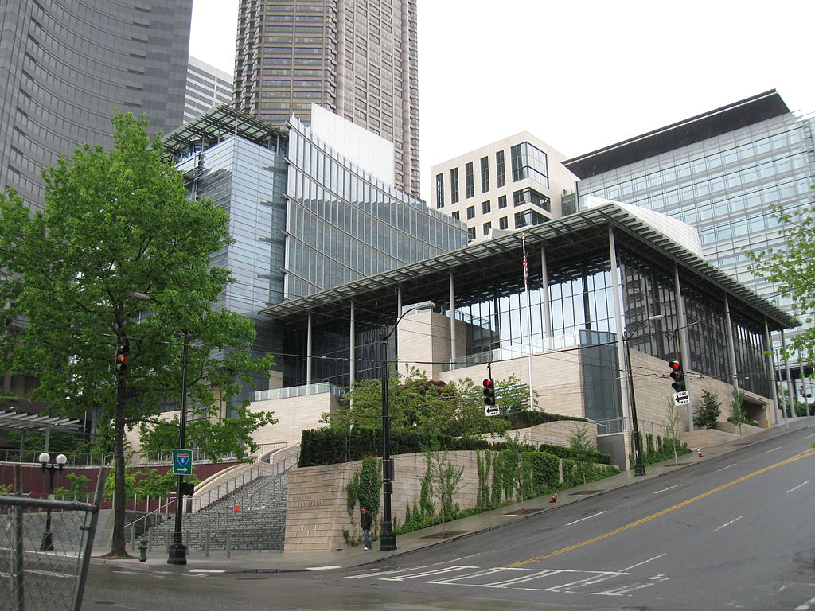
Sustainable Buildings
Current sustainable building stock exhibits 25% - 35% improvement in energy consumption over traditional buildings.
Seattle City Hall, LEED Gold, Bassetti Architects/Bohlin
Cywinski Jackson Joint Venture; Photo by Rootology

Slide 41
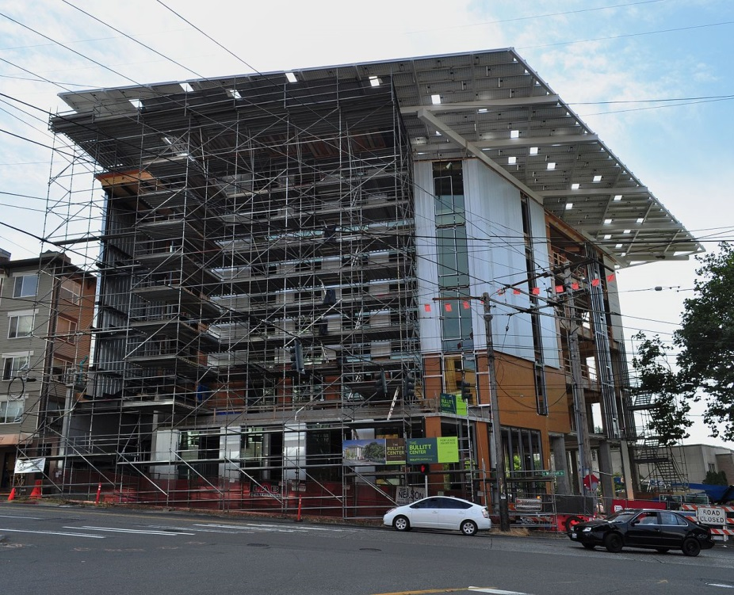
Sustainable Buildings
State of the art projects are even achieving Living Building certification.
Bullitt Center, Miller Hull Architect, photo by Joe Mabel

Slide 42
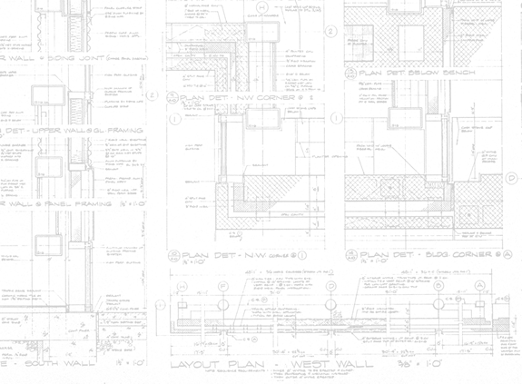
THE WORK
OF THE
DESIGN PROFESSIONAL

Slide 43
Design Architect or Engineer
Translates owner’s building ideas and needs into a complete design.
Construction documents fully describe the building to be built, consisting of:
Graphic construction drawings
Written specifications

Slide 44
Zoning Regulations
Control land use:
Types of allowed activities, such as industrial, commercial, residential, etc.
How much land may be covered by buildings
Distance from buildings to property lines
Parking requirements
Building height and area
Special fire district requirements, etc.

Slide 45
Building Codes
Regulate building health and safety:
Fire safety
Emergency egress
Construction quality
Structural integrity
Durability
Livability

Slide 46
Building Codes
Also:
Energy conservation
Health codes
Electrical/mechanical codes
Fire codes (building operations)
Accessibility for physically handicapped
…

Slide 47
Model Building Codes
Standardized codes, adopted and put into legal effect by local jurisdictions
Canada: National Building Code of Canada
U.S.:
International Building Code (IBC)
International Residential Code (IRC)

Slide 48
Model Building Codes
IBC and IRC are the models for most U.S. local building codes.
IRC:
One- and two-family homes
Townhouses
3 stories maximum height
IBC: All buildings not covered by the IRC

Slide 49
IBC Occupancy Classifications
Define activities within a building:
A Assembly
B Business
E Educational
F Factory
H High hazard
I Institutional
M Mercantile
R Residential
S Storage
U Utility

Slide 50
IBC Occupancy Classifications
Reflect the relative safety concerns of different types of activities:
Occupancy A Assembly
Theaters, auditoriums, lecture halls, night clubs, and other places of public gathering
Large crowds in unfamiliar settings
Need special attention to emergency exit provisions

Slide 51
IBC Occupancy Classifications
Occupancy Group I Institutional
Hospitals, prisons, care facilities
Residents cannot fend for themselves in an emergency
Provide protected areas within the building where occupants can wait for assistance

Slide 52
IBC Construction Types
Define buildings constructed to varying degrees of resistance to fire
Type I – Most resistant
Type II
Type III
Type IV
Type V - Least resistant

Slide 53
IBC Construction Types
Combustibility
Type I | Noncombustible materials only (steel, concrete, masonry)
Type II
Type III | Noncombustible exterior walls and combustible (wood) interior materials
Type IV
Type V | Fully noncombustible

Slide 54
IBC Construction Types
Fire Resistance (endurance)
 | Structural Frame Fire-Resistance Rating
Type I | 2 – 3 hours
Type II | 0 – 1 hour
Type III | 0 – 1 hour
Type IV | Heavy Timber
Type V | 0 – 1 hour

Slide 55
IBC Construction Types
Table 601: Fire resistance (hours) for building elements

Slide 56
IBC Allowable Height and Area
Occupancy groups and construction types determine allowable building size.
Occupancies with greater hazard: smaller buildings
Construction systems more resistant to fire: bigger buildings

Slide 57
IBC Allowable Height and Area
Table 502 example, Occupancy A-1, Construction Type II-B: 55 feet in height, 2 stories, 8500 sf per floor.

Slide 58
IBC Allowable Height and Area
Generally, fire-resistance increases to the left, as do height and area.
More fire-resistant
Larger buildings
Less fire-resistant
Smaller buildings

Slide 59
IBC Allowable Height and Area
Tabulated figures in Table 501 are adjusted due to:
Fire sprinklers
Fire fighter access around building

Slide 60
IBC Allowable Height and Area
Fire sprinklers: Historically proven to provide a major life safety benefit.
Allowable area per floor: x 4 for 1-story building and x 3 for multistory building
Allowable height: + 20 feet and 1 story

Slide 61
IBC Allowable Height and Area
Expanding fire truck access around building perimeter allows up to an additional 75% increase in area per floor.

Slide 62
Other Regulations
Equal access to facilities for persons with disabilities:
Building code accessibility requirements
Federal civil rights laws such as Americans with Disabilities Act, Fair Housing Act, and others

Slide 63
Other Regulations
Worker safety: Occupational Safety and Health Administration (OSHA)
Environmental protections: EPA protection of sensitive land, waterways, limits on emission of air pollutants, etc.
more…

Slide 64
Construction Standards
Define good practice
Ensure minimum quality
Encourage standardization and efficiency in methods

Slide 65
Consensus Standards
Independent consensus organizations
ASTM International: Materials and methods standards
American National Standards Institute (ANSI): Wide variety of products and systems standards
International Code Council: IBC, IRC, and other standards

Slide 66
Government Agency Standards
Government funded agencies
U.S. Department of Commerce, National Institute of Science and Technology (NIST)
National Research Council Canada Institute for Research in Construction (NRC-IRC)
U.S. Consumer Product Safety Commission

Slide 67
Private Industry Standards
Building insurance industry: Uses rate incentives to encourage owner’s to build in ways that limit property damage
(Building codes primary focus is life safety. Insurance standards primary emphasis is protection of property.)

Slide 68
Trade and Professional Organization Standards
Research and standards development relevant to their group’s interests
American Institute of Architects (AIA)
Construction Specifications Institute (CSI)
American Institute of Steel Construction (AISC)
Western Wood Products Association
and many, many more…

Slide 69
Organizing Construction Information
MasterFormat
Numbering system for the organization of construction materials and systems
Developed by Construction Specifications Institute (CSI) and Construction Specifications Canada (CSC)
50 major Divisions

Slide 70
MasterFormat
Division 00 – Procurement and Contracting Requirements
Division 01 – General Requirements
Division 02 – Existing Conditions
Division 03 – Concrete
Division 04 – Masonry
Division 05 - Metals
Division 06 – Wood, Plastics, and Composites
Division 07 – Thermal and Moisture Protection
Division 08 – Openings
Division 09 – Finishes
Division 10 – Specialties
Division 11 – Equipment
Division 12 – Furnishings
Division 13 – Special Construction
Division 14 – Conveying Equipment
Division 21 – Fire Suppression
Division 22 – Plumbing
Division 23 – Heating, Ventilating, and Air Conditioning
Division 25 – Integrated Automation
Division 26 – Electrical
Division 27 – Communications
Division 28 – Electronic Safety and Security
Division 31 – Earthwork
Division 32 – Exterior Improvements
Division 33 – Utilities
(This list includes only Divisions most relevant to this text and building construction in general)

Slide 71
MasterFormat
Sections within Divisions define the work of individual trades or suppliers. E.g.:
Division 05 – Metals
Section 05 10 00 – Structural Steel Framing
Section 05 21 00 – Steel Joist Framing
Section 05 31 00 – Steel Decking
Section 05 40 00 – Cold-Formed Metal Framing
Section 05 50 00 – Metal Fabrications
Section 05 51 33 – Metal Ladders
Section 05 51 33.13 Vertical Metal Ladders

Slide 72
MasterFormat
Provides the organization for construction specifications, the written portion of construction documents. Also used to:
Organize construction cost data
Organize trade and technical literature
Sometimes, to systematize notes on construction drawings

Slide 73
Other Organizational Systems
CSI/CSC UniFormat
Classification of building elements by functional groups, such as substructure, shell, interiors, services, etc.

Slide 74
UniFormat
Eight Level 1 categories:
A Substructure
B Shell
C Interiors
D Services
E Equipment and Furnishings
F Special Construction and Demolition
G Building Sitework
Z General

Slide 75
UniFormat
Classes and subclasses for greater definition:
Level 1: B Shell
Level 2: B10 Superstructure
Level 3: B1010 Floor Construction
Level 4: B1010.10 Floor Structural Frame
Level 5: B1010.10.WF Wood Floor Framing
Etc.

Slide 76
UniFormat
Early stage design and pricing
Performance specification of systems
Organization of construction data in building information models

Slide 77
OmniClass Construction Classification System
A broadly flexible system for organizing construction information according to any number of schemes, such as function, form, elements, work results, phases, properties, etc.

Slide 78
OmniClass
15 Tables, e.g.:
Table 13: Spaces by Function
Table 21: Elements (like Uniformat)
Table 22: Work Results (like MasterFormat)
Table 23: Products
Table 31: Phases
Table 32: Services
Table 35: Tools
Table 41: Materials
Table 49: Properties

Slide 79
Organizational Systems
Information standards matter because of increasing:
Digital modeling
Complexity of information
Sharing of data between disciplines
Extending data usage beyond the construction phase

Slide 80
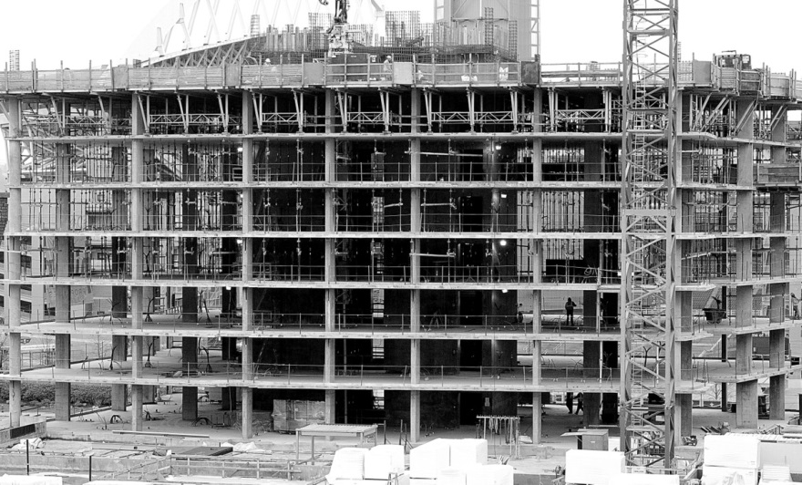
THE WORK
OF THE CONSTRUCTION PROFESSIONAL

Slide 81
Providing Construction Services
Allocation of responsibilities and risks among major parties:
Design team: architects, engineers, and other consultants
Construction team: General contractor, subcontractors, suppliers
Owner team: Owner, financers, user groups

Slide 82
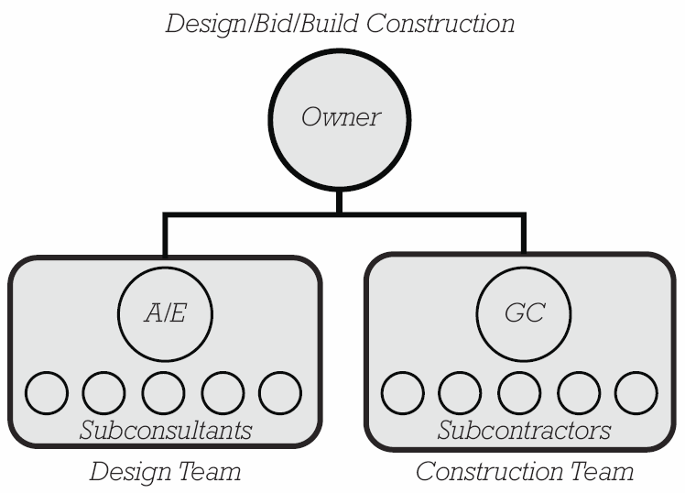
Project Delivery Methods
Design/Bid/Build
Owner hires separate design and construction teams.

Slide 83
Project Delivery Methods
Design/Bid/Build
Separate entities provide checks and balances
Difficult to integrate construction expertise into design

Slide 84
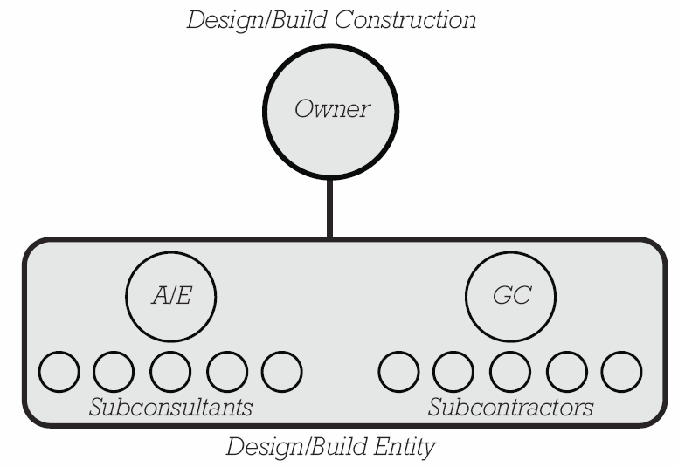
Project Delivery Methods
Design/Build
Owner hires single design and construction entity.

Slide 85
Project Delivery Methods
Design/Build
Fosters coordination between A/E and GC
Single point of accountability for owner
Fewer checks and balances

Slide 86
Project Delivery Methods
Construction Management
Owner hires independent CM to oversee design and construction services provided by multiple entities.

Slide 87
Project Delivery Methods
Construction Management
Construction expertise is available to owner throughout project
Most commonly associated with large scale, complex projects

Slide 88
Project Delivery Methods
CM at risk: Aspects of construction manager and general contractor
Turnkey construction: Single entity provides financing as well as construction services
Single-purpose entity: combines owner, design, and construction teams into one legal entity
And many more variations…

Slide 89
Paying for Construction Services
Fixed fee (lump sum)
Owner pays an agreed, fixed amount for work to be performed.
GC assumes most risk or potential reward for unplanned construction costs or savings.

Slide 90
Paying for Construction Services
Fixed fee (lump sum)
Best suited to projects where scope of work is well defined before construction starts.
(If scope is unknown, it is difficult to determine what the fixed, full cost should be.)

Slide 91
Paying for Construction Services
Cost Plus a Fee
Owner pays GC’s direct costs plus an added fee.
Owner assumes more cost risk/savings reward potential.

Slide 92
Paying for Construction Services
Cost Plus a Fee
Well suited to projects where scope is not fully defined when construction begins.
Adding a guaranteed maximum price (GMAX, GMP) limits the maximum cost and shifts some cost risk back toward the contractor.

Slide 93
Paying for Construction Services
Other types of risk allocation:
Incentive provisions financially reward contractor for timely completion of cost savings.
Surety bonds, purchased by owner, protect against contractor default.

Slide 94
Construction Phasing
Sequential Construction
Each major phase begins only after the preceding phase is complete.
Design is completed before construction begins.

Slide 95
Construction Phasing
Phased Construction
Design and construction phases overlap.
Aim is to reduce total project duration.

Slide 96
Construction Phasing
Sequential construction is simpler to manage.
Phased construction requires closer coordination between design and construction activities.
Phased construction can introduce additional risks if elements built early come into conflict with later design decisions.

Slide 97
Construction Phasing
Phased construction is most naturally suited to design/build and construction management project delivery, where construction expertise is available during the design phases of the project.
Traditionally, sequential construction is most commonly associated with design/bid/build construction.

Slide 98
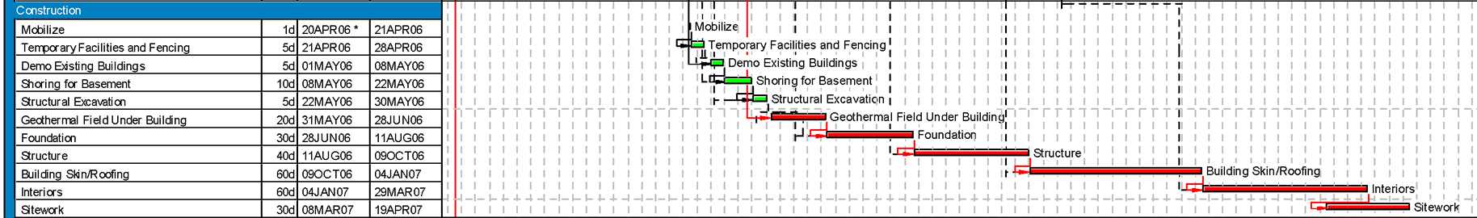
Construction Scheduling
Gantt Charts
Represent project tasks or phases on a horizontal timeline
Provide an easy to understand picture of a project schedule and relationships between phases.

Slide 99
Construction Scheduling
Critical Path Method
Analyzes task dependencies.

Slide 100
Construction Scheduling
Critical Path
Sequence of tasks that determines the least amount of time in which a project can be completed.

Slide 101
Managing Construction
The general contractor:
Oversees construction
Controls the project site
Manages trades and suppliers
Coordinates communications between construction team and owner, designer

Slide 102
Managing Construction
filing construction permits
securing the project site
providing temporary power and water
setting up office trailers and support facilities
providing insurance coverage for the work in progress
managing personnel on site
maintaining a safe work environment
stockpiling materials
performing testing and quality control
providing site surveying and engineering
arranging for cranes and other construction machinery

Slide 103
Managing Construction
providing temporary structures and weather protection
disposing or recycling of construction waste soliciting the work of subtrades and coordinating their efforts
submitting product samples and technical information to the design team for review
maintaining accurate records of the construction as it proceeds
monitoring costs and schedules
managing changes to the work
protecting completed work
and more…

Slide 104
Trends
Improving collaboration between owner/contractor/designer entities: e.g., integrated project delivery
Improving efficiency in production: e.g., lean construction
Improving information management: e.g., building information modeling (BIM)

